Slide 1



Idiomatic Programmer Learning Keras
Computer Vision Workshop Version: May 2019

Slide 2
Idiomatic Programmer Learning Keras
Repo: github.com/GoogleCloudPlatform/keras-idiomatic-programmer
Workshops and Handbooks:
are under ‘handbooks’ and ‘workshops’ subdirectory

Slide 3
Computer Vision Workshop - 2019
Session 1 : Models
Session 2 : Data Engineering
Session 3 : Training & Deployment
Each session is approximately 2 hrs, consisting of:
1 hr and 15 minute presentation and code-follow
20 minute post Q&A and Exercises
10 minute break / network

Slide 4
Computer Vision - Models
Part 1 : Neural Networks
Part 2 : Convolutional Neural Networks
Part 3 : Wide Convolutional Neural Networks
Part 4: Advanced Convolutional Neural Networks
Part 5: Mobile Convolutional Neural Networks

Slide 5
Neural Networks - Model Types
Identify the Type of Model for the Problem
The Keras framework is about building neural network models.
Neural Network layouts fall into four primary categories:
1. DNN (Deep Neural Networks) - These are good for numerical solutions.
2. CNN (Convolutional Neural Networks) - These are good for computer vision solutions and (audio) signal processing.
3. RNN (Recurrent Neural Networks) - These are good for text and speech recognition, and anything else that has a time sequence nature to it.
4. GAN (Generative Adversarial Networks) - These are good for synthesizing creative works, and reconstruction.

Slide 6
Neural Networks - Install
Packages to Install
I assume you have Python installed (preferably version 3). Whether you directly installed it, or it got installed as part of a larger package, like Anaconda, you got with it a nifty command like tool called pip. This tool is used to install any Python package you will ever need again from a single command invocation. You go pip install and then the name of the package.
cmd> pip install keras
cmd> pip install tensorflow
cmd> pip install numpy
cmd> pip install python-opencv

Slide 7
Neural Networks - Input Layer
Input Layer
The input layer to a neural network takes numbers! All the input data is converted to numbers. Everything is a number. The text becomes numbers, speech becomes numbers, pictures become numbers, and things that are already numbers are just numbers.
Neural networks take numbers either as vectors, matrices or tensors. They are names for the number of dimensions in an array. A vector is a one dimensional array, like a list of numbers. A matrix is a two dimensional array, like the pixels in a black and white image, and a tensor is any array three or more dimensions.
you're going to be using a lot of numpy

Slide 8
Neural Networks - Input Class
Input Class
Keras is based on object oriented programming with a collection of classes and associated methods and properties.
We instantiate an Input class object. For this class object, we define the shape (i.e., dimensions) of the input. In our example, the input is a one dimensional array (i.e., vector) of 13 elements, one for each feature.
from keras import Input Input(shape=(13,))

Slide 9
Neural Networks - Input Class
Input Class
When you run the previous two lines in a notebook, you will see the output:
<tf.Tensor 'input_1:0' shape=(?, 13) dtype=float32>
This is showing you what Input(shape=(13,)) evaluates to. It produces a tensor object by the name 'input_1:0'. This name will be useful later in assisting you in debugging your models. The '?' in shape shows that the input object takes an unbounded number of entries (your samples or rows) of 13 elements each. That is, at run-time it will bind the number of one dimensional vectors of 13 elements to the actual number of samples (rows) you pass in. The 'dtype' shows the default data type of the elements, which in this case is a 32-bit float (single precision).

Slide 10
Neural Networks - Deep Neural Networks
Deep Neural Networks
Deep Learning, Deep, Deep, Deep. What's this? It just means that the neural network has one or more layers between the input layer and the output layer. Visualize a directed graph in layers of depth. The root nodes are the input layer and the terminal nodes are the output layer. The layers in between are known as the hidden (deep) layers. That's it. A four layer DNN would look like:
input layer
hidden layer
hidden layer output layer
For our purposes, we will start with every node in every layer, except the output layer, is the same type of node. And that every node on each layer is connected to every other node on the next layer. This is known as a fully connected neural network (FCNN)

Slide 11
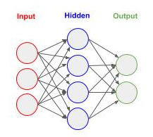
Neural Networks - Deep Neural Networks
Number of Connections
For example, if the input layer has three nodes and the next (hidden) layer has four nodes, then each node on the first layer is connected to all four nodes on the next layer for a total of 12 (3x4) connections.

Slide 12
Neural Networks - Feed Forward
Feed Forward
The DNN (and CNN) are known as feed forward neural networks. This means that data moves through the network sequential in one direction (from input to output layer). That's like a function in procedural programming. The inputs are passed as parameters (i.e., input layer), the function performs a sequenced set of actions based on the inputs (i.e., hidden layers) and outputs a result (i.e., output layer).
There are two distinctive styles, which you will see in blogs, when coding a forward feed network in Keras. I will briefly touch on both so when you see a code snippet in one style you can translate it to the other.
Sequential Method
Functional (Layers) Method

Slide 13
Neural Networks - Keras Sequential Method
The Sequential Method Approach
The Sequential method is easier to read and follow for beginners, but the trade off is its less flexible. Essentially, you create an empty forward feed neural network with the Sequential class object, and then "add" one layer at a time, until the output layer.
from keras import Sequential model = Sequential() model.add( /the first layer/ ) model.add( /the next layer/ ) model.add( /the output layer/ )

Slide 14
Neural Networks - Keras Sequential Method
The Sequential Method Approach (List)
The layers in the neural network may alternately be specified as a list in a sequential order which is passed as a parameter when instantiating the Sequential class object.
from keras import Sequential model = Sequential([ /the first layer/, /the next layer/, /the output layer/ ])

Slide 15
Neural Networks - Keras Functional Method
The layers Approach (Functional Method)
The layers approach is more advanced. You build the layers separately and then "tie" them together. This latter step gives you the freedom to connect layers in creative ways. Essentially, for a forward feed neural network, you create the layers, bind them to another layer(s), and then pull all the layers together in a final instantiation of a Model class object.
from keras import Model from keras.layers import layers input = layers.(/the first layer/) hidden = layers.(/the next layer/)( /the layer to bind to/ ) output = layers.(/the output layer/)( /the layer to bind to/ ) model = Model(input, output)

Slide 16
Neural Networks - Input Shape
Input Shape vs Input Layer
The input shape and input layer can be confusing at first. They are not the same thing. More specifically, the number of nodes in the input layer does not need to match the shape of the input vector. That's because every element in the input vector will be passed to every node in the input layer.
If our input layer is ten nodes, and we use our above example of a thirteen element input vector, we will have 130 connections (10 x 13) between the input vector and the input layer.

Slide 17
Neural Networks - Dense Layer
The Dense() Layer
In Keras, layers in a fully connected neural network (FCNN) are called Dense layers.
A Dense layer is defined as having "n" number of nodes, and is fully connected to the previous layer. Let's continue and define in Keras a three layer neural network, using the Sequential method. Our input layer will be ten nodes, and take as input a thirteen element vector (i.e., the thirteen features), which will be connected to a second (hidden) layer of ten nodes, which will then be connected to a third (output) layer of one node.
This is an example where we are going to use a neural network as a regressor. That means, the neural network will output a single real number.
input layer = 10 nodes
hidden layer = 10 nodes output layer = 1 node

Slide 18
Neural Networks - Sequential Example
Sequential Approach Example - Three Layer FCNN
Let's first do this using the Sequential method. In the example below, we have three add() calls to the class object Dense(). The add() method "adds" the layers in the same sequential order we specified them in. The first (positional) parameter is the number of nodes, ten in the first and second layer and one in the third layer. Notice how in the first Dense() layer we added the (keyword) parameter input_shape. This is where we will define the input vector and connect it to the first (input) layer in a single instantiation of Dense().
from keras import Sequential from keras.layers import Dense model = Sequential() # Add the first (input) layer (10 nodes) with input shape 13 element vector (1D). model.add(Dense(10, input_shape=(13,))) # Add the second (hidden) layer of 10 nodes. model.add(Dense(10)) # Add the third (output) layer of 1 node. model.add(Dense(1))

Slide 19
Neural Networks - Sequential Example
Sequential Approach Example (as List) - Three Layer FCNN
Alternatively, using the Sequential method, we will add the three layers by specifying them in a list in sequential order, and pass the list as a parameter when instantiating the Sequential() class object.
from keras import Sequential from keras.layers import Dense model = Sequential([ # Add the first (input) layer (10 nodes) Dense(10, input_shape=(13,)), # Add the second (hidden) layer of 10 nodes. Dense(10), # Add the third (output) layer of 1 node. Dense(1) ])

Slide 20
Neural Networks - Layers Example
Layer Approach Example - Three Layer FCNN
Let's now do the same using the layers method. We start by creating an input vector by instantiating a Input() class object. The (positional) parameter to the Input() class is the shape of the input, which can be a vector, matrix or tensor. In our example, we have a vector that is thirteen elements long. So our shape is (13,).
from keras import Input, Model # Create the input vector (13 elements). inputs = Input((13,))

Slide 21
Neural Networks - Layers Example
Layer Approach Example - Connect Input Layer
Next, we create the input layer by instantiating a Dense() class object. The positional parameter to the Dense() class is the number of nodes; which in our example is ten. Note the peculiar syntax that follows with a (inputs). The Dense() object is a callable. That is, the object returned by instantiating the Dense() class can be callable as a function. So we call it as a function, and in this case, the function takes as a (positional) parameter the input vector (or layer output) to connect it to; hence we pass it inputs so the input vector is bound to the ten node input layer.
from keras import Input, Model from keras.layers import Dense # Create the input vector (13 elements). inputs = Input((13,)) # Create the first (input) layer (10 nodes) and connect it to the input vector. input = Dense(10)(inputs)

Slide 22
Neural Networks - Layers Example
Layer Approach Example - Connect Hidden and Output Layers
Next, we create the hidden layer by instantiating another Dense() class object with ten nodes, and using it as a callable, we (fully) connect it to the input layer. Then we create the output layer by instantiating another Dense() class object with one node, and using it as a callable, we (fully) connect it to the hidden layer.
Finally, we put it altogether by instantiating a Model() class object, passing it the (positional) parameters for the input vector and output layer.
from keras import Input, Model from keras.layers import Dense # Create the input vector (13 elements). inputs = Input((13,)) # Create the first (input) layer (10 nodes) and connect it to the input vector. input = Dense(10)(inputs) # Create the next (hidden) layer (10 nodes) and connect it to the input layer. hidden = Dense(10)(input) # Create the output layer (1 node) and connect it to the previous (hidden) layer. output = Dense(1)(hidden) # Now let's create the neural network, specifying the input layer and output layer. model = Model(inputs, output)

Slide 23
Neural Networks - Activations
Activations
When training or predicting (inference), each node in a layer will output a value to the nodes in the next layer. We don't want to pass the value 'as-is', but instead we want to change the value by some manner. This process is called an activation function. Think of a function that returns some result, like return result. In the case of an activation function, instead of returning result, we would return the result of passing the result value to another (activation) function, like return A(result), where A() is the activation function. Conceptually, you can think of this as:
def layer(params):
""" inside are the nodes """
result = some_calculations
return A(result)
def A(result):
""" modifies the result """
return some_modified_value_of_result
Activation functions assist neural networks in learning faster and better.

Slide 24
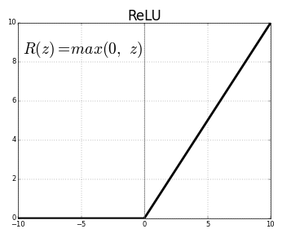
Neural Networks - ReLU Activations
Rectified Linear Unit (ReLU)
By default, when no activation function is specified, the values from one layer are passed as-is (unchanged) to the next layer. There are three activation functions you will use most of the time; they are the rectified linear unit (ReLU), sigmoid and softmax. The rectified linear unit passes values greater than zero as-is (unchanged); otherwise zero (no signal).

Slide 25
Neural Networks - ReLU Activations
Adding ReLU Activation between Layers
The rectified linear unit is generally used between layers. In our example, we will add a rectified linear unit between each layer.
from keras import Sequential from keras.layers import Dense, ReLU model = Sequential() # Add the first (input) layer (10 nodes) with input shape 13 element vector (1D). model.add(Dense(10, input_shape=(13,))) # Pass the output from the input layer through a rectified linear activation function. model.add(ReLU()) # Add the second (hidden) layer (10 nodes). model.add(Dense(10)) # Pass the output from the input layer through a rectified linear activation function. model.add(ReLU()) # Add the third (output) layer of 1 node. model.add(Dense(1))

Slide 26
Neural Networks - Model Summary
Getting a Summary of the Model Architecture
Let's take a look inside our model object and see if we constructed what we think we did. You can do this using the summary() method. It will show in sequential order a summary of each layer.
model.summary()
Layer (type) Output Shape Param # ================================================================= dense_56 (Dense) (None, 10) 140 _________________________________________________________________ re_lu_18 (ReLU) (None, 10) 0 _________________________________________________________________ dense_57 (Dense) (None, 10) 110 _________________________________________________________________ re_lu_19 (ReLU) (None, 10) 0 _________________________________________________________________ dense_58 (Dense) (None, 1) 11 ================================================================= Total params: 261 Trainable params: 261 Non-trainable params: 0

Slide 27
Neural Networks - Model Summary
Number of Parameters
Next, let's look at the parameter field in the summary. See how for the input layer it shows 140 parameters. You wonder how's that calculated. We have 13 inputs and 10 nodes, so 13 x 10 is 130. Where does 140 come from? Your close, each connection between the inputs and each node has a weight, which adds up to 130. But each node has an additional bias. That's ten nodes, so 130 + 10 = 140. It's the weights and biases the neural network will "learn" during training.
At the next (hidden) layer you see 110 params. That's 10 outputs from the input layer connected to each of the ten nodes from the hidden layer (10x10) plus the ten biases for the nodes in the hidden layers, for a total of 110 parameters to "learn".

Slide 28
Neural Networks - Shorthand Syntax
Shorthand Syntax
Keras provides a shorthand syntax when specifying layers. You don't actually need to separately specify activation functions between layers, as we did above. Instead, you can specify the activation function as a (keyword) parameter when instantiating a Dense() layer.
The code below does exactly the same as the previous code sample.
from keras import Sequential from keras.layers import Dense model = Sequential() # Add the first (input) layer (10 nodes) with input shape 13 element vector (1D). model.add(Dense(10, input_shape=(13,), activation='relu')) # Add the second (hidden) layer (10 nodes). model.add(Dense(10, activation='relu')) # Add the third (output) layer of 1 node. model.add(Dense(1))

Slide 29
Neural Networks - Compile
Optimizer (Compile)
Once you've completed building the forward feed portion of your neural network, as we have for our simple example, we now need to add a few things for training the model. This is done with the compile() method. This step adds in the backward propagation during training.
Each time we send data (or a batch of data) forward through the neural network, the neural network calculates the errors in the predicted results (loss) from the actual values (labels) and uses that information to incrementally adjust the weights and biases of the nodes - what we are "learning".

Slide 30
Neural Networks - Loss Function
Calculating the Loss
The calculation of the error is called a loss. It can be calculated in many different ways. Since we designed our neural network to be a regresser, we want to use a loss function that is best suited for a regresser. Generally, for this type of neural network, the Mean Square Error method of calculating a loss is used. The compile() method takes a (keyword) parameter loss where we can specify how we want to calculate it. We are going to pass it the value 'mse' for Mean Square Error.

Slide 31
Neural Networks - Optimizer
Optimizer - Convergence
The next step in the process is the optimizer that occurs during backward propagation. The optimizer is based on gradient descent; where different variations of the gradient descent algorithm can be selected.
Essentially, each time we pass data through the neural network we use the calculated loss to decide how much to change the weights and biases in the layers by. The goal is to gradually get closer and closer to the correct values for the weights and biases to accurately predict (estimate) the "label" for each sample.
This process of progressively getting closer and closer is called convergence.
For our regresser neural network we will use the rmsprop method (root mean square property).
model.compile(loss='mse', optimizer='rmsprop')

Slide 32

Neural Networks - Binary Classifier
DNN Binary Classifier
Another form of a DNN, is a binary classifier (logistic classifier). In this case, we want the neural network to predict whether something is or is not something. That is, the output can have two states: yes/no, true/false, 0/1, etc.
Instead of using a linear activation function on the output node, we will use a sigmoid activation function. The sigmoid squashes all values to be between 0 and 1, and as values move away from the center they quickly move to the extremes of 0 and 1.

Slide 33
Neural Networks - Binary Classifier
Binary Cross Entropy Loss Function
We will now code this in several different styles. Let's start by taking our previous code example, where we specify the activation function as a (keyword) parameter. In this example, we add to the output Dense() layer the parameter activation='sigmoid' to pass the output result from the final node through a sigmoid function.
Next, we are going to change our loss parameter to 'binary_crossentropy'. This is the loss function that is generally used in a binary classifier (logistic classifier).
from keras import Sequential from keras.layers import Dense model = Sequential() # Add the first (input) layer (10 nodes) with input shape 13 element vector (1D). model.add(Dense(10, input_shape=(13,), activation='relu')) # Add the second (hidden) layer (10 nodes). model.add(Dense(10, activation='relu')) # Add the third (output) layer of 1 node, and set the activation function to a Sigmoid. model.add(Dense(1, activation='sigmoid')) # Use the Binary Cross Entropy loss function for a Binary Classifier. model.compile(loss='binary_crossentropy', optimizer='rmsprop', metrics=['accuracy'])

Slide 34
Neural Networks - Binary Classifier
Layers Approach
Now we will rewrite the same code using the layers approach. Notice how we repetitively used the variable x. This is common. We want to avoid creating lots of one-time use variables. Since we know in this type of neural network, the output of every layer is the input to the next layer (or activation), except for the input and output, we just use x as the connecting variable.
from keras import Sequential, Model, Input from keras.layers import Dense, ReLU, Activation # Create the input vector (13 elements) inputs = Input((13,)) # Create the first (input) layer (10 nodes) and connect it to the input vector. x = Dense(10)(inputs) # Pass the output from the input layer through a rectified linear activation function x = Activation('relu')(x) # Create the next (hidden) layer (10 nodes) and connect it to the input layer. x = Dense(10)(x) x = Activation('relu')(x) x = Dense(1)(x) output = Activation('sigmoid')(x) # Now let's create the neural network, specifying the input layer and output layer. model = Model(inputs, output)

Slide 35
Neural Networks - Multi-Class Classifier
DNN Multi-Class Classifier
Another form of a DNN is a multi-class classifier, which means that we are going to classify (predict) more than one class. Another form of a DNN is a multi-class classifier, which means that we are going to classify (predict) more than one class. For example, let's say from a set of body measurements (e.g., height and weight) and gender we want to predict if someone is a baby, toddler, preteen, teenager or adult, for a total of five classes.
We can already see we will have some problems. For example, men on average as adults are taller than women. But during the preteen years, girls tend to be taller than boys. We know on average that men get heavier early in their adult years in comparison to their teenage years, but women on average are less likely. So we should anticipate lots of problems in predicting around the preteen years for girls, teenage years for boys, and adult years for women.
These are examples of non-linearity, where there is not a linear relationship between a feature and a prediction, but is instead broken into segments of disjoint linearity. This is the type of problem neural networks are good at.
2

Slide 36
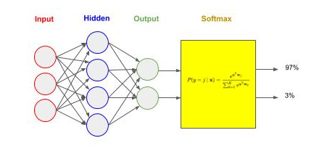
Neural Networks - Multi-Class Classifier
Softmax Activation Function
We have four “features" and a "label" that consists of five classes. We change our input vector in the next example to four, to match the number of features, and change our output layer to five nodes, to match the number of classes. In this case, each output node corresponds to one unique class (i.e., baby, toddler, etc). We want to train the neural network so each output node outputs a value between 0 and 1 as a prediction. For example, 0.75 would mean that the node is 75% confident that the prediction is the corresponding class (e.g., toddler).
Each output node will independently learn and predict its confidence on whether the input is the corresponding class. This leads to a problem in that because the values are independent, they won't add up to 1 (i.e, 100%). Softmax is a mathematical function that will take a set of values (i.e., the outputs from the output layer) and squash them into a range between 0 and 1 and where all the values add up to 1.

Slide 37
Neural Networks - Multi-Class Classifier
Softmax Activation Function
Next, we will change the activation function in our example to 'softmax'. Then we will set our loss function to 'categorical_crossentropy'. This is generally the most common used for multi-class classification. Finally, we will use a very popular and widely used variant of gradient descent called the Adam Optimizer ('adam'). Adam incorporates several aspects of other methods, such as rmsprop (root mean square) and adagrad (adaptive gradient), along with an adaptive learning rate. It's generally considered best-in-class for a wide variety of neural networks.
from keras import Sequential from keras.layers import Dense model = Sequential() # Add the first (input) layer (10 nodes) with input shape 4 element vector (1D). model.add(Dense(10, input_shape=(4,), activation='relu')) # Add the second (hidden) layer (10 nodes). model.add(Dense(10, activation='relu')) # Add the third (output) layer of 5 nodes, and set the activation function to a Softmax. model.add(Dense(5, activation='softmax')) # Use the Categorical Cross Entropy loss function for a Multi-Class Classifier. model.compile(loss='categorical_crossentropy', optimizer='adam', metrics=['accuracy'])

Slide 38
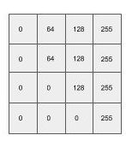
Neural Networks - Simple Image Classifier
DNN Image Classifier
Using neural networks for image classification is now used throughout computer vision. For small size "gray scale" images, we can use a DNN similar to what we have already described. This type of DNN has been widely published in use of the MNIST dataset; which is a dataset for recognizing handwritten digits. The dataset consists of grayscale images of size 28 x 28 pixels.
We will need to make one change though. A grayscale image is a matrix (2D array). Think of them as a grid, sized height x width, where the width are the columns and the height are the rows. A DNN though takes as input a vector (1D array).

Slide 39
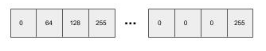
Neural Networks - Flattening
Matrix Flattening
We are going to do classification by treating each pixel as a "feature". Using the example of the MNIST dataset, the 28 x 28 images will have 784 pixels, and thus 784 "features". We convert the matrix (2D) into a vector (1D) by flattening it. Flattening is the process where we place each row in sequential order into a vector. So the vector starts with the first row of pixels, followed by the second row of pixels, and continues by ending with the last row of pixels.

Slide 40
Neural Networks - Flattening
Flattening Layer
In our next example below, we add a layer at the beginning of our neural network to flatten the input, using the class Flatten. The remaining layers and activations are typical for the MNIST dataset.
from keras import Sequential from keras.layers import Dense, Flatten, ReLU, Activation model = Sequential() # Take input as a 28x28 matrix and flatten into a 784 vector model.add(Flatten(input_shape=(28,28))) # Add the first (input) layer (512 nodes) with input shape 784 element vector (1D). model.add(Dense(512)) model.add(ReLU()) # Add the second (hidden) layer (512 nodes). model.add(Dense(512)) model.add(ReLU()) # Add the third (output) layer (10 nodes) with Sigmoid activation function. model.add(Dense(10)) model.add(Activation('sigmoid')) # Use the Categorical Cross Entropy loss function for a Multi-Class Classifier. model.compile(loss='categorical_crossentropy', optimizer='adam', metrics=['accuracy'])

Slide 41
Neural Networks - Model Summary
Model Summary
Let's now look at the layers using the summary() method. As you can see, the first layer in the summary is the flattened layer and shows that the output from the layer is 784 nodes. That's what we want. Also notice how many parameters the network will need to "learn" during training ~ nearly 700,000.
Layer (type) Output Shape Param # ================================================================= flatten_1 (Flatten) (None, 784) 0 _________________________________________________________________ dense_69 (Dense) (None, 512) 401920 _________________________________________________________________ re_lu_20 (ReLU) (None, 512) 0 _________________________________________________________________ dense_70 (Dense) (None, 512) 262656 _________________________________________________________________ re_lu_21 (ReLU) (None, 512) 0 _________________________________________________________________ dense_71 (Dense) (None, 10) 5130 _________________________________________________________________ activation_10 (Activation) (None, 10) 0 ================================================================= Total params: 669,706 Trainable params: 669,706 Non-trainable params: 0

Slide 42
Neural Networks - Overfitting
Overfitting
During training, a dataset is split into training data and test data. Only the training data is used during the training of the neural network. Once the neural network has reached convergence, training stops.
Afterwards, the training data is forward feed again without backward propagation enabled (i.e., no learning) to obtain an accuracy. In a train/test, the test data, which has been set aside and not used as part of training, is forward feed again without backward propagation enabled to obtain an accuracy.
Ideally, the accuracy on the training data and the test data will be nearly identical. In reality, the test data will always be a little less.
Once you reach convergence, continually passing the training data through the neural network will cause the neurons to more and more fit the data samples versus generalizing. This is known as overfitting. When the neural network is overfitted to the training data, you will get high training accuracy, but substantially lower accuracy on the test/evaluation data.

Slide 43
Neural Networks - Dropout
Dropout
Regularization is a method to address overfitting when training neural networks. The most basic type of regularization is called dropout. Dropout is like forgetting.
The dropout technique in neural networks mimics this process. Between any layer you can add a dropout layer where you specify a percentage (between 0 and 1) to forget. The nodes themselves won't be dropped, but instead a random selection on each forward feed will not pass a signal forward (forget).
from keras import Sequential from keras.layers import Dense, Flatten, ReLU, Activation, Dropout model = Sequential() model.add(Flatten(input_shape=(28,28))) model.add(Dense(512)) # Add dropout of 50% at the input layer. model.add(Dropout(0.5)) model.add(ReLU()) model.add(Dense(512)) # Add dropout of 50% at the hidden layer. model.add(Dropout(0.5)) model.add(ReLU())

Slide 44
Neural Networks - Code Lab #1
Optional Code Lab - Get Started with a Deep Neural Network (DNN)¶
Idiomatic Programmer - handbook 1 - Codelab 1.ipynb

Slide 45
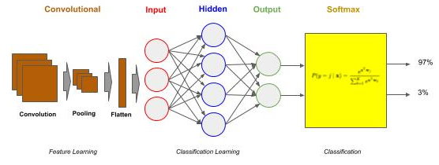
Convolutional Neural Networks
Convolutional Neural Networks (CNN)
Convolutional Neural Networks (CNN) are a type of neural network that can be viewed as consisting of two parts, a frontend and a backend. The backend is a deep neural network (DNN). The name convolutional neural network comes from the frontend, referred to as a convolutional layer(s). The frontend acts as a preprocessor.
The DNN backend does the "classification learning". The CNN frontend preprocesses the image data into a form which is computationally practical for the DNN to learn from. The CNN frontend does the "feature learning".

Slide 46
Convolutional Neural Networks - Classifier
CNN Classifier
Once we get to larger image sizes, the number of pixels for a DNN becomes computationally too expensive to be feasible. Presume you have a 1MB image, where each pixel is represented by a single byte (0..255 value). At 1MB you have one million pixels. That would require an input vector of 1,000,000 elements. And let's assume that input layer has 1024 nodes. The number of weights to "update and learn" learn would be over a billion (1 million x 1024) at just the input layer!
Contrast this to the MNIST example where we had 784 pixels times 512 nodes on our input layer. That's 400,000 weights to learn, which is considerably smaller than 1 billion.

Slide 47
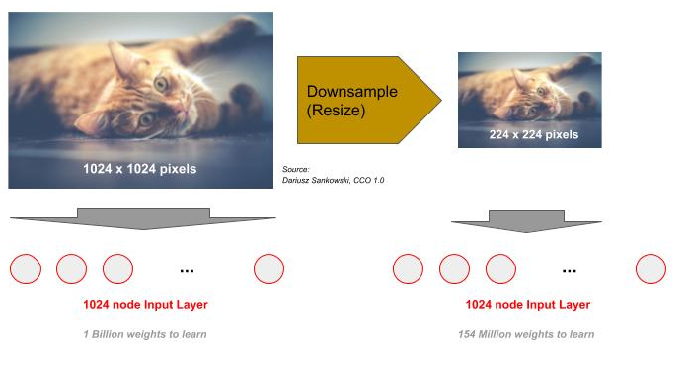
Convolutional Neural Networks - Resize
Downsampling (Resize)
One approach is to reduce the resolution of the image (downsampling). At some point if we reduce too far we lose the ability to distinguish clearly what's in the image - it becomes fuzzy and/or has artifacts. So, the first step is to reduce the resolution down to the level that we still have enough details. The common convention for everyday computer vision is around 224 x 224. We do this by resizing. Even at this lower resolution and three channels for color images, and an input layer of 1024 nodes, we still have 154 million weights to "update and learn" (224 x 224 x 3 x 1024).

Slide 48
Convolutional Neural Networks - Layers
Convolutional Layers
So training on real-world images was out of reach with neural networks until the discovery of using convolutional layers. To begin with, a convolutional layer is a frontend to a neural network, which transforms the images from a high dimensional pixel based image to a substantially lower dimensionality feature based image.
The substantially lower dimensionality features can then be inputted as the input vector to a DNN.
Thus, a convolutional frontend is a frontend between the image data and the DNN.

Slide 49
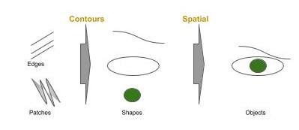
CNN - Feature Detection
Feature Detection (Human)
For these higher resolution and more complex images, we do recognition by detecting and classifying features instead of classifying pixel positions. Visualize an image, and ask yourself what makes you recognize what's there? Go beyond the high level of asking is that a person, a cat, a building, but ask why can you seperate in a picture a person standing in front of a building, or a person holding a cat.
Your eyes are recognizing low-level features, such as edges, blurs, contrast, etc. These low-level features are built up into contours and then spatial relationships. Suddenly, the eye/brain have the ability to recognize nose, ears, eyes - that's a cat face, that's a human face.

Slide 50
CNN - Feature Detection
Feature Detection (Convolution)
A convolutional layer performs the task of feature detection within an image. Each convolution consists of a set of filters. These filters are NxM matrices of values that are used to detect the likely presence (detection) of a feature.
They are slid across the image, and at each location a comparison is made between the filter and the pixel values at that location. That comparison is done with a matrix dot product.
What's important, is the result of this operation will generate a value that indicates how strongly the feature was detected at that location in the image. For example, a value of 4 would indicate a stronger presence of the feature than the value of 1.

Slide 51
Convolutional Neural Networks - Filters
Filters are Learned
Prior to neural networks, imaging scientists hand designed these filters. Today, the filters along with the weights in the neural network are "learned".
In a convolutional layer, one specifies the size of the filter and the number of filters. Typical filter sizes are 3x3 and 5x5, with 3x3 the most common.
The number of filters varies more, but they are typically multiples of 16, such as 16, 32 or 64 are the most common.

Slide 52
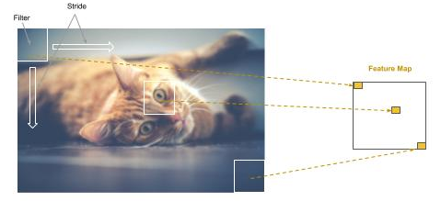
CNN - Feature Maps
Feature Maps
Additionally, one specifies a stride. The stride is the rate that the filter is slid across the image. For example, if the stride is one, the filter advances one pixel at a time, thus the filter would partially overlap with the previous step in a 3x3 filter (and consequently so would a stride of 2). In a stride of 3, there would be no overlap. Most common practice is to use strides of 1 and 2. Each filter that is "learned" produces a feature map, which is a mapping (where) on how strongly the feature is detected in the image.

Slide 53
CNN - Filters & Strides
Filters and Strides
When there are multiple convolutional layers, the common practice is to keep the same or increase the number of filters on deeper layers, and to use stride of 1 on the first layer and 2 on deeper layers.
The increase in filters provides the means to go from coarse detection of features to more detailed detection within coarse features, while the increase in stride offsets the increase in size of retained data.
More Filters => More Data
Bigger Strides => Less Data

Slide 54
Convolutional Neural Networks - Pooling
Pooling
Even though each feature map generated is less than the size of the image (e.g., ~75% to 90% reduction), because we generate multiple feature maps (e.g., 16), the total data size has gone up. The next step is to reduce the total amount of data, while retaining the features detected and corresponding spatial relationship between the detected features.
This step is referred to as pooling. Pooling is the same as downsampling (or sub-sampling); whereby the feature maps are resized to a smaller dimension using either max (downsampling) or mean (sub-sampling) pixel average within the feature map.

Slide 55
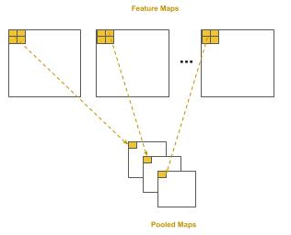
Convolutional Neural Networks - Pooling
Pooling
In pooling, we set the size of the area to pool as a NxM matrix as well as a stride. The common practice is a 2x2 pool size with a stride of 2. This will result in a 75% reduction in pixel data, while still preserving enough resolution that the detected features are not lost through pooling.

Slide 56
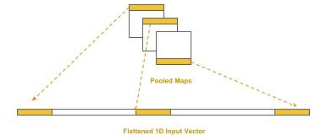
Convolutional Neural Networks - Flattening
Flattening
Deep neural networks take vectors as input, that’s one dimensional arrays of numbers. In the case of the pooled maps, we have a list (plurality) of 2D matrices, so we need to transform these into a single 1D vector which then becomes the input vector to the DNN.
This process is called flattening; that is, we flatten the list of 2D matrices into a single 1D vector. We start with the first row of the first pooled map as the beginning of the 1D vector. We then take the 2nd row and append it to the end, and then the 3rd row, and so forth. We then proceed to the second pooled map and do the same process, continuously appending each row, until we’ve completed the last pooled map. As long as we follow the same sequencing through pooled maps, the spatial relationship between detected features will be maintained across images for training and inference (prediction).

Slide 57
CNN - Basic Sequential Model
Basic Sequential CNN - Conv2D
We will design a basic sequential model in two parts, the convolutional frontend and the DNN backend. We start by adding a convolutional layer of 16 filters as the first layer using the Conv2D class object.
The size of each filter will be a 3x3, which is specified by the parameter kernel_size and a stride of 2 by the parameter strides. Note that for strides a tuple of (2, 2) is specified instead of a single value 2. The first digit is the horizontal stride (across) and the second digit is the vertical stride (down). It’s a common convention for stride that the horizontal and vertical are the same; therefore one commonly says a “stride of 2” instead of “a 2x2 stride”.
We pick an input size for our images. We like to reduce the size to as small as possible without losing detection of the features. In this case, we choose 128 x 128 (grayscale). The Conv2D class always requires specifying the number of channels, instead of defaulting to one for grayscale; we specified it as (128, 128, 1) instead of (128, 128).
from keras.models import Sequential, Conv2D, MaxPooling2D, Flatten from keras.layers import Dense, ReLU, Activation model = Sequential() # Create a convolutional layer with 16 3x3 filters and stride of two as the input layer model.add(Conv2D(16, kernel_size=(3, 3), strides=(2, 2), padding="same", input_shape=(128,128,1)))

Slide 58
CNN - Basic Sequential Model
Basic Sequential CNN - MaxPooling2D - Flatten
The output from the convolution layer is passed through a rectified linear unit activation, which is then passed to the max pooling layer, using the MaxPool2D class object. The size of the pooling region will be 2x2, specified by the parameter pool_size, with a stride of 2 by the parameter strides. The pooling layer will reduce the feature maps by 75% into pooled feature maps. The pooled feature maps are then flattened, using the Flatten class object, into a 1D vector for input into the DNN. We will glance over the parameter padding. It is suffice for our purposes to say that in almost all cases, you will use the value same; it’s just that the default is not same and therefore you need to explicitly add it.
# Pass the output (feature maps) from the input layer (convolution) through a rectified linear unit activation function. model.add(ReLU()) # Add a pooling layer to max pool (downsample) the feature maps into smaller pooled feature maps model.add(MaxPooling2D(pool_size=(2, 2), strides=(2, 2))) # Add a flattening layer to flatten the pooled feature maps to a 1D input vector for the DNN classifier model.add(Flatten())

Slide 59
CNN - Basic Sequential Model
Basic Sequential CNN - Attaching the DNN Classifier
Finally, we attach the DNN classifier. In this example, we assume the classifier will be trained for recognizing 26 handwritten lowercase (or hand-signed) characters of the English alphabet.
# Add the input layer for the DNN, which is connected to the flattening layer of the convolutional frontend model.add(Dense(512)) model.add(ReLU()) # Add the output layer for classifying the 26 hand signed letters model.add(Dense(26)) model.add(Activation('softmax')) # Use the Categorical Cross Entropy loss function for a Multi-Class Classifier. model.compile(loss='categorical_crossentropy', optimizer='adam', metrics=['accuracy'])

Slide 60
CNN - Basic Sequential Model
Basic Sequential CNN - Model Summary
Feature Map Size (e.g., 64 x 64)
Layer (type) Output Shape Param # ================================================================= conv2d_1 (Conv2D) (None, 64, 64, 16) 160 _________________________________________________________________ re_lu_1 (ReLU) (None, 64, 64, 16) 0 _________________________________________________________________ max_pooling2d_1 (MaxPooling2 (None, 32, 32, 16) 0 _________________________________________________________________ flatten_1 (Flatten) (None, 16384) 0 _________________________________________________________________ dense_1 (Dense) (None, 512) 8389120 _________________________________________________________________ re_lu_2 (ReLU) (None, 512) 0 _________________________________________________________________ dense_2 (Dense) (None, 26) 13338 _________________________________________________________________ activation_1 (Activation) (None, 26) 0 ================================================================= Total params: 8,402,618 Trainable params: 8,402,618 Non-trainable params: 0
Number of Filters
No Training Parameters
16384 x 512 (weights) + 512 (bias) = 8,389,120
512 * 26 (weights) + 26 (bias) = 13,338
Vector Length of Flattened Feature Maps

Slide 61
CNN - Basic Sequential Model
Basic Sequential CNN - Layers Approach
In the layers approach we separately define each layer, starting with the input vector and proceed to the output layer. At each layer we use polymorphism to invoke the instantiated class (layer) object as a callable and pass in the object of the previous layer to connect it to.
from keras import Input, Model from keras.layers import Dense from keras.layers import Conv2D, MaxPooling2D, Flatten # Create the input vector (128 x 128). inputs = Input(shape=(128, 128, 1)) layer = Conv2D(16, kernel_size=(3, 3), strides=(2, 2), padding="same", activation='relu')(inputs) layer = MaxPooling2D(pool_size=(2, 2), strides=(2, 2))(layer) layer = Flatten()(layer) layer = Dense(512, activation='relu')(layer) output = Dense(26, activation='softmax')(layer) # Now let's create the neural network, specifying the input layer and output layer. model = Model(inputs, output)
#1 - Start with inputs
#2 - attach layers
#3- Last Layer is the output
#4 Put it together: inputs => output

Slide 62
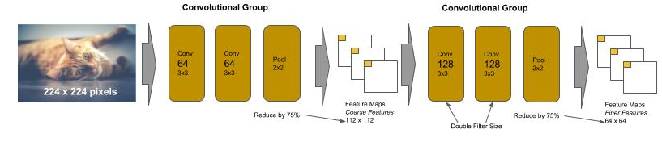
VGG
VGG Networks
The VGG type of CNN was designed by the Visual Geometry Group at Oxford. It was designed to compete in the international ImageNet competition for image recognition for 1000 classes of images. The VGGNet in the 2014 contest took first place on image location task and second place on the image classification task.
It is designed using a handful of principles that are easy to learn. The convolutional frontend consists of a sequence of pairs (and later triples) of convolutions of the same size, followed by a max pooling. The max pooling layer downsamples the generated feature maps by 75% and the next pair (or triple) of convolutional layers than doubles the number of learned filters. The principle behind the convolution design was that the early layers learn coarse features and subsequent layers, by increasing the filters, learn finer and finer features, and the max pooling is used between the layers to minimize growth in size (and subsequently parameters to learn) of the feature maps. Finally, the DNN backend consists of two identical sized dense hidden layers of 4096 nodes each, and a final dense output layer of 1000 nodes for classification.

Slide 63
VGG16
VGG16 - Sequential Flow We will code a VGG16 in two coding styles. The first in a sequential flow.
from keras import Sequential from keras.layers import Conv2D, MaxPooling2D, Flatten, Dense model = Sequential() # First convolutional block model.add(Conv2D(64, (3, 3), strides=(1, 1), padding="same", activation="relu", input_shape=(224, 224, 3))) model.add(Conv2D(64, (3, 3), strides=(1, 1), padding="same", activation="relu")) model.add(MaxPooling2D((2, 2), strides=(2, 2))) # reduce feature maps by 75% # Second convolutional block - double the number of filters model.add(Conv2D(128, (3, 3), strides=(1, 1), padding="same", activation="relu")) model.add(Conv2D(128, (3, 3), strides=(1, 1), padding="same", activation="relu")) model.add(MaxPooling2D((2, 2), strides=(2, 2))) # reduce feature maps by 75% ### REMOVED Lines for Brevity # DNN Backend model.add(Flatten()) model.add(Dense(4096, activation='relu')) model.add(Dense(4096, activation='relu')) # ...

Slide 64
VGG16
VGG16 - Procedurally (Reuse)
Let’s now code the same using a procedural “reuse” style. In this example we created a procedure (function) call conv_block() which builds the convolutional blocks, and takes as parameters the number of layers in the block (2 or 3), and number of filters (64, 128, 256 or 512). Note that we kept the first convolutional layer outside of the conv_block. The first layer needs the input_shape parameter. We could have coded this as a flag to conv_block, but since it would only occur one time, then it’s not reuse. So we inline it instead.
from keras import Sequential from keras.layers import Conv2D, MaxPooling2D, Flatten, Dense def conv_block(n_layers, n_filters): for n in range(n_layers): model.add(Conv2D(n_filters, (3, 3), strides=(1, 1), padding="same", activation="relu")) model.add(MaxPooling2D(2, strides=2)) # Convolutional Frontend model = Sequential() model.add(Conv2D(64, (3, 3), strides=(1, 1), padding="same", activation="relu", input_shape=(224, 224, 3))) conv_block(1, 64) conv_block(2, 128) conv_block(3, 256) conv_block(3, 512) conv_block(3, 512) # ...

Slide 65
Residual Convolutional Networks (ResNet)
ResNet Networks
The ResNet type of CNN was designed by Microsoft Research. It was designed to compete in the international ImageNet competition. The ResNet in the 2015 contest took first place in all categories for ImageNet and COCO competition.
ResNet, and other architectures within this class, use different layer to layer connection patterns. The pattern we’ve discussed so far (ConvNet and VGG) use the fully connected layer to layer pattern.
ResNet 34 introduced a new block layer and layer connection pattern, residual blocks and identity connection, respectively.
The residual block in ResNet 34 consists of blocks of two identical convolutional layers without a pooling layer.
Each block has an identity connection which creates a parallel path between the input of the residual block and its output.
Like VGG, each successive block doubles the number of filters. Pooling is done at the end of the sequence of blocks.

Slide 66
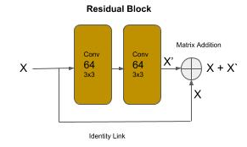
Residual Convolutional Networks (ResNet)
ResNet Networks
One of the problems with neural networks is that as we add deeper layers (under the presumption of increasing accuracy) their performance can degrade. That is, it can get worse not better.
Residual blocks allow neural networks to be built with deeper layers without a degradation in performance.

Slide 67
ResNet - Residual Block
Residual Blocks
Below is shows how a residual block can be coded in Keras using the Sequential method approach. The variable x represents the output of a layer, which is the input to the next layer. At the beginning of the block, we retain a copy of the previous block/layer output as the variable shortcut. We then pass the previous block/layer output (x) through two convolutional layers, each time taking the output from the previous layer as input into the next layer. Finally, the last output from the block (retained in the variable x) is added (matrix addition) with the original value of x (shortcut). This is the identity link.
shortcut = x x = layers.Conv2D(64, kernel_size=(3, 3), strides=(1, 1), padding='same')(x) x = layers.ReLU()(x) x = layers.Conv2D(64, kernel_size=(3, 3), strides=(1, 1), padding='same')(x) x = layers.ReLU()(x) x = layers.add([shortcut, x])

Slide 68
ResNet - Convolutional Block Connector
Convolutional Block Connector
Unlike VGG though, there is no pooling layer between the groups that would reduce the size of the feature maps. Now, if we connected these blocks directly with each other, we have a problem. That is, the input to the next block has the shape based on the previous block’s filter size (let’s call it X). The next block by doubling the filters will cause the output of that residual block to be double in size (let’s call it 2X). The identity link would attempt to add the input matrix (X) and the output matrix (2X). Yeaks, we get an error, indicating we can’t broadcast (for add operation) matrices of different sizes.
For ResNet, this is solved by adding a convolutional block between each “doubling” group of residual blocks. The convolutional block doubles the filters to reshape the size and doubles the stride to reduce the size by 75%.
# First Residual Block Group of 64 filters for _ in range(3): x = residual_block(64, x) # Double the size of filters and reduce feature maps by 75% (strides=2, 2) to fit the next Residual Group x = conv_block(128, x)

Slide 69
ResNet - ReUse Procedures
Residual and Convolutional Blocks as Reuse Procedures
def residual_block(n_filters, x): """ Create a Residual Block of Convolutions n_filters: number of filters x : input into the block """ shortcut = x x = layers.Conv2D(n_filters, (3, 3), strides=(1, 1), padding="same", activation="relu")(x) x = layers.Conv2D(n_filters, (3, 3), strides=(1, 1), padding="same", activation="relu")(x) x = layers.add([shortcut, x]) return x def conv_block(n_filters, x): """ Create Block of Convolutions without Pooling n_filters: number of filters x : input into the block """ x = layers.Conv2D(n_filters, (3, 3), strides=(2, 2), padding="same", activation="relu")(x) x = layers.Conv2D(n_filters, (3, 3), strides=(2, 2), padding="same", activation="relu")(x) return x

Slide 70
ResNet - Pooling/Flattening
Global Average Pooling
The output of the last residual block group is passed to a pooling and flattening layer (GlobalAveragePooling2D), which is then passed to a single Dense layer of 1000 nodes (number of classes).
In modern convolutional architectures, the DNN backend is now a single dense layer for the final classification. In other words, except for the last step of predicting the class (label), classification is now pushed to the frontend in the last convolutional blocks.
# Now Pool at the end of all the convolutional residual blocks x = layers.GlobalAveragePooling2D()(x) # Final Dense Outputting Layer for 1000 outputs outputs = layers.Dense(1000)(x) model = Model(inputs, outputs)

Slide 71
ResNet - Computational Faster
Computational Complexity
Let’s now run model.summary(). We see that the total number of parameters to learn is 21 million. This is in contrast of the VGG16 which has 138 million parameters. So the ResNet architecture is 6 times computationally faster. This reduction is mostly achieved by the construction of the residual blocks. Notice how the DNN backend is just a single output Dense layer. In effect, there is no backend. The top residual block groups act as the CNN frontend doing the feature detection, while the bottom residual blocks perform the classification. In doing so, unlike VGG, there was no need for several fully connected dense layers, which would have substantially increased the number of parameters.
Another advantage is the identity link, which provided the ability to add deeper layers, without degradation, for higher accuracy.

Slide 72
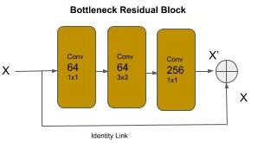
ResNet50 - Bottleneck Residual Block
Bottleneck Residual Block
ResNet50 introduced a variation of the residual block referred to as the bottleneck residual block. In this version, the group of two 3x3 convolution layers are replaced by a group of 1x1, then 3x3, and then 1x1 convolution layer. The 1x1 convolutions perform a dimension reduction reducing the computational complexity, and the last convolutional restores the dimensionality increasing the number of filters by a factor of 4. The bottleneck residual group allows for deeper neural networks, without degradation, and further reduction in computational complexity.

Slide 73
ResNet50 - Bottleneck Residual Block
Bottleneck Residual Block
Below is a code snippet for writing a bottleneck block as a reusable function:
def bottleneck_block(n_filters, x): """ Create a Bottleneck Residual Block of Convolutions n_filters: number of filters x : input into the block """ shortcut = x x = layers.Conv2D(n_filters, (1, 1), strides=(1, 1), padding="same", activation="relu")(x) x = layers.Conv2D(n_filters, (3, 3), strides=(1, 1), padding="same", activation="relu")(x) x = layers.Conv2D(n_filters * 4, (1, 1), strides=(1, 1), padding="same", activation="relu")(x) x = layers.add([shortcut, x]) return x

Slide 74
Batch Normalization
Batch Normalization
Another problem with adding deeper layers in a neural network is the vanishing gradient problem. This is actually about the computer hardware. During training (process of backward propagation and gradient descent), at each layer the weights are being multiplied by very small numbers, specifically numbers less than 1. As you know, two numbers less than one multiplied together make an even smaller number. When these tiny values are propagated through deeper layers they continuously get smaller. At some point, the computer hardware can’t represent the value anymore - and hence, the vanishing gradient.
The problem is further exacerbated if we try to use half precision floats (16 bit float) for the matrix operations versus single precision (32 bit float). The advantage of the former is that the weights (and data) are stored in half the amount of space and using a general rule of thumb by reducing the computational size in half, we can execute 4 times as many instructions per compute cycle. The problem of course is that with even smaller precision, we will encounter the vanishing gradient even sooner.

Slide 75
Batch Normalization
Batch Normalization
Batch normalization is a technique applied to the output of a layer (before or after the activation function).It normalizes the shift in the weights as they are being trained. This has several advantages, it smoothes out (across a batch) the amount of change, thus slowing down the possibility of getting a number so small that it can’t be represented by the hardware. Additionally, by narrowing the amount of shift between the weights, convergence can happen sooner using a higher learning rate and reducing the overall amount of training time. Batch normalization is added to a layer in Keras with the BatchNormalization() class.
from keras import Sequential from keras.layers import Conv2D, ReLU, BatchNormalization, Flatten, Dense model = Sequential() model.add(Conv2D(64, (3, 3), strides=(1, 1), padding='same', input_shape=(128, 128, 3))) # Add a batch normalization (when training) to the output before the activation function model.add(BatchNormalization()) model.add(ReLU()) model.add(Flatten()) model.add(Dense(4096)) model.add(ReLU()) # Add a batch normalization (when training) to the output after the activation function model.add(BatchNormalization())

Slide 76
Convolutional Neural Networks - Code Lab #2
Optional Code Lab - Get Familiar with Convolutional Neural Networks (CNN)
Idiomatic Programmer - handbook 1 - Codelab 2.ipynb

Slide 77
Wide Convolutional Neural Networks
Wide Layers
Up to now, we’ve focused on networks with deeper layers, block layers and shortcuts. Starting in 2014 with Inception v1 (GoogleNet) and 2015 with ResNeXt (Microsoft Research) and Inception v2, neural network designs moved into wide layers (vs. deeper layers). Essentially, a wide layer is having multiple convolutions in parallel and then concatenating their outputs.
The GoogLeNet (Inception v1) won the 2014 ImageNet contest and introduced the ‘inception module”. The inception module is a convolutional layer with parallel convolutions of different sizes, with the outputs concatenated together. The principle behind it was that instead of trying to pick the best filter size for a layer, each layer has multiple filter sizes in parallel, and the layer learns which size is the best.

Slide 78
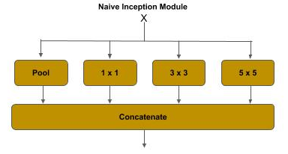
Wide CNN - Naive Inception Module
Naive Inception Module
The figure below shows the naive inception module, which demonstrates the principle behind the inception module. In a conventional convolution block, the output from the convolution layer is passed through a pooling layer for dimensionality reduction. The output from a previous convolution layer is branched.
One branch is passed through a pooling layer for dimensionality reduction, as in a conventional convolutional layer,
and the remaining branches are passed through convolution layers of different sizes (i.e., 1x1, 3x3, 5x5).
The outputs from the pooling and the other convolution layers are then concatenated together.

Slide 79
Wide CNN - Naive Inception Module
Naive Inception Module - Filters
The theory behind it, is that the different filter sizes capture different levels of detail. The 1x1 convolution captures fine details of features, while the 5x5 captures more abstract features. The code below demonstrates a naive inception module. The input from a previous layer x is branched and passed through a max pooling layer, 1x1, 3x3 and 5x5 convolution, which are then concatenated together.
# The inception branches (where x is the previous layer) x1 = layers.MaxPooling2D((3, 3), strides=(1,1), padding='same')(x) x2 = layers.Conv2D(64, (1, 1), strides=(1, 1), padding='same')(x) x3 = layers.Conv2D(96, (3, 3), strides=(1, 1), padding='same')(x) x4 = layers.Conv2D(48, (5, 5), strides=(1, 1), padding='same')(x) # concatenate the filters x = layers.concatenate([x1, x2, x3, x4])

Slide 80
Wide CNN - Naive Inception Module
Naive Inception Module - Padding
By setting padding=’same’, the height and width dimensions are preserved. This allows concatenating the filters together. For example, if the above the input to this layer was 28x28x256, the dimensions at the branch layers would be:
x1 (pool) : (?, 28, 28, 256)
x2 (1x1) : (?, 28, 28, 64)
x2 (3x3) : (?, 28, 28, 96)
x3 (5x5) : (?, 28, 28, 48)
After the concatenation, the output would be:
x (concat) : (?, 28, 28, 464)

Slide 81
Wide CNN - Naive Inception Module
Naive Inception Module - Padding
If the padding=’same’ argument is left out (defaults to padding=’valid’), the shapes would be instead:
x1 (pool) : (?, 26, 26, 256)
x2 (1x1) : (?, 28, 28, 64)
x2 (3x3) : (?, 26, 26, 96)
x3 (5x5) : (?, 24, 24, 48)
Since the width and height dimensions do not match, if one tried to concatenate these layers, one would get an error:
ValueError: A Concatenate layer requires inputs with matching shapes except for the concat axis. Got inputs shapes: [(None, 26, 26, 256), (None, 28, 28, 64), (None, 26, 26, 96), (None, 24, 24, 48)]

Slide 82
Wide CNN - Naive Inception Module
Naive Inception Module - Parameters
A summary() for these layers shows 544K parameters to train.
max_pooling2d_161 (MaxPooling2D (None, 28, 28, 256) 0 input_152[0][0] __________________________________________________________________________________________________ conv2d_13130 (Conv2D) (None, 28, 28, 64) 16448 input_152[0][0] __________________________________________________________________________________________________ conv2d_13131 (Conv2D) (None, 28, 28, 96) 221280 input_152[0][0] __________________________________________________________________________________________________ conv2d_13132 (Conv2D) (None, 28, 28, 48) 307248 input_152[0][0] __________________________________________________________________________________________________ concatenate_429 (Concatenate) (None, 28, 28, 464) 0 max_pooling2d_161[0][0] conv2d_13130[0][0] conv2d_13131[0][0] conv2d_13132[0][0] ================================================================================================== Total params: 544,976 Trainable params: 544,976

Slide 83
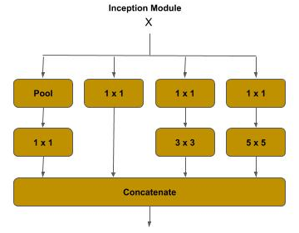
Wide CNN - Inception v1
Inception v1 - Dimensionality Reduction
In the GoogLeNet, a further dimensionality reduction was introduced by adding a 1x1 convolution (bottleneck) to the pooling, 3x3 and 5x5 branches. This dimension reduction reduced the overall computational complexity by nearly ⅔.

Slide 84
Wide CNN - Inception v1
Inception v1 - Dimensionality Reduction
Below is an example of an Inception v1 module:.
# The inception branches (where x is the previous layer) x1 = layers.MaxPooling2D((3, 3), strides=(1,1), padding='same')(x) x1 = layers.Conv2D(64, (1, 1), strides=(1, 1), padding='same')(x1) x2 = layers.Conv2D(64, (1, 1), strides=(1, 1), padding='same')(x) # passes straight through x3 = layers.Conv2D(64, (1, 1), strides=(1, 1), padding='same')(x) x3 = layers.Conv2D(96, (3, 3), strides=(1, 1), padding='same')(x3) x4 = layers.Conv2D(64, (1, 1), strides=(1, 1), padding='same')(x) x4 = layers.Conv2D(48, (5, 5), strides=(1, 1), padding='same')(x4) # concatenate the filters x = layers.concatenate([x1, x2, x3, x4])

Slide 85
Wide CNN - Inception v1
Inception v1 - Parameters
A summary() for these layers shows 198K parameters to train.
max_pooling2d_162 (MaxPooling2D (None, 28, 28, 256) 0 input_153[0][0] __________________________________________________________________________________________________ conv2d_13135 (Conv2D) (None, 28, 28, 64) 16448 input_153[0][0] __________________________________________________________________________________________________ conv2d_13137 (Conv2D) (None, 28, 28, 64) 16448 input_153[0][0] __________________________________________________________________________________________________ conv2d_13133 (Conv2D) (None, 28, 28, 64) 16448 max_pooling2d_162[0][0] __________________________________________________________________________________________________ conv2d_13134 (Conv2D) (None, 28, 28, 64) 16448 input_153[0][0] __________________________________________________________________________________________________ conv2d_13136 (Conv2D) (None, 28, 28, 96) 55392 conv2d_13135[0][0] __________________________________________________________________________________________________ conv2d_13138 (Conv2D) (None, 28, 28, 48) 76848 conv2d_13137[0][0] __________________________________________________________________________________________________ concatenate_430 (Concatenate) (None, 28, 28, 272) 0 conv2d_13133[0][0] conv2d_13134[0][0] conv2d_13136[0][0] conv2d_13138[0][0] ================================================================================================== Total params: 198,032 Trainable params: 198,032

Slide 86
Wide CNN - Inception v1
Inception v1 - Architecture
GoogLeNet consists of four groups:
Stem Convolutional Group :
This is the entry point into the neural network. The inputs (images) are processed
by a sequential (deep) set of convolutions and max pooling, much like a conventional ConvNet. Wide Convolutional Group : This is a set of seven inception blocks in five groups. The wider blocks in the diagram represent a group of two or three inception blocks, and the thinner ones are a single inception block, for a total of nine inception blocks. The fourth and seventh block (single blocks) are separated out to highlight they have an additional component, referred to as the auxiliary classifier.
Auxiliary Classifiers Group : This is a set of two classifiers, acting as auxiliary (aids) in training the neural network, each consisting of a convolutional layer, a dense layer and a final softmax activation function.
Classifier Group This is a single and final classifier in both training the neural network and in prediction (inference).

Slide 87
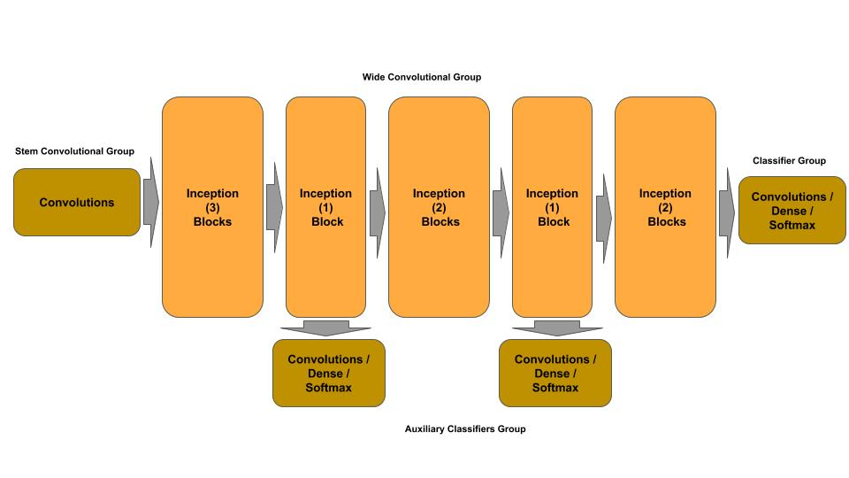
Wide CNN - Inception v1
Inception v1 - Auxiliary Classifiers
The GoogleLeNet architecture introduced the concept of an auxiliary classifier. The principle here is that as a neural network gets deeper in layers (i.e., the front layers get further away from the final classifier) the front layers are more exposed to a vanishing gradient and increased time (e.g., number of epochs) to train the weights in the front most layers.

Slide 88
Wide CNN - ResNeXt
Residual Wide Convolutional Neural Networks
ResNeXt (Microsoft Research) was the winner of the 2015 ImageNet competition and introduced the concept of a wide residual (block) neural network and cardinality (i.e., width). This architecture uses a split, branch and merge method of parallel convolutional blocks. The number of parallel convolutional blocks (i.e., width) is referred to as the cardinality. For example, in the 2015 competition, the ResNeXt architecture used a cardinality of 32, meaning each ResneXt layer consisted of 32 parallel convolutional blocks.
At each ResNeXt layer:
The input from the previous layer is split across the parallel convolutional blocks,
and the output (feature maps) from each convolutional block is concatenated,
and finally the input to the layer is matrix added to the concatenated output (identity link) to form the residual block.

Slide 89
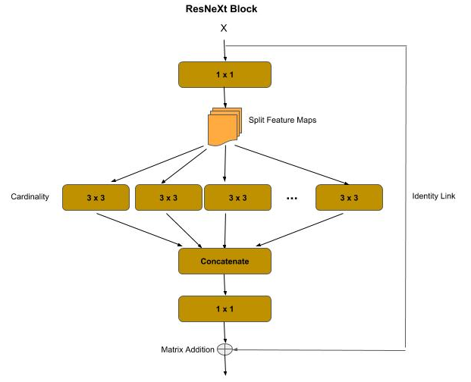
Wide CNN - ResNeXt
ResNeXt Blocks
The wide residual block group consists of:
A first bottleneck convolution ( 1 x 1 kernel )
A split-branch-concatenate convolution of a cardinality N
A final bottleneck convolution ( 1 x 1 kernel )
An identity link between the input and the final
convolution output

Slide 90
Wide CNN - ResNeXt
ResNeXt Blocks - Splitting / Cardinality
The first bottleneck convolution performs a dimensionality reduction (feature pooling), similar to its use in a residual block or inception module. After the bottleneck convolution:
The feature maps are split among the parallel convolutions according to the cardinality. For example, if the number of feature maps (filters) is 128 and the cardinality is 32, then each parallel convolution will get 4 feature maps (128 / 32).
The outputs from the parallel convolutions are then concatenated back into a full set of feature maps, which are then passed through a final bottleneck convolution for another dimensionality reduction (feature pooling).
As in the residual block, there is an identity link between the input to and output from the resnext block, which is then matrix added.

Slide 91
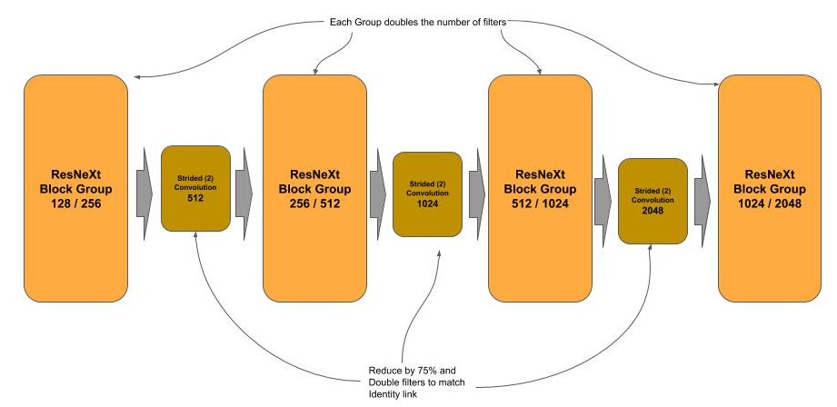
Wide CNN - ResNeXt
ResNeXt Blocks - Architecture
The ResNeXt-50 architecture starts with a stem convolution block for the input, which consists of a 7 x 7 convolution which is then passed through a max pooling layer for reducing the data.
Following the stem are four groups of resnext blocks. Each group progressively doubles the number of filters outputted vs. the input. Between each block is a strided convolution, which serve two purposes (reduces data by 75% [feature pooling], and doubles the filters from the output of the previous layer, to match the identity link.

Slide 92
Wide CNN - ResNeXt Block
def _resnext_block(shortcut, filters_in, filters_out, cardinality=32): # Bottleneck layer x = layers.Conv2D(filters_in, kernel_size=(1, 1), strides=(1, 1), padding='same')(shortcut) x = layers.BatchNormalization()(x) x = layers.ReLU()(x) # Cardinality (Wide) Layer filters_card = filters_in // cardinality groups = [] for i in range(cardinality): group = layers.Lambda(lambda z: z[:, :, :, i * filters_card:i * filters_card + filters_card])(x) groups.append(layers.Conv2D(filters_card, kernel_size=(3, 3), strides=(1, 1), padding='same')(group)) # Concatenate the outputs of the cardinality layer together x = layers.concatenate(groups) x = layers.BatchNormalization()(x) x = layers.ReLU()(x) # Bottleneck layer x = layers.Conv2D(filters_out, kernel_size=(1, 1), strides=(1, 1), padding='same')(x) x = layers.BatchNormalization()(x) # Identity Link: Add the shortcut (input) to the output of the block x = layers.add([shortcut, x]) x = layers.ReLU()(x) return x

Slide 93
Wide CNN - Stem & Strided Convolution
Stem Group & Strided Convolution between ResNeXt Groups
# The input tensor inputs = layers.Input(shape=(224, 224, 3)) # Stem Convolutional layer x = layers.Conv2D(64, kernel_size=(7, 7), strides=(2, 2), padding='same')(inputs) x = layers.BatchNormalization()(x) x = layers.ReLU()(x) x = layers.MaxPool2D(pool_size=(3, 3), strides=(2, 2), padding='same')(x) # First ResNeXt Group for _ in range(3): x = _resnext_block(x, 128, 256) # strided convolution to match the number of output filters on next block and reduce by 2 x = layers.Conv2D(512, kernel_size=(1, 1), strides=(2, 2), padding='same')(x) # Second ResNeXt Group for _ in range(4): x = _resnext_block(x, 256, 512)

Slide 94
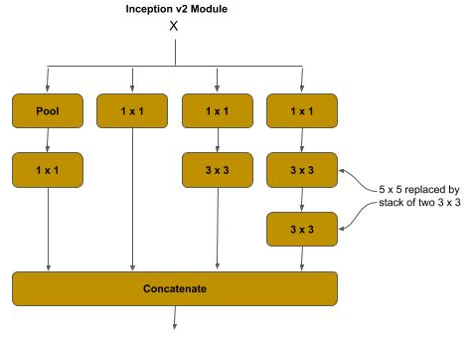
Wide CNN - Inception V2
Factorization
Inception v2 introduced the concept of factorization for the more expensive convolutions in an inception module to reduce computational complexity, and reduce information loss from representational bottlenecks.
The larger a filter (kernel) size is in a convolution, the more computationally expensive it is. The paper which presented the Inception v2 architecture calculated that the 5 x 5 convolution in the inception module was 2.78x more computationally expensive than a 3 x 3. In the Inception v2 module, the 5 x 5 filter is replaced by a stack of two 3 x 3 filters, which results in a reduction of computational complexity of the replaced 5 x 5 filter by 33%.

Slide 95
Wide CNN - Inception V2
Inception V2 Module
A summary() for these layers shows 169K parameters to train, when compared to 198K for the inception v1 module.
# The inception branches (where x is the previous layer) x1 = layers.MaxPooling2D((3, 3), strides=(1,1), padding='same')(x) x1 = layers.Conv2D(64, (1, 1), strides=(1, 1), padding='same')(x1) x2 = layers.Conv2D(64, (1, 1), strides=(1, 1), padding='same')(x) # pass straight thru x3 = layers.Conv2D(64, (1, 1), strides=(1, 1), padding='same')(x) x3 = layers.Conv2D(96, (3, 3), strides=(1, 1), padding='same')(x3) x4 = layers.Conv2D(64, (1, 1), strides=(1, 1), padding='same')(x) x4 = layers.Conv2D(48, (3, 3), strides=(1, 1), padding='same')(x4) # 5x5 is replaced by two 3x3 x4 = layers.Conv2D(48, (3, 3), strides=(1, 1), padding='same')(x4) # concatenate the filters x = layers.concatenate([x1, x2, x3, x4])

Slide 96
Wide CNN - Inception V3
Stem Factorization
The Inception v3 architecture primarily made updates to improve the auxiliary classifiers, and additionally, the 7 x 7 convolution in the stem convolution group was factorized and replaced by a stack of three 3 x 3 convolutions, where:
The first 3 x 3 is a strided convolution (strides=2, 2) which performs a feature map reduction.
The second 3 x 3 is a regular convolution.
The third 3 x 3 doubles the number of filters.
# Inception v3 stem, 7 x 7 is replaced by a stack of 3 x 3 convolutions. x = layers.Conv2D(32, (3, 3), strides=(2, 2), padding='same')(input) x = layers.Conv2D(32, (3, 3), strides=(1, 1), padding='same')(x) x = layers.Conv2D(64, (3, 3), strides=(1, 1), padding='same')(x) # max pooling layer x = layers.MaxPooling2D((3, 3), strides=(2, 2), padding='same')(x) # bottleneck convolution x = layers.Conv2D(80, (1, 1), strides=(1, 1), padding='same')(x) # next convolution layer x = layers.Conv2D(192, (3, 3), strides=(1, 1), padding='same')(x) # strided convolution - feature map reduction x = layers.Conv2D(256, (3, 3), strides=(2, 2), padding='same')(x)

Slide 97
Wide CNN - Inception V4
Further Stem Factorization
The Inception v4 architecture made additional improvements to the stem convolution group to reduce computational complexity by introducing reduction blocks (which appear to be a variation of a residual block). In a reduction block, the input is branched and then merged with a concatenation operation.
The max pooling layer is replaced with a reduction block.
A max pooling layer
A 3 x 3 strided convolution
The bottleneck and second convolution layer are replaced with a variation of a reduction block.
The bottleneck convolution is reduced from size (from 80 to 64) and stacked with a 3 x 3 convolution.
The second convolution layer is replaced with a stack of 1 x 1 bottleneck, a nx1 and 1xn pair and a 3 x 3 convolution.
The final strided convolution is replaced with a reduction block.
A max pooling layer
A 3 x 3 strided convolution

Slide 98
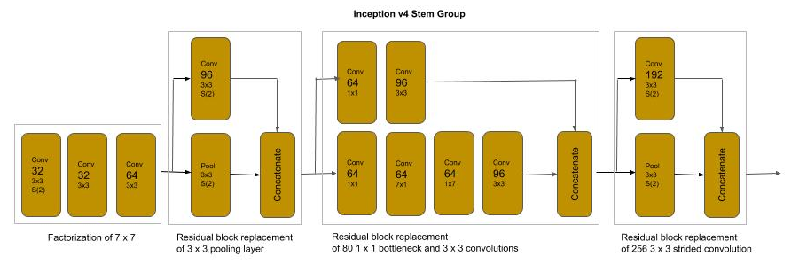
Wide CNN - Inception V4
Stem Architecture
A summary() for the stem group shows 426K parameters to train with input (229, 229, 3) vs. the 614K for the Inception v3 stem group.

Slide 99
Wide CNN - Inception V4
# Inception v4 stem, 7 x 7 is replaced by a stack of 3 x 3 convolutions. x = layers.Conv2D(32, (3, 3), strides=(2, 2), padding='same')(inputs) x = layers.Conv2D(32, (3, 3), strides=(1, 1), padding='same')(x) x = layers.Conv2D(64, (3, 3), strides=(1, 1), padding='same')(x) # max pooling is replaced by reduction block of max pooling and strided convolution bpool = layers.MaxPooling2D((3, 3), strides=(2, 2), padding='same')(x) b3x3 = layers.Conv2D(96, (3, 3), strides=(2, 2), padding='same')(x) x = layers.concatenate([bpool, b3x3]) # bottleneck and 3x3 convolution replaced by reduction block bnxn = layers.Conv2D(64, (1, 1), strides=(1, 1), padding='same')(x) bnxn = layers.Conv2D(64, (7, 1), strides=(1, 1), padding='same')(bnxn) bnxn = layers.Conv2D(64, (1, 7), strides=(1, 1), padding='same')(bnxn) bnxn = layers.Conv2D(96, (3, 3), strides=(1, 1), padding='same')(bnxn) b3x3 = layers.Conv2D(64, (1, 1), strides=(1, 1), padding='same')(x) bnxn = layers.Conv2D(96, (3, 3), strides=(1, 1), padding='same')(b3x3) x = layers.concatenate([bnxn, b3x3]) # 3x3 strided convolution replaced by reduction block bpool = layers.MaxPooling2D((3, 3), strides=(2, 2), padding='same')(x) b3x3 = layers.Conv2D(192, (3, 3), strides=(2, 2), padding='same')(x) x = layers.concatenate([bpool, b3x3])

Slide 100
Wide CNN - Code Lab #3
Optional Code Lab - Get Familiar with Wide Convolutional Neural Networks
Idiomatic Programmer - handbook 1 - Codelab 3.ipynb

Slide 101
Advanced - Pre-Stems
Pre-Stems - Different Input Sizes
Generally, your input data is preprocessed into a specific shape for the target network architecture. But what if you want to reuse the image data preprocessed for one neural network on another with a different input shape, without reprocessing it.
The simplest approach would be to resize() the preprocessed image data, which could introduce the following issues:
The amount of computational time expended in re-processing the images.
Introduction of artifacts as a result of resizing, particularly if upsampled.
The conventional practice when reusing preprocessed image data for a stem that takes a different input shape is:
If the input shape of the new stem is smaller, then downsample (resize()) the preprocessed images (e.g., (299, 299, 3) => (224, 224, 3)).
If the input shape of the new stem is greater, then zero pad the image to enlarge the dimensions to the new shape (e.g., (224, 224, 3) => (230, 230 3). That is your adding an outer pad of zeros to match the shape.

Slide 102
Advanced - Pre-Stems
Pre-Stems - Stem Mismatch
Let’s now assume that we instead use the input shape (224, 224, 3) on the same stem, as in the code example below. In this case, the stem would output a 109 x 109 feature maps instead of 112 x 112 which the architecture was not optimized for.
This will be more problematic if the model has been pretrained (weights). The weights trained for the feature maps won’t match now.
from keras import layers, Input inputs = Input(shape=(224, 224, 3)) # this stem's expected shape is (230, 230, 3) x = layers.Conv2D(64, (7, 7), strides=(2,2))(inputs) X = layers.BatchNormalization()(x) x = layers.ReLU()(x) # this will output: (?, 109, 109, 64) print(x.shape)

Slide 103
Advanced - Pre-Stems
Pre-Stems - Stem Mismatch
Let’s now assume that we instead use the input shape (224, 224, 3) on the same stem, as in the code example below. In this case, the stem would output a 109 x 109 feature maps instead of 112 x 112 which the architecture was not optimized for.
from keras import layers, Input inputs = Input(shape=(224, 224, 3)) # this stem's expected shape is (230, 230, 3) x = layers.Conv2D(64, (7, 7), strides=(2,2))(inputs) X = layers.BatchNormalization()(x) x = layers.ReLU()(x) # this will output: (?, 109, 109, 64) print(x.shape)

Slide 104
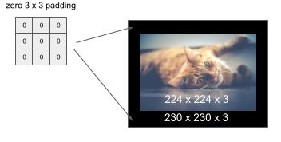
Pre-Stems - Zero Padding
Pre-Stems - Zero Padding
We fix this problem by adding padding around the input shape to match the input shape that the neural network architecture was optimized and/or trained for. In our example, we need to extend the 224 x 224 to 230 x 230. We can do this by adding a 3 x 3 pad (of zero values) around the image, as shown below:

Slide 105
Advanced - Pre-Stems - Zero Padding
Pre-Stems - Zero Padding
The code below demonstrates using the ZeroPadding2D() method for adding a pad, where the parameter (3, 3) specifies the height and width of the pad to place around the image.
from keras import layers, Input # not the input shape expected by the stem (which is (230, 230, 3) inputs = Input(shape=(224, 224, 3)) # pre-stem inputs = layers.ZeroPadding2D((3, 3))(inputs) # this will output: (230, 230, 3) print(inputs.shape) # this stem's expected shape is (230, 230, 3) x = layers.Conv2D(64, (7, 7), strides=(2,2))(inputs) X = layers.BatchNormalization()(x) x = layers.ReLU()(x) # this will output: (?, 112, 112, 64) print(x.shape)

Slide 106
Representational Equivalence
Representational Equivalence and Factorization
Factorization is decomposing a first block structure into smaller components which are representationally equivalent. The term representational equivalence means that the replaced design will maintain the same accuracy during training.
The goal of the factorization is to replace one design with another that is representationally equivalent but its computational complexity is less. The result is a smaller model to train, as measured by the number of weights, but retains the same accuracy.
The architectures for ResNeXt and for later versions of Inception relied on factorization. Typically, these factorizations are inferred through computational theory and then proved empirically.

Slide 107
DenseNet
DenseNet
DenseNet introduced the concept of a Densely Connected Convolutional Network. The corresponding paper won CVPR 2017 (Best Paper Award). It is based on the principal, that the output of each residual block layer is connected to the input of every subsequent residual block layer. This extends the concept of identity links.
Prior to DenseNet, an identity link between the input and output of a residual block was combined by matrix addition. In a dense block, the input to the residual block is concatenated to the output of the residual block. This change introduced the concept of feature (map) reuse.

Slide 108
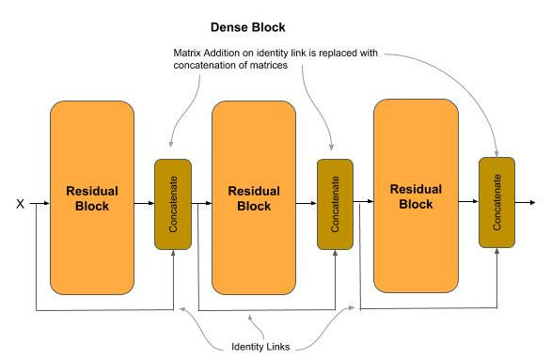
DenseNet - Feature Map Concatenation
DenseNet - Feature Map Concatenation
Let’s assume the output of a layer are feature maps of size 28 x 28 x 10. After a matrix addition, the outputs continue to be 28 x 28 x 10 feature maps. The values within them are the addition of the residual block’s input and output, and thus do not retain the original values (i.e., they have been merged). In the dense block, the input feature maps are concatenated (not merged) to the residual block output, and the original value of the identity link is preserved. In our example, assuming the input and output where 28 x 28 x 10, after the concatenation the output will be 28 x 28 x 20. Continuing to the next block, the output will be 28 x 28 x 30. In this way, the output of each layer is concatenated into the input of each subsequent layer (hence the reference to densely connected).

Slide 109
DenseNet - Feature Map Reuse
DenseNet - Feature Map Reuse
The replacing of the matrix addition with a concatenation has the advantages of:
Further alleviating the vanishing gradient problem over deeper layers.
Further reducing the computational complexity (parameters) with narrower feature maps.
With concatenation, the distance between the output (classifier) and the feature maps is shorter which reduces the vanishing gradient problem, allowing for deeper networks for higher accuracy.
The reuse of feature maps has representational equivalence with the former operation of a matrix addition, but with more narrow layers. With the narrower layers, the overall number of parameters to train is reduced.

Slide 110
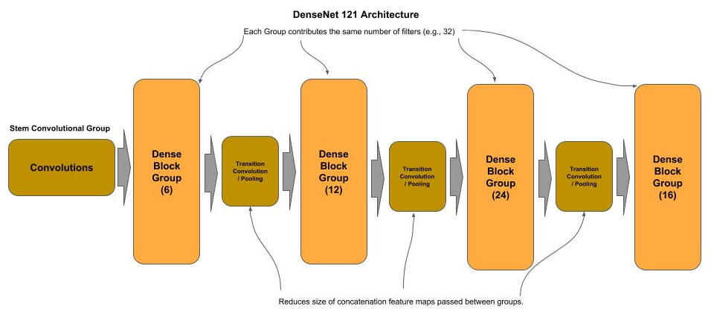
DenseNet - Transition Block
DenseNet - Transition Block
To further reduce computational complexity, a transition block is inserted between each dense block. The transition block is a strided convolution and feature pooling used to reduce the overall size of the concatenated feature maps (feature reuse) as they move from one dense group to the next. Below is a diagram of the DenseNet 121 architecture.

Slide 111
DenseNets - Dense Blocks
DenseNet - Dense Blocks
def dense_block(x, nblocks, nb_filters): # Construct a group of residual blocks for _ in range(nblocks): x = residual_block(x, nb_filters) return x def residual_block(x, nb_filters): shortcut = x # remember input tensor into residual block # Bottleneck convolution, expand filters by 4 (DenseNet-B) x = layers.Conv2D(4 * nb_filters, (1, 1), strides=(1, 1))(x) x = layers.BatchNormalization()(x) x = layers.ReLU()(x) # 3 x 3 convolution with padding=same to preserve same shape of feature maps x = layers.Conv2D(nb_filters, (3, 3), strides=(1, 1), padding='same')(x) x = layers.BatchNormalization()(x) x = layers.ReLU()(x) # Concatenate the input (identity) with the output of the residual block # Concatenation (vs. merging) provides Feature Reuse between layers x = layers.concatenate([shortcut, x]) return x

Slide 112
DenseNets - Dense Blocks
DenseNet - Building the Neural Network Architecture
def trans_block(x, reduce_by): # Reduce (compression) the number of feature maps (DenseNet-C) # shape[n] returns a class object. We use int() to cast it into the dimension size nb_filters = int( int(x.shape[3]) * reduce_by ) # Bottleneck convolution x = layers.Conv2D(nb_filters, (1, 1), strides=(1, 1))(x) x = layers.BatchNormalization()(x) x = layers.ReLU()(x) # Use mean value (average) instead of max value sampling when pooling reduce by 75% x = layers.AveragePooling2D((2, 2), strides=(2, 2))(x) return x # … OMITTED ... # Create the dense blocks and interceding transition blocks nb_filters = 32 for nblocks in blocks: x = dense_block(x, nblocks, nb_filters) x = trans_block(x, 0.5) # Add the last dense block w/o a following transition block x = dense_block(x, last, nb_filters) # … OMITTED ...

Slide 113
DenseNet121 vs ResNetX50
Comparing Complexity
Below is the ending of the summary() output. Note how the number of trainable parameters in this 121 layer DenseNet architecture is half of that of a 50 layer ResNeXt architecture.
In summary, this means that:
With ½ of the number of parameters we can train roughly in ½ of the time.
With more than double the number of layers (121 vs 50) we can train for more accurate results
Total params: 7,946,408 Trainable params: 7,925,928 Non-trainable params: 20,480

Slide 114
Xception
Xception
The Xception (Extreme Inception) architecture was introduced by Google in 2017 as a further improvement over the Inception v3 architecture. In this architecture the factorization of a convolution into a spatial separable convolution in an inception module is replaced with a depthwise separable convolution.

Slide 115
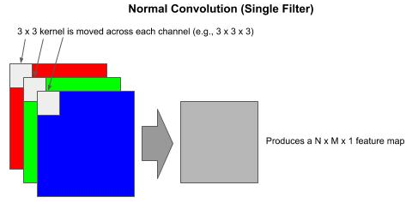
Xception
Normal Convolution
In a normal convolution, the kernel (e.g., 3 x 3) is applied across the height (H), width (W) and depth (D, channels). Each time the kernel is moved, the number of multiply operations equals the number of pixels as H x W x D.
On an RGB image (3 channels) with a 3 x 3 kernel done across all 3 channels, one has 3 x 3 x 3 = 27 multiply operations, producing a N x M x 1 (e.g., 8 x 8 x 1) feature map (per kernel), where N and M are the resulting height and width of the feature map.

Slide 116
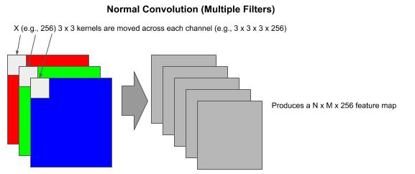
Xception
Normal Convolution (Multiple Filters)
If we specify 256 filters for the output of the convolution, we have 256 kernels to train. In the RGB example using 256 3x3 kernels, we have 6,912 multiply operations each time the kernels move.

Slide 117
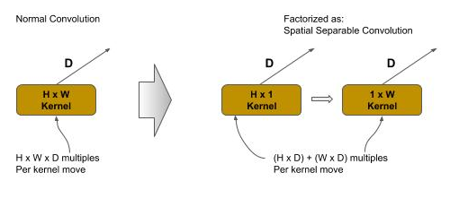
Xception - Spatial Separable Convolution
Spatial Separable Convolution
A spatial separable convolution factors a 2D kernel (e.g., 3x3) into two smaller 1D kernels. Representing the 2D kernel as H x W, then the factored two smaller 1D kernels would be H x 1 and 1 x W. It lowers the total number of computations by 1/3.
In the same RGB example with a factored 3 x 3 kernel, a spatial separable convolution would be (3 x 1 x 3) + (1 x 3 x 3) = 18 multiply operations each time the kernel is moved (vs. 27 in a normal convolution)

Slide 118
Xception - Depthwise Separable Convolution
Depthwise Separable Convolution
A depthwise separable convolution is used where a convolution cannot be factored into a spatial separable convolution without representational loss. A depthwise spatial convolution factors a 2D kernel into two 2D kernels, where the first is a depthwise convolution and the second is a pointwise convolution.

Slide 119
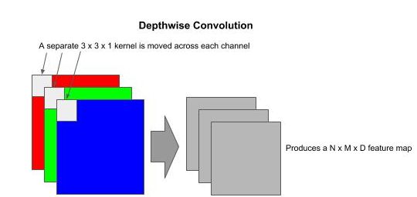
Xception - Depthwise Convolution
Depthwise Convolution
In a depthwise convolution the kernel is split into single H x W x 1 kernels, one per channel, and where each kernel operates on a single channel instead across all channels.
In the RGB example using a 3x3 kernel, a depthwise convolution would be three 3x3x1 kernels. While the number of multiply operations as the kernel is moved is the same as the normal convolution (e.g., 27 for 3x3 on three channels), the output is a D depth feature map instead of a 2D (depth=1) feature map.

Slide 120
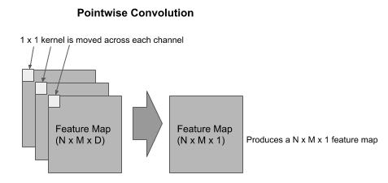
Xception - Pointwise Convolution
Pointwise Convolution
The output from a depthwise convolution is then passed as the input to a pointwise convolution, which forms a depthwise separable convolution. The pointwise convolution is used to combine the outputs of the depthwise convolution and expand the number of feature maps to match the specified number of filters (feature maps).
A pointwise convolution has a 1x1xD (number of channels). It will iterate through each pixel producing a N x M x 1 feature map, which replaces the N x M x D feature map.

Slide 121
Xception - Depthwise Separable Convolution
Computational Complexity
In the pointwise convolution we use 1x1xD kernels, one for each output. As in the early example, of our output is 256 filters (feature maps), we will use 256 1x1xD kernels.
In the RGB example using a 3x3x3 kernel for the depthwise convolution, we have 27 multiply operations each time the kernel moves. This would be followed by a 1x1x3x256 (where 256 is the number of outputted filters) which is 768. The total number of multiply operations would be:
Normal Convolution: 6912
Spatial Separable Convolution: 4608
Depthwise Separable Convolution: 795

Slide 122
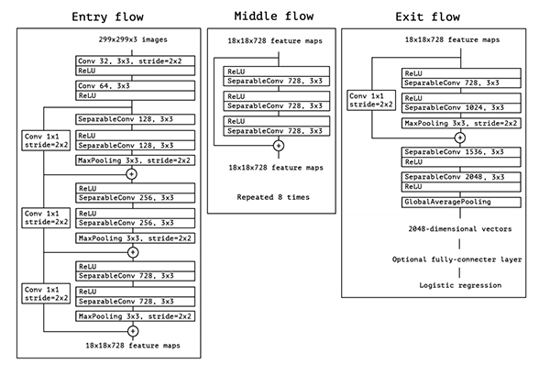
Xception - Architecture
In the Xception architecture, the spatial separable convolutions in the inception module are replaced with a depthwise separable convolution, reducing computational complexity (number of multiply operations) by 83%.

Slide 123
Xception - Architecture
Code snippet of a Keras implementation of a Depthwise Separable Convolution followed by a Pooling and Strided Convolution.
shortcut = x # First Depthwise Separable Convolution x = layers.SeparableConv2D(728, (3, 3), padding='same')(x) x = layers.BatchNormalization()(x) # Second Depthwise Separable Convolution x = layers.SeparableConv2D(1024, (3, 3), padding='same')(x) x = layers.BatchNormalization()(x) x = layers.ReLU()(x) # Create pooled feature maps, reduce size by 75% x = layers.MaxPooling2D((3, 3), strides=(2, 2), padding='same')(x) # Add strided convolution to identity link to double number of filters to # match output of residual block for the add operation shortcut = layers.Conv2D(1024, (1, 1), strides=(2, 2), padding='same')(shortcut) shortcut = layers.BatchNormalization()(shortcut) x = layers.add([x, shortcut])

Slide 124
Advanced CNN - Code Lab #4
Optional Code Lab - Get Familiar with Advanced Convolutional Neural Networks
Idiomatic Programmer - handbook 1 - Codelab 4.ipynb

Slide 125
MobileNet
Mobile Neural Networks
MobileNet is an architecture introduced by Google in 2017 for producing smaller networks which can fit on mobile and embedded devices, while maintaining accuracy close to their larger network counterparts. The MobileNet architecture replaces normal convolutions with depthwise separable convolutions to further reduce computational complexity.
Two additional hyperparameters were introduced for thinning the size of the network: width multiplier and resolution multiplier.

Slide 126
MobileNet
Width Multiplier
The first hyperparameter introduced was the width multiplier α (alpha), which thins a network uniformly at each layer.
The value of α (alpha) is between 0 and 1, and will reduce the computational complexity of a mobile net by α (alpha)**2. Typically values are 0.25 (6%), 0.50 (25%), and 0.75 (56%).
In tests results reported in the paper, a non-thinned mobilenet-224 had a 70.6% accuracy on ImageNet with 4.2 million parameters and 569 million matrix multi-add operations, while a 0.25 (width multiplier) mobilenet-224 had 50.6% accuracy with 0.5 million parameters and 41 million matrix multi-add operations.

Slide 127
MobileNet
Resolution Multiplier
The second hyperparameter introduced was the resolution multiplier ρ (rho), which thins the input shape and consequently the feature map sizes at each layer.
The value of ρ (rho) is between 0 and 1, and will reduced computational complexity of a mobile net by ρ (rho)**2.
In tests results reported in the paper, a 0.25 (resolution multiplier) mobilenet-224 had 64.4% accuracy with 4.2 million parameters and 186 million matrix multi-add operations.

Slide 128
MobileNet
Example Use of Width Multiplier
def stem(inputs, alpha): """ Create the stem group inputs : input tensor alpha : width multiplier """ # Apply the width filter to the number of feature maps filters = int(32 * alpha) # Normal Convolutional block x = layers.ZeroPadding2D(padding=((0, 1), (0, 1)))(inputs) x = layers.Conv2D(filters, (3, 3), strides=(2, 2), padding='valid')(x) x = layers.BatchNormalization()(x) x = layers.ReLU()(x) # Depthwise Separable Convolution Block x = depthwise_block(x, 64, alpha, (1, 1)) return x
#1 Width multiplier for reducing number of filters
#2 Number of filters for stem convolution is reduced
#3 Pass along the width multiplier to the next convolution group

Slide 129
SqueezeNet
SqueezeNet - New Module and Terminology
SqueezeNet is an architecture proposed by joint research of DeepScale and UC Berkeley and Stanford University in 2015. In the corresponding paper, the authors introduced a new type of module, referred to as the fire module, and introduced terminology for microarchitecture, macroarchitecture and metaparameters.
Microarchitecture is the design of modules, or groups.
Macroarchitecture is how the modules, or groups, are connected.

Slide 130
SqueezeNet - Metaparameters
SqueezeNet - Metaparameters
The use of the term metaparameters aided in better distinguishing what a hyperparameter is.
Model Parameters - the weights and biases that are learned during training are the model parameters.
Hyperparameters - the tunable parameters used to train the model.
Metaparameters - the structure of the model architecture that is configurable.

Slide 131
SqueezeNet - Architecture
SqueezeNet - Architecture Goals
The authors wanted to demonstrate a CNN architecture design that would fit on a mobile device and still retain comparable accuracy of AlexNet on ImageNet 2012 dataset,
The authors reported achieving the same results empirically with a 50X reduction (fewer) parameters.
The authors reported that a small CNN architecture could maintain accuracy when compressed, with the DeepCompression algorithm, which reduced the size of the model from 4.8Mb to 0.47Mb.
The work contributed to an emerging field now referred to as compact models.

Slide 132
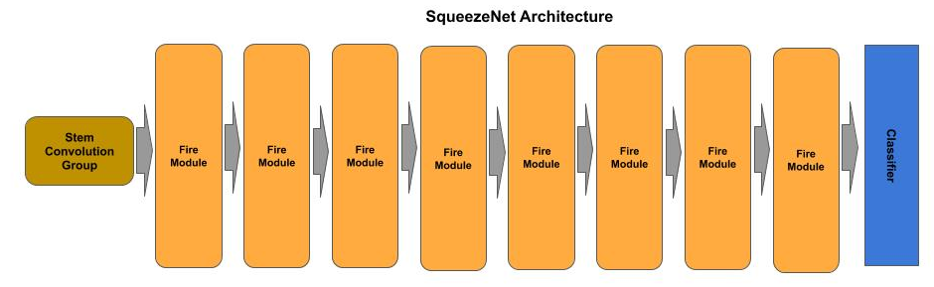
SqueezeNet - Architecture
SqueezeNet - Architecture
The SqueezeNet architecture consists of a stem group, followed by eight fire modules and then a classifier.

Slide 133
SqueezeNet - Architecture
SqueezeNet - Design Principles
The authors describe their design principles to achieve their objectives, which they referred to as strategy 1, 2 and 3:
Strategy 1: Use mostly 1x1 filters instead of the more common convention of 3x3 filters, which give a 9X reduction in the number of parameters. The v1.0 version of SqueezeNet used a 2:1 ratio of 1x1 to 3x3 filters.
Strategy 2: Reduce the number of input filters to the 3x3 layers to further reduce the number of parameters. They refer to this component of the fire module as the squeeze layer.
Strategy 3: Delay downsampling of feature maps to as late as possible in the network, in contrast to the convention of the time to downsample early to preserve accuracy, by using a stride of 1 on the early convolution layers and delay using stride of 2, which are strided convolutions which perform feature map downsampling.

Slide 134
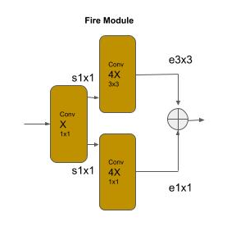
SqueezeNet - Fire Module
SqueezeNet - Fire Module
The fire module consists of two convolutional layers, where the first layer is the squeeze layer and the second layer is the expand layer. The squeeze layer uses a bottleneck convolution to preserve the size of the feature maps (i.e., no downsampling), and reduce the number of filters passed to the expand layer.
The expand layer is a branch of two convolutions, a 1x1 convolution and a 3x3 convolution. The outputs (feature maps) from the convolutions are then concatenated. The expand layer expands the number of feature maps by a factor of 4.

Slide 135
SqueezeNet - Fire Module
SqueezeNet - Fire Module
The code below implements a fire module:
def fire(x, n_filters): ''' Create a fire module ''' # squeeze layer squeeze = Conv2D(n_filters, (1, 1), strides=1, activation='relu', padding='same', kernel_initializer='glorot_uniform')(x) # branch the squeeze layer into a 1x1 and 3x3 convolution and double the number # of filters expand1x1 = Conv2D(n_filters * 4, (1, 1), strides=1, activation='relu', padding='same', kernel_initializer='glorot_uniform')(squeeze) expand3x3 = Conv2D(n_filters * 4, (3, 3), strides=1, activation='relu', padding='same', kernel_initializer='glorot_uniform')(squeeze) # concatenate the feature maps from the 1x1 and 3x3 branches x = Concatenate()([expand1x1, expand3x3]) return x

Slide 136
SqueezeNet - Classifier
SqueezeNet - An Unconventional Classifier
The classifier does not follow the conventional practice of a global averaging pooling layer followed by a dense layer where the number of output nodes equals the number of classes.
Instead, it uses a convolutional layer where the number of filters equals the number of classes, followed by a global averaging pooling layer such that each prior filter (class) is reduced to a single value.
def classifier(x, n_classes): ''' The classifier ''' # set the number of filters equal to number of classes x = Conv2D(n_classes, (1, 1), strides=1, activation='relu', padding='same', kernel_initializer='glorot_uniform')(x) # reduce each filter (class) to a single value x = GlobalAveragePooling2D()(x) x = Activation('softmax')(x) return x

Slide 137
Computer Vision - Data Engineering
Part 6 : Data Collection & Assembly
Part 7 : Data Engineering
Part 8 : Data Augmentation
Part 9 : Data Curation

Slide 138
Data Collection & Assembly
Data Collection
The capability of a trained model for image classification is dependent on the quantity and distribution of the image data the model was trained with. Here are typical problems you might encounter with your training data:
Too few images overall.
Too few images of a specific label (class).
Insufficient variation in perspective (e.g., angle, zoom).
Insufficient variation in lighting conditions.

Slide 139
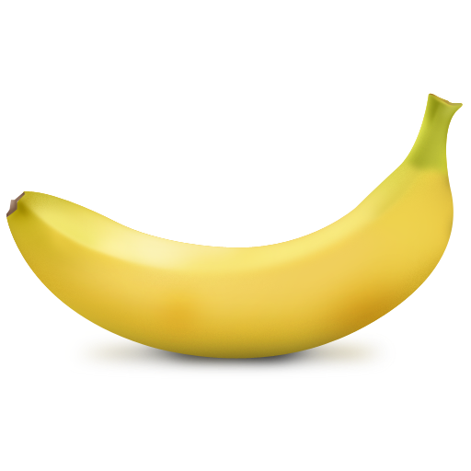
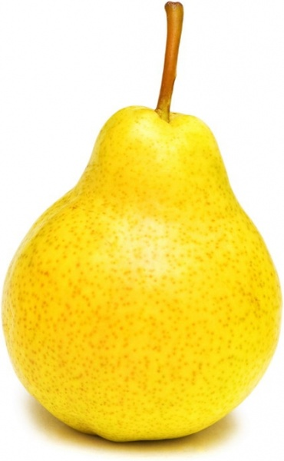
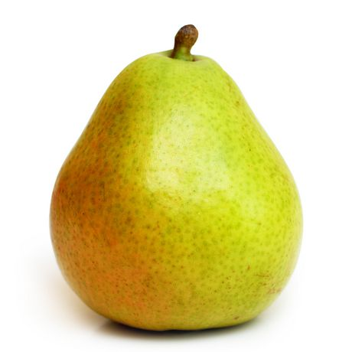
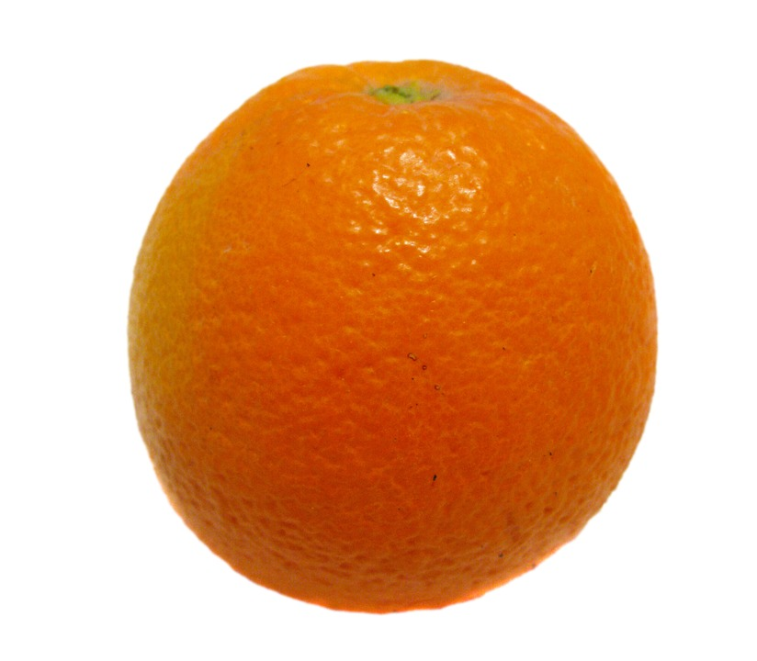
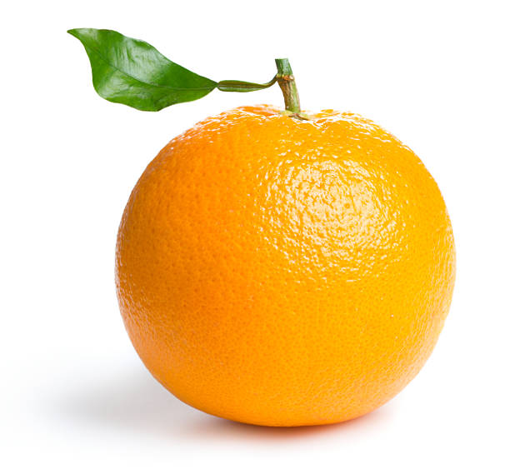
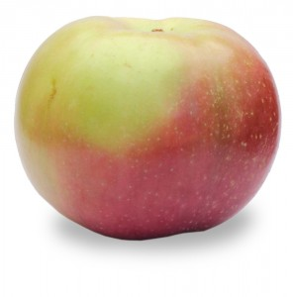
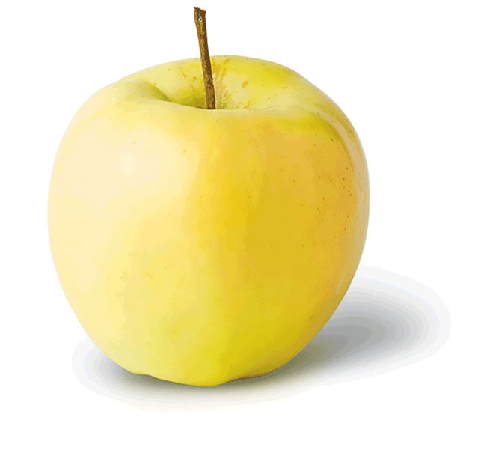
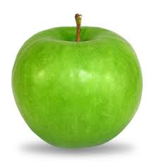
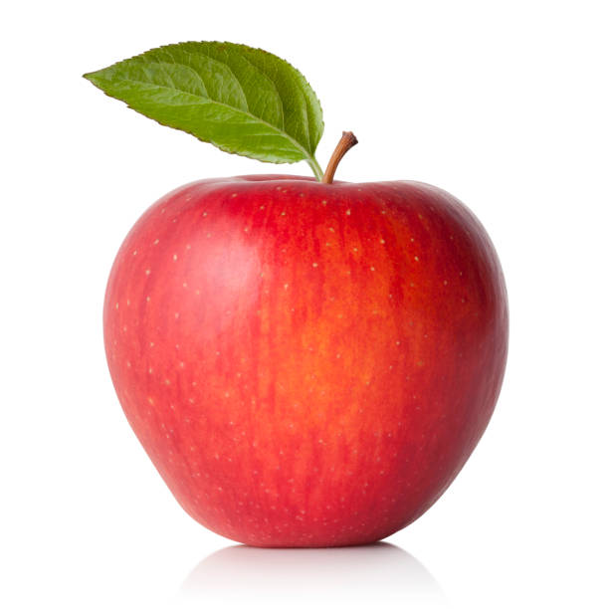
Data Collection - Too Few Images
Too Few Images Overall
A dataset may simply be too small for a convolutional neural network to learn:
The features associated with each label (class).
The distribution of the features across samples of each label.
The variance in the features of each label.
Let’s consider a dataset of types of fruits (e.g., apples, oranges, bananas, pears, etc). Apples, oranges and pears have some similarity in shape, while bananas would be very different in shape. Oranges are fairly consistent in color, while apples and bananas can have a range of colors (green and yellow for both, and red for apples). For apples, pears and oranges, we might still have part of the stem, while bananas have no stems.
Samples of fruits of different colors and with and without stems

Slide 140
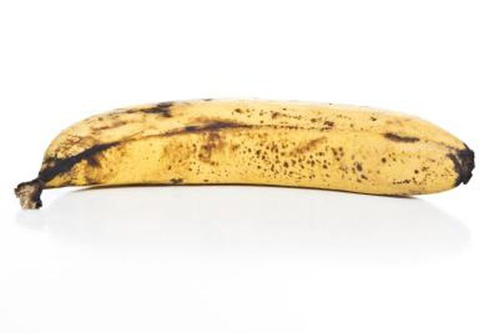
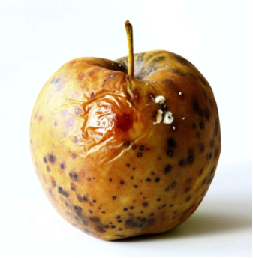
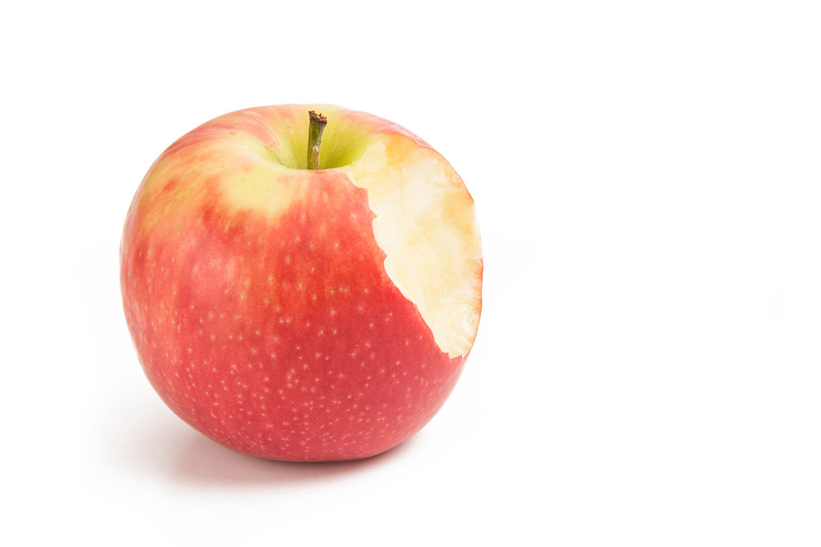
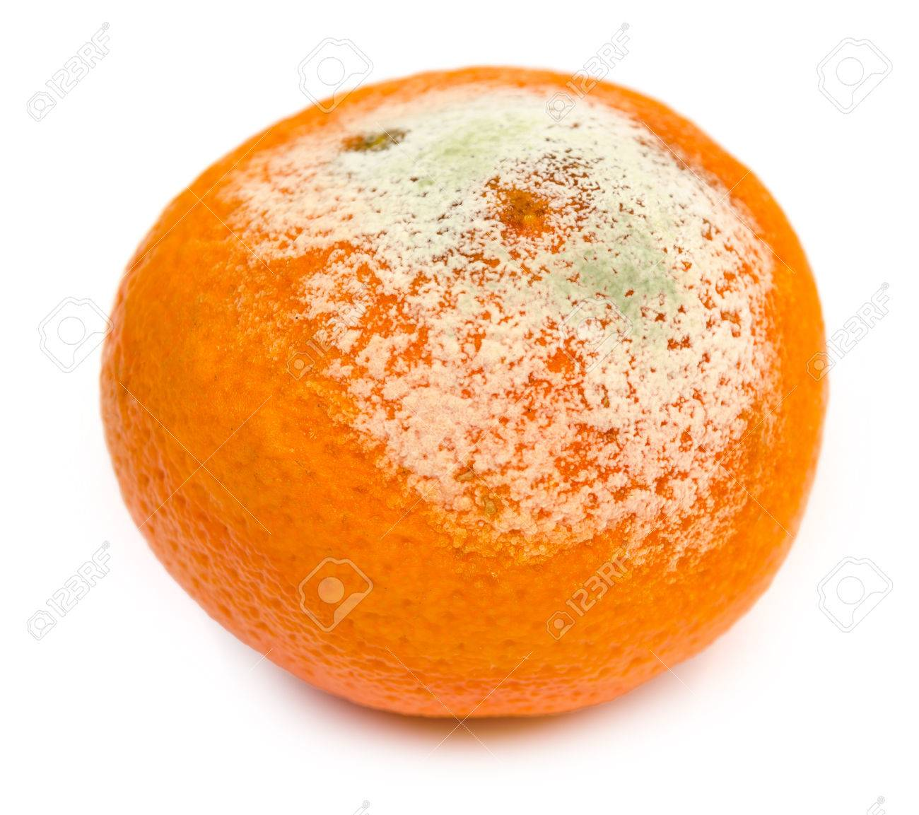
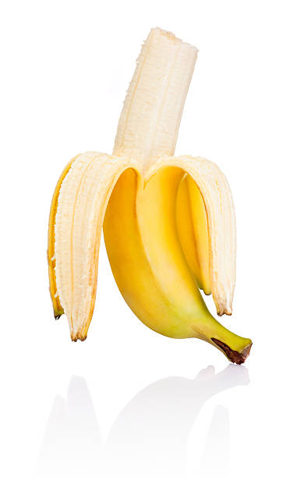
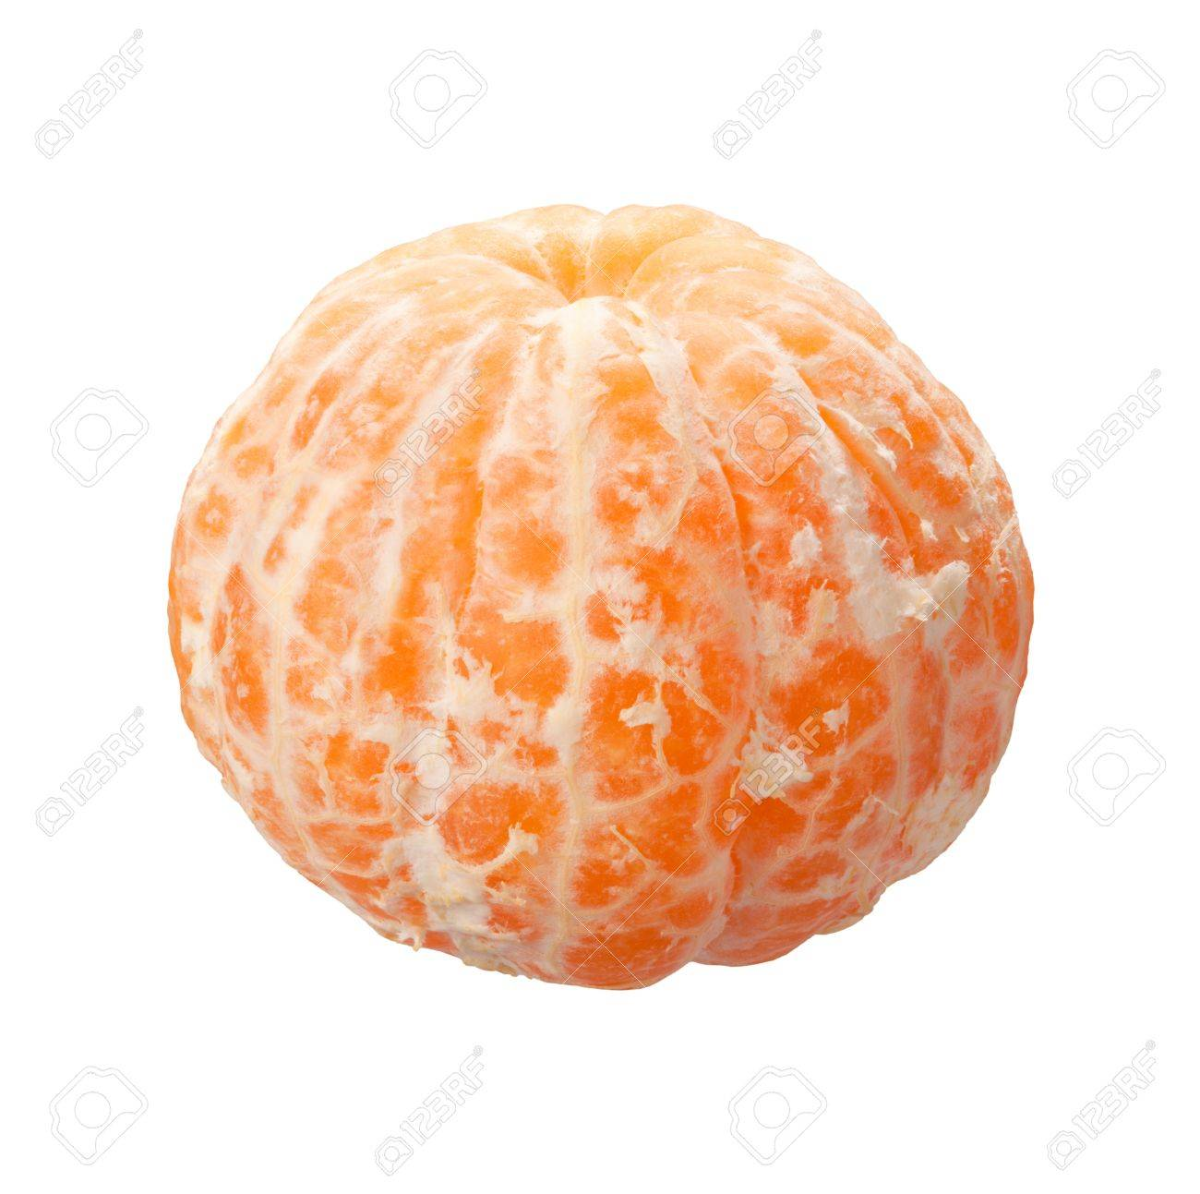
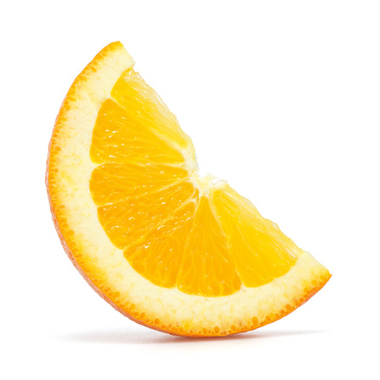
Data Collection - Too Few Images
Too Few Images Overall
We may want to recognize the fruit when it is spoiled. But spoiling patterns differ. For bananas, apples and pears they turn brown, but with orange you have a white fungus. We may want to recognize the fruit when it is partially eaten, like a bit out of an apple, a sliced orange, or a peeled banana.
Samples of fruits of different spoilage, bitten, peeled and sliced

Slide 141
Data Collection - Best Practices
Best Practices
There is a lot of things to consider, but let’s start with the basic common practices when collecting images for a dataset.
Each label (class) should have at least 1000 images.
Each distinct color for a label should be at least 10% of the images for that label.
Example: 1000 images of apples with color red, green and yellow. At least 100 should be green apples, another 100 red apples and another 100 yellow apples.
Each secondary (not always present) feature for a label should be at least 5% of the images for the label.
Example: 1000 images of apples. At least 50 are with a stem and 50 without a stem.
When there is a progression in state (e.g., age) for a label, the progression should be at least 20% of the images for the label.
Example: 1000 images of apples. At least 200 are ripe, spoiled, insect damaged, sliced or Partially eaten.

Slide 142
Data Collection - Not Any Class
Not Any Class
Another common practice that improves overall accuracy is to create one additional label as not any, and populate the label with randomly chosen images that are not of any of the labels which the model will be trained to recognize.

Slide 143
Data Collection - Unbalanced
Too Few Examples in Class (Unbalanced)
A label (class) within a dataset may simply be too small, relative to the other labels. In this case, the dataset is referred to as being unbalanced.
Here are some common practices for determining when a dataset is considered unbalanced:
If the number of images for any label is less than 20% of the mean. For example, let’s say that for each label in the fruits dataset has an average (mean) of 1000 images --then for any one label (e.g., plum), there should be at least 200 images.
If the number of images for any label is less than 10% of the label with the most images.
For example, let’s say that apples have 3000 images and has the most images of all the labels --then for any one label, there should be at least 300 images.

Slide 144
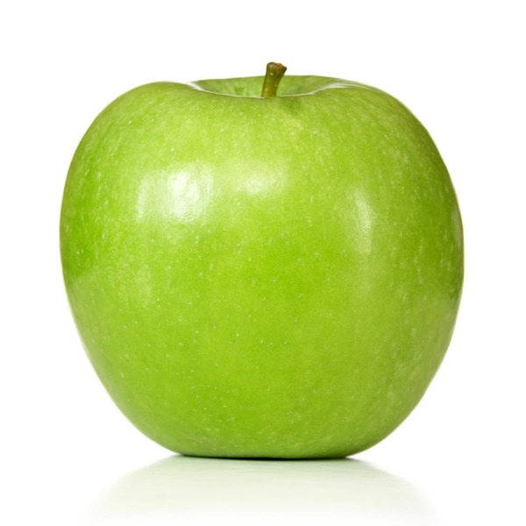
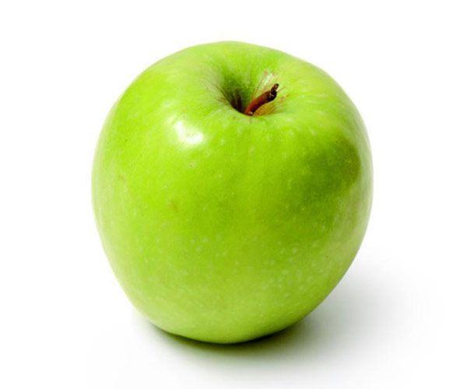
Data Collection - Insufficient Variance
Insufficient Variance in Perspective
If all the images in a label are from the same perspective (angle, distance) then it’s likely during training that the model will overfit.
Overfitting means that the weights and biases learned will be tightly fitted to the images for that label(s) in the training data, and while the accuracy will be very high with the training data, but when evaluated against image samples of a different perspective, the accuracy is very low.
A change in perspective will cause a change in spatial distances between features. Consider the example of the two images of an apple below. In the first one, the apple is viewed straight on, while in the second one, the apple is slightly tilted. It’s the same apple, but the spatial relationship between the stem and the body of the apple has changed (i.e., rotation).

Slide 145

Data Collection - Spatial Relationships
Spatial Relationships of Features
Convolutional layers will learn filters to extract individual features into feature maps. Each feature map contains the strength of detection and location in the image of detecting the individual feature, from which the neural network can learn the spatial relationship and variance between instances of the single feature.
Feature maps are then stacked (see picture below). This stacking allows the neural network to learn the spatial relationships and variance between different features.

Slide 146
Data Collection - Insufficient Lighting
Insufficient Lighting
Another area to consider is the lighting conditions. Does the lighting conditions of the images reflect the variance in lighting conditions in the application that will use the trained model.
If the application is used only indoors and under a constant well lighted condition, then there may not be a need for variance in lighting conditions. For all other environments the images should have different lighting conditions, such as:
Natural Light - Daytime
Natural Light - Dusk
Indoor Light - Well Lighted
Indoor Light - Dimmed

Slide 147

Assembling a Dataset
Assembling an Image Dataset
You need photos (images) of what your going to train a neural network to recognize (classify).
You need to decide what it is your going to classify.
You will need to group the photos by the classification you decided on.

Slide 148
Number of Images
Number of Images
Best practices recommend at least a 1000 images of each class (label).
Consider the source of the images. If they are copyrighted, you may not have the legal right to use them for training a neural network for a commercial application.
If you’re not certain on the accuracy of how correctly the images are labeled (e.g., an image of a Persian cat is labeled as a Siamese), you may want to have a second set of eyes go over and correct any mistakes. You can still learn and build a reliable neural network model with some errors if the proportion of incorrectly labeled images is very small. Typically, for statistical purposes, the rule of thumb is less than 4%.

Slide 149
Image Background Diversity
Background Diversity
Consider how the images were taken and if they are diverse enough. For example, if all the images are taken with the same background that is generally not going to be a problem. That is, if all the classes have the same background, the background will not contribute to the class recognition, and the neural network will “learn” to filter it out.
If all images of one class have the same background, and all the remaining classes have varied background, the neural network may inadvertently learn the background instead of the object for the one class. For example, in a paper published in 2016 by Rubeiro, an example dataset of wolves and huskies was used to train a model, where all the images of wolves were taken during the winter with snow in the background. The paper showed how the neural network inadvertently learned ‘snow’ for classifying a wolf, and when shown a picture of a husky in snow, it would predict the image as a wolf.

Slide 150

Dataset Layout - Directory Structure
Dataset as a Directory Structure
Laying out (placing) the images into a directory folder structure on a local disk is one of the most common layouts. In this layout, the root (parent) folder is a container for the dataset. Below the root level are one or more subdirectories, where each subdirectory corresponds to a class (label), and where each subdirectory contains the images that correspond to that class. Using our cats and dogs example, one would have a parent directory that might be named ‘cats_n_dogs’, with two subdirectories, one named ‘cats’ and the other ‘dogs’. Within each subdirectory would be the corresponding class of images.
.

Slide 151

Dataset Layout - Directory Structure
Train and Test Directory Structure
Alternatively, if the dataset has been pre-split into training and test data, explained subsequently, then the split images for each class (label) are placed under the corresponding subfolders train and test, which are then underneath (subfolder of) the root folder of the dataset.

Slide 152

Dataset Layout - Directory Structure
Hierarchical Directory Structure
Alternatively, if the dataset has been pre-split into training and test data, explained subsequently, then the split images for each class (label) are placed under the corresponding subfolders train and test, which are then underneath (subfolder of) the root folder of the dataset.

Slide 153
Dataset Layout - CSV File
CSV File
Another common layout is to use a CSV file to identify the location and class (label) of each image. In this case, each row in the CSV file is a separate image, and the CSV file contains at least two columns, one for the location of the image, and the other for the class (label) of the image. The location might be either a local path, a remote location, or the pixel data is embedded as the value of the location.
local path example: remote path example:
label,location label, location ‘cat’, cats_n_dogs/cat/1.jpg ‘cat’,’http://mysite.com/cats_n_dogs/cat/1.jpg’ ‘dog’,cats_n_dogs/dog/2.jpg ‘dog’,’http://mysite.com/cats_n_dogs/dog/2.jpg’ … ...
embedded data example:
Label,location ‘cat’,[[...],[...],[...]] ‘dog’,[[...], [...], [...]]

Slide 154
Dataset Layout - JSON File
JSON File
Another common layout is to use a JSON file to identify the location and class (label) of each image. In this case, the JSON file is an array of objects, where each object is a separate image, and each object has at least two keys, one for the location of the image, and the other for the class (label) of the image.The location might be either a local path, a remote location, or the pixel data is embedded as the value of the location.
local path example:
[ {‘label’: ‘cat’, ‘location’: ‘cats_n_dogs/cat/1.jpg’ }, {‘label’: ‘dog’, ‘location’: ‘cats_n_dogs/dog/2.jpg’} … ]

Slide 155
Dataset Layout - HDF5 File
HDF5 File
Another common layout and storage format is to use a HDF5 (hierarchical data format) format file, which are very efficient for storing and accessing large amounts of multi-dimensional data, such as images. The format supports dataset and group objects, as well as attributes (metadata) per object. Typically, the file will consist of a group object per class (label), and each group will consist of one or more dataset objects for the corresponding images. Additional information, such as the label name, are stored as group attributes.
Group Attribute: {label: cats} Dataset: [...]
Group Attribute: {label: dogs} Dataset

Slide 156
Dataset Layout - HDF5 Hierarchical Storage
HDF5 Hierarchical Storage
The format supports hierarchical storage of groups. If the images are hierarchically labeled, then each group is further partitioned into a hierarchy of subgroups.
Group Attribute: {label: cats} Group: Attribute: {label: persian} Dataset: [...] Group: Attribute: {label: siamese} Dataset: [...]
Group Attribute: {name: dogs} Group: Attribute: {label: poodle} Dataset: [...] Group: Attribute: {label: beagle} Dataset: [...]

Slide 157
Dataset Layout - In Memory
In Memory
An image dataset may already be in memory. This is typical for curated datasets provided by ML frameworks (like Keras) for educational purposes. In this case, the image dataset has been prepared into machine learning ready data, and pre-split into train and test, with the label data already one-hot encoded (discussed later in this part).
Image 1 Image 2 Image 3 Image 4 Image 5 X_train = [ [ [...],[...],[...]], [ [...],[...],[...]], [ [...],[...],[...]], [ [...],[...],[...]], [ [...],[...],[...]], … ] Y_train = [ [... 1 …] [… 1 …], [… 1 …], [... 1 …], [... 1 …], … ]

Slide 158
Data Engineering
Data Engineering
You can’t just drop images into a neural network and expect it to learn (recognize) what the images are.
There are some preprocessing steps that need to be done with an image dataset, which is referred to as data engineering. These include:
Loading (reading) in the images as raw pixel data.
Fitting them to the input vector of the neural network which will be used for training.
Conversion of the pixel data.
Splitting the dataset
In the following sections, we will cover the different ways to perform these steps in openCV, PIL and Keras library modules.

Slide 159
Data Engineering - PIL Library
PIL Library
PIL or Pillow is Python’s image manipulation library. In this section, we use the library to manually prepare an image dataset into machine learning ready data. Let’s first cover some basics of PIL.
PIL was last updated in 2009 and supports Python 2 only. Pillow is a fork of the original PIL repo and continues to be maintained.
One can install Pillow with pip install pillow.

Slide 160
PIL Reading Images
Reading Images
The first step is to read an image from disk into memory. The image on disk will be in an image format, like JPG, PNG, TIF, etc. These formats define how the image is encoded and compressed for storage. An image is read into memory using the PIL Image.open() method.
from PIL import Image image = Image.open('myimage.jpg')

Slide 161
PIL Reading Images
Reading Images
Let’s assume you want to read in all the images under some subdirectory (e.g., cats). In the code below, we scan (get list of) all the files in the subdirectory, read each one in as an image, and maintain a list of the read-in images as a list:
Note, os.scandir() was added in Python 3.5. If you are using Python 2.7 or an earlier version of Python 3, you can obtain a compatible version with pip install scandir.
from PIL import Image import os def loadImages(subdir): images = [] # get list of all files in subdirectory cats files = os.scandir(subdir) # read each image in and append the in-memory image to a list for file in files: images.append(Image.open(file.path)) return images loadImages('cats')

Slide 162
PIL Reading Images - Subdirectories
Reading Images from Sub-Directories
Let’s expand on the above and assume the image dataset is laid out as a directory structure, where each subdirectory is a class (label). In this case, we would want to scan each subdirectory separately, and keep a record of the subdirectory names for the classes.
def loadDirectory(parent): classes = {} # list of class to label mappings dataset = [] # list of images by class # get list of all subdirectories under the parent (root) directory of the dataset for subdir in os.scandir(parent): # ignore any entry that is not a subdirectory (e.g., license file) if not subdir.is_dir(): continue # maintain mapping of class (subdirectory name) to label (index) classes[subdir.name] = len(dataset) # maintain list of images by class dataset.append(loadImages(subdir.path)) print("Processed:", subdir.name, "# Images", len(dataset[len(dataset)-1])) return dataset, classes loadDirectory('cats_n_dogs')

Slide 163
PIL Reading Images - Remote
Reading Images from Remote Locations
Let’s now try an example where the location of the image is remote (not local) and specified by an URL. In this case, we will need to make an HTTP request for the contents of the resource (image) specified by the URL and then decode the response into a binary byte stream.
from PIL import Image import requests from io import BytesIO def remoteImage(url): try: response = requests.get(url) return Image.open(BytesIO(response.content)) except: return None

Slide 164

Channel Conversion
Channel Conversions (Grayscale vs. Color)
Next, we need to set the number of channels to match the input shape of your neural network. The number of channels is the number of color planes in your image. For example, a grayscale image will have one color plane. An RGB color image will have three color planes, one for each of Red, Green and Blue.

Slide 165
PIL Channel Conversion
Image.open() and Alpha Channels (RGBA)
The Image.open() method will read in the image according to the number of planes in the image stored on disk. So if its a grayscale image, it will read it in as a single plane, if it’s RGB it will read it in as three planes, and if it’s RGBA (+alpha channel), it will read it in as 4 planes.
In general when working with RGBA images, the alpha channel can be dropped. It is a mask for setting the transparency of each pixel in the image, and therefore does not contain information that would otherwise contribute to the recognition of the image.

Slide 166
PIL Channel Conversion
Convert Number of Channels to Match Input Shape
Once the image is read into memory, the next step is to convert the image to the number of channels that match the input shape of your neural network.
The convert() method will do channel conversion. A parameter value of ‘L’ will convert to single channel (grayscale) and ‘RGB’ to three channel (RGB color). Below we updated the loadImages() function to include channel conversion:
def loadImages(subdir, channels): images = [] # get list of all files in subdirectory cats files = os.scandir(subdir) # read each image in and append the in-memory image to a list for file in files: image = Image.open(file.path) # convert to grayscale if channels == 1: image = image.convert('L') # convert to RGB color else: image = image.convert('RGB') images.append(image) return images loadImages('cats', 3)

Slide 167
PIL Resizing
Resizing
Next, we need to resize each image to fit the shape of the input shape of the neural network. For example, a 2D convolutional neural network will take a shape of the form (height, width, channels). We dealt with the channel portion above, so next we need to resize the pixel height and width of each image to match the input shape. For example, if the input shape is (64, 128, 3), then we want to resize the height and width of each image to (64, 128). The resize() method will do the resizing.
In most cases, you will be downsizing (i.e., downsampling) each image. For example, 1024 x 768 image will be 3Mb in size. This is far more resolution than a neural network needs (see section on Convolutional Neural Networks). When the image is downsized, some resolution (details) will be lost. To minimize the effect when downsizing, it is a common practice to use the anti-aliasing algorithm in PIL.
def loadImages(subdir, channels, shape): # … deleted for brevity for file in files: image = Image.open(file.path) # … deleted for brevity # resize the image to the target input shape images.append(image.resize(shape, Image.ANTIALIAS)) return images loadImages('cats', 3, (128, 128))

Slide 168
PIL to Numpy Array
Converting PIL objects to Numpy Arrays
In Keras (and other Python ML frameworks), the inputs to neural networks are multi-dimensional numpy arrays. Lists in Python are implemented as dynamic arrays and use indirect addressing on the heap. While this provides great flexibility, the performance is very poor for large dynamic arrays. In machine learning, arrays (vectors, matrices, tensors and batches) are very, very large.
The numpy module is a package that implements high-performance large array handling in contiguous memory in C, with a Python linkage.
For our purposes, we are going to want to convert the list of PIL images to a multi-dimensional numpy array. We can do this with the numpy.asarray() method.

Slide 169
PIL to Numpy Array
Converting PIL objects to Numpy Arrays
In the code example below, we update the loadImages() function to include the step of converting the list of PIL images to a numpy array.
def loadImages(subdir, channels, shape): images = [] # … deleted for brevity # UPDATED STEP # convert all the PIL images to numpy arrays in a single invocation return np.asarray(images) loadImages('cats', 3, (128, 128))

Slide 170
OpenCV Library
OpenCV Library
OpenCV is an open source image manipulation library that is implemented in a wide variety of programming languages, including Python. It has been around a long-time and widely supported and updated by the open source community. It has been the conventional work-horse of imaging scientists.
Everything we did in PIL, we will show in this section how to do in OpenCV.
One can install OpenCV with pip install opencv-python.

Slide 171
OpenCV Reading Images
OpenCV Reading Images
An image is read into memory using the cv2.imread() method. One of the first advantages I find with the cv2.imread() method is the output is already in a multi-dimensional numpy data type.
By default, cv2.imread() will convert the image to a three channel RGB image.
import cv2 image = cv2.imread('myimage.jpg')

Slide 172
OpenCV Channel Conversion
OpenCV Channel Conversion
Another advantage of OpenCV over PIL is that you can do the channel conversion at the time of reading in the image, instead of a second step. You can specify a second parameter that indicates which channel conversion to use. In the example below, we show doing the channel conversion at the time the image is read in.
# read in image as a single channel (grayscale) image if channel == 1: image = cv2.imread('myimage.jpg', cv2.IMREAD_GRAYSCALE) # read in image as a three channel (color) image else: image = cv2.imread('myimage.jpg', cv2.IMREAD_COLOR)

Slide 173
OpenCV Reading Image - Remote
OpenCV Reading Image from Remote Location
In the example below, we show reading in the image from a remote location (url) and doing the channel conversion at the same time. In this case, we use the method cv2.imdecode():
try: response = requests.get(url) if channel == 1: return cv2.imdecode(BytesIO(response.content), cv2.IMREAD_GRAYSCALE) else: return cv2.imdecode(BytesIO(response.content), cv2.IMREAD_COLOR) except: return None

Slide 174
OpenCV Resizing Image
OpenCV Resizing
Images are resized using the cv2.resize() method. The second parameter is a tuple of the height and width to resize the image to. The optional (keyword) third parameter is the interpolation algorithm to use when resizing. Since in most cases you will be downsampling, the common practice is to use the cv2.INTER_AREA algorithm for best results in preserving information and minimizing artifacts when downsampling an image.):
# resize an image to 128 (height) x 128 (width) image = cv2.resize(image, (128, 128), interpolation=cv2.INTER_AREA)

Slide 175
OpenCV LoadImages()
Rewrite LoadImages() using OpenCV
Let’s now rewrite the loadImages() function using OpenCV.
def loadImages(subdir, channels, shape): images = [] # get list of all files in subdirectory cats files = os.scandir(subdir) # read each image in and append the in-memory image to a list for file in files: # convert to grayscale if channels == 1: image = cv2.imread(file.path, cv2.IMREAD_GRAYSCALE) # convert to RGB color else: image = cv2.imread(file.path, cv2.IMREAD_COLOR) # resize the image to the target input shape images.append(cv2.resize(image, shape, cv2.INTER_AREA)) return np.asarray(images) loadImages('cats', 3, (128, 128))

Slide 176
Normalization (Standardization)
Normalization and Data Type
At this point, all the image data is in a numpy multidimensional array. As a final step, we want to perform :
normalization (or standardization) on the pixel data, and
fit the pixel data to a data type size.
The process makes all the images have a similar pixel value distribution, which leads to faster convergence when training a neural network. This means less epochs (or steps), which means less total compute time.
Normalization will squash all the pixel values in a range between 0 and 1, or between -1 and 1, while standardization will squash the pixel values into a distribution with a mean centered at 0 and one standard deviation.

Slide 177
Normalization
Normalization using Numpy
Images taken by a camera are almost universally 8 bits per pixel per channel format, represented as an unsigned 8 bit integer value (e.g., np.uint8). Therefore, we can do the squashing function by dividing each pixel value by 255. So a value 0 would become a 0, a value of 255 would become a 1, and all other values will be in-between.
The numpy library has overridden the division operator between two numpy arrays to perform a very fast array-wide matrix division. So we can do this operation as a single step.
# Normalization between 0 and 1 of 8 bits per pixel per channel images = images / 255.0

Slide 178
Normalization - High Dynamic Range
Normalization of High Dynamic Range Images (16bpp/channel)
In some image datasets, the images may be in a different bits per pixel representation. For example, 16 bits per pixel per channel for high color images, which have a dynamic color range between 0 .. 65535 vs 0 .. 255 for 8 bits per pixel. When normalizing between 0 and 1, we need to divide by the maximum value of the pixel range.
if images.itemsize == 1: images = images / 255.0 # Normalization between 0 and 1 of 16 bits per pixel per channel elif images.itemsize == 2: images = images / 65535.0

Slide 179
Normalization - Center at Zero
Normalization between 0 and 1
When normalizing, some prefer to normalize between -1 and 1, to center the pixel values around 0.
if images.itemsize == 1: images = images / 127.5 - 1 elif images.itemsize == 2: images = images / 32767.5 - 1

Slide 180
Standardization
Standardization
Another method of squashing pixel values into a similar distribution is called standardization. In this method, a mean and a standard deviation are calculated across all the pixel values. Then the mean is centered at zero and each pixel divided by a standard deviation of 1. This takes more computation than normalization.
If your images are a fairly basic and fairly consistent distribution of pixel values, then a normalization is sufficient. For example, in the MNIST dataset, all the digits are in a narrow grayscale range and all the backgrounds are the same. For this case, normalization is sufficient. When your working though with color images, the distribution of pixel values can be very diverse across images. In general, normalization is used with grayscale images and standardization with color images.

Slide 181
Standardization
Standardization
To prevent a division by zero in the case where the standard deviation is zero, it is a common practice to add a tiny amount, referred to as an epsilon, so the denominator will never be zero.
# standardization across all pixels/channels e = 1e-7 # epison, add a tiny amount to standard deviation to prevent divide by 0. images = (images - np.mean(images)) / (np.std(images) + e) - 1

Slide 182
Standardization - Other Means
Standardization - Per Channel and Per Pixel (Image) Mean
The previous example calculated the mean and standard deviation across all pixels and channels. Other practices will calculate a mean and standard deviation per channel. In the case of a 3 channel RGB image, this is done as:
Another practice is to calculate the mean and standard deviation on a per pixel location. In the case of a 3 channel RGB image, this is done as:
# standardization by per channel mean e = 1e-7 # epison, add a tiny amount to standard deviation to prevent divide by 0. images = (images - np.mean(images, axis=(0,1))) / (np.std(images, axis=(0,1)) + e)
# standardization by mean image e = 1e-7 # epison, add a tiny amount to standard deviation to prevent divide by 0. images = (images - np.mean(images, axis=(2))) / (np.std(images, axis=(2)) + e)

Slide 183
Data Types
Floating Point Size
The last step is setting the data type of the normalized (or standardized) pixel data. At this point the pixel data values are floating point numbers, and generally very small numbers (e.g., between 0.0 and 1.0). By default, numpy will represent floating point values as double precision floats (float64). That’s 8 bytes per float, which is 8 bytes per pixel per channel. Let’s assume the input shape to the neural network is (128, 128, 3). That will require 50K pixels per image, and at 8 bytes per pixel per channel, that’s 400K bytes per image. At 10,000 images, that will require 4GB of memory to hold them all at once in memory.
Neural networks work well with lower float precision. Single precision float (float32) is the common practice, which takes ½ the space and ¼ the number of floating point instructions per cycle.
# set the data type images = images.astype(np.float32) # now do the standardization images = (images - np.mean(images)) - np.std(images)

Slide 184
Keras Image Preprocessing
Keras Image Preprocessing
Keras provides image preprocessing functions for both in-memory (i.e., numpy arrays) and on-disk images with the class ImageDataGenerator. This class combines data preprocessing, data feeding and data augmentation in a single step. I find whether you do your data preprocessing, as well as augmentation and feeding, outside of Keras functions or all-in-one is a personal preference.
For those wanting the fine level control of the data for functionality and the bare-metal programming for speed, I recommend the ‘manual’ approach of using openCV or PIL.
For those seeking an easy encapsulation of the steps, I would recommend the methods builtin to Keras.

Slide 185
ImageDataGenerator
Data Feeder - ImageDataGenerator
The ImageDataGenerator class creates a generator for feeding batches into a neural network during training. For our purpose here, I will only cover the preprocessing functions. The subset of parameters in ImageDataGenerator for preprocessing are:
rescale / dtype
featurewise_center / featurewise_std_normalization
samplewise_center / samplewise_std_normalization
zca_whitening / zca_epsilon
The image preprocessing using ImageDataGenerator is a two-step process:
Specify normalization / standardization in the instantiation of the ImageDataGenerator object.
The images are presumed to either:
be in memory as numpy tensors and already resized (flow() method), or
are resized when feeding from disk using the flow_from_directory() method.

Slide 186
ImageDataGenerator - Normalization
Normalization with ImageDataGenerator
In this code example, we instantiate the ImageDataGenerator to do a normalization of the pixel data by squashing the values between 0 and 1, and then perform the normalization by invoking the fit() method of the training data (x_train).
from keras.preprocessing.image import ImageDataGenerator # specify normalizing the pixel data between 0 and 1 (for 8 bits per pixel/per channel) datagen = ImageDataGenerator(rescale=1/255.0) # normalize the pixels pixels in the training data datagen.fit(x_train)

Slide 187
ImageDataGenerator - Normalization
Standardization with ImageDataGenerator
Alternately, we can normalize the pixel data by centering it around the mean (i.e., per channel mean) by setting the featurewise_center to True.
Additionally, we can specify to do standardization of both centering the pixel data around the mean (i.e., per channel) and squashing the values to +/- one standard deviation by setting featurewise_std_normalization to True.
# specify normalizing the pixel data by centering them around a mean of 0 datagen = ImageDataGenerator(featurewise_center=True)
# specify normalizing the pixel data by centering them around a mean of 0 and # squashing the values within +/- one standard deviation datagen = ImageDataGenerator(featurewise_std_normalization=True)

Slide 188
ImageDataGenerator - Data Type
Setting Data Type with ImageDataGenerator
The data type of the pixel data, after optional normalization or standardization, by default with be a double precision float (FLOAT64). The parameter dtype when specified, will cast the pixel data to the corresponding data type, which is specified as a numpy data type (e.g., np.float32 for FLOAT32).
# specify normalizing the pixel data by centering them around a mean of 0 and # squashing the values within +/- one standard deviation datagen = ImageDataGenerator(featurewise_std_normalization=True, dtype=np.float32)

Slide 189
flow_from_directory() - Resizing
flow_from_directory() Method - Resizing
When feeding data during training to a Keras model, the data is either feed from in-memory or on-disk. When feeding in-memory using the flow() method, you must resize the images prior to feeding the neural network, such as the methods we described using PIL or OpenCV.
When you feed from on-disk using the flow_from_directory(), your set the parameter target_size to the height x width (HxW) of the input vector to the neural network.
# Create generator for feeding neural network from on-disk, and resize images to 128 x 128 as being feed feeder = datagen.flow_from_directory('root_of_dataset', target_size=(128, 128)) # Train the neural network by calling the fit_generator() method with the above feeder model.fit_generator(feeder, steps_per_epoch=steps, epochs=epochs)

Slide 190

Label Encoding
Label Encoding
We need to keep track of which label (class) goes with each image. For each class (e.g., apple, pear, peach, banana, etc - Fruits360) we assign a unique integer value, starting with 0 to represent the class (remember everything in a neural network is a number - even the labels). When we train a neural network, the label will be the integer value we assigned to the class (y) and when predicting the neural network will output the integer value of the class it predicts (ŷ , aka. y-hat).

Slide 191
Label Encoding
Build a List of Labels corresponding to the Images
In the previous loadDirectory() example, the list dataset has an entry for each class of images processed, and the length of the entry is the number of images. In the code below we build a parallel list for the corresponding labels, with the same number of entries, and same length per entry as the dataset (processed images).
In the above, we set the data type of the labels to np.uint16, which is a 16-bit integer which can hold up to 65,535, to conserve space. If you have more than 65,535 classes, then you will want to set the data type as np.uint32.
dataset, classes = loadDirectory('fruits') # construct a corresponding labels list for ix, images in enumerate(dataset): # The labels have the same indices as the images (that's the label) label = np.asarray([ix] * len(images)).astype(np.uint16) labels.append(label)

Slide 192

Label Encoding
Labels and Images as Multi-Dimensional Numpy Arrays
Next, we want both the list of processed images (machine learning ready data) and list of labels to each be a single long contiguous array. We use the np.concatenate() method to concatenate each element sequentially in a list into a single contiguous multidimensional numpy array.
# Convert list of Images and Labels to a contiguous numpy multidimensional array dataset = np.concatenate(dataset) labels = np.concatenate(labels)

Slide 193

One Hot Encoding of Labels
One Hot Encoding of Labels
The final preparation step for the labels is to one-hot encode them to match the output vector of the neural network. The neural network will have an output node per class. For each label (e.g., 2), a one value is placed at the index location in the output vector that corresponds to the node for that label, and the remaining entries have the value 0.

Slide 194

One-Hot Encoding using Numpy
One Hot Encoding of Labels using Numpy
The code example below demonstrates how to ‘manually’ do a one hot encoding in a single shot. The function one_hot() takes as input the 1D array of labels (Y) and outputs a 2D one-hot encoded version (return Y). The second parameter (C) is the number of classes (output nodes), which will correspond to the length of each one-hot encoded label. The np.eye() method creates a zero value 2D matrix with an equal number of rows and columns (square) specified by the parameter C, and then places a one value along the diagonal.
def one_hot(Y, C): """ Convert Vector to one-hot encoding """ Y = np.eye(C)[Y.reshape(-1)] return Y # one-hot encode the labels labels = one_hot(labels, len(classes))

Slide 195
One-Hot Encoding in Keras
One Hot Encoding of Labels in Keras
The Keras framework has a builtin method to_categorical() to automatically do one-hot encoding of labels.
from keras.utils import to_categorical # one-hot encode the labels labels = to_categorical(labels, len(classes))

Slide 196
Dataset Splitting
Splitting into Train and Test
When training a neural network for computer vision, one splits the processed image dataset into training data and test data, also referred to as the holdout set. That is, a portion of the processed image dataset is set aside to test the accuracy of the trained model, and is not used as part of the training. Generally only a small percentage should be set aside, and the larger the image dataset, the smaller that percentage can be. Below is a general rule of thumb of the percentage to set aside for test data, based on the number of images in the dataset:
< 1000 20% <10000 10%
>10000 5%

Slide 197
Dataset Shuffling
Shuffle and then Split
Prior to splitting the image dataset, we will want to randomly shuffle it. Why? Let’s presume that when building the dataset that all the images were sequenced by class. For example, all the apples come first, followed by pears, followed by peaches, and then by bananas. If we split this as 75% train and 25% test without shuffling, all the apples, pears and peaches will be in the training set and the bananas in the test set. The model won’t learn to recognize bananas, since they are not in the training set, and the test set will attempt to test for a class that the model hasn’t been trained on.

Slide 198
Dataset Shuffling
Shuffle and then Split
If we randomly shuffle the processed image dataset, we can assume a fairly balanced distribution of the classes between the training and test data. The example code below shows a ‘manual’ method to shuffle the processed image dataset prior to splitting.
Random number generators are actually pseudo random number generators, in that they use a mathematical formula to generate a pseudo random number sequence. A seed initializes the formula; whereby the same seed will always generate the same random number sequence. To shuffle both the dataset (images) and labels separately and maintain the same corresponding random sequence between the two, we use the same seed before each shuffle.
import random # set a seed for the random number distribution before shuffling the data (images) random.seed(101) random.shuffle(dataset) # set the same seed before shuffling the corresponding labels to get the same random number distribution random.seed(101) random.shuffle(labels)

Slide 199
Dataset Slicing
Manual Split using Python Slicing
In the code below, we calculate a pivot point in the shuffled dataset, where the training percentage will be before the pivot point and the test percentage after the pivot point. We then use the pivot point to create (array slicing) the corresponding train and test dataset and labels.
# Split the preprocessed image data (and labels) into train and test data pivot = int(len(indices) * (1 - SPLIT)) X_train = X[:pivot] Y_train = Y[:pivot] X_test = X[pivot:] Y_test = Y[pivot:]

Slide 200
Dataset Splitting - Scikit-Learn
Dataset Splitting with Scikit-Learn
One can automatically shuffle and split a processed image dataset and labels using the scikit-learn function train_test_split().
from sklearn.model_selection import train_test_split # Split the processed image dataset into training and test data X_train, X_test, Y_train, Y_test = train_test_split(dataset, labels, test_size=0.20, shuffle=True)

Slide 201
Dataset Splitting - Keras
Dataset Splitting with Keras
As an alternative if the dataset is to be fed from on-disk (vs. in-memory), one can automatically shuffle and split the dataset and labels using Kera’s ImageDataGenerator method flow_from_directory().
# Create data generator where images will be normalized between 0 and 1, and # split the dataset between training and validation (10%). datagen = ImageDataGenerator(rescale=1/255.0, validation_split=0.1) # Create a generator to feed the model during training generator = datagen.flow_from_directory(dataset_directory, target_size=(128, 128), batch_size=32, shuffle=True) # train the model model.fit_generator(generator, epochs=50)

Slide 202
Image Augmentation
Image Augmentation
Image augmentation is the process of generating new images from existing images to improve the balance and/or variance in the training data. It is typically used to address:
Label(s) which have too few images.
Insufficient variance in [view] perspective.
Insufficient variance in lighting.
Image augmentation uses imaging algorithms which will modify an existing image without changing what the image is. That is, when a person views the modified image they will still see the same thing.

Slide 203
Image Augmentation - Cautionary Note
Image Augmentation - Underfitting
You should take image augmentation with some caution. As you increase the amount of image augmentation, the model will become more and more generalized. At some point the model may over generalized and become underfitted. In this situation, you will have a high rate of correctly classifying an image of label A is label A (True Positive - TP), but you will see a dramatic increase of the model classifying images of non-label A as label A (False Positive - FP). This is referred to as precision ( TP / (TP + FP)). So when using a high level of image augmentation, you need to pay attention to drops in precision as well as paying attention to accuracy.
Accuracy = TP Precision = TP
------------ ----------
No. of Samples TP + FP

Slide 204
Image Augmentation - Perspective
Image Augmentation - Perspective Change
In general practice, the augmentation method that contributes the most to increasing the accuracy of a neural network are changes in the perspective. The methods, also referred to as transformations, are:
Flip
Rotation
Zoom
Shift

Slide 205



Image Augmentation - Flip
Image Augmentation - Flip
Flip transforms an image by flipping an image either on the vertical or horizontal axis. Since the image data is represented as a stack of 2D matrices (i.e., one per channel), A flip can be done efficiently as a matrix transpose function without changes (e.g., interpolation) of the pixel data.
Original Vertical Flip Horizontal Flip

Slide 206
Image Augmentation - Flip using PIL
Image Augmentation - Flip with PIL ImageOps Library
The code example below demonstrates how to flip an image vertically (mirror) and horizontally using a matrix transpose method in Python’s PIL imaging library:
from PIL import Image # read in the image image = Image.open('apple.jpg') # display the image in its original perspective image.show() # flip the image on the vertical axis (mirror) flip = image.transpose(Image.FLIP_LEFT_RIGHT) flip.show() # flip the image on the horizontal axis (upside down) flip = image.transpose(Image.FLIP_TOP_BOTTOM) flip.show()

Slide 207
Image Augmentation - ImageOps
Image Augmentation - Flip with PIL ImageOps
Alternately, the flips can be done using the PIL class ImageOps module, as demonstrated in the code below:
from PIL import Image, ImageOps # read in the image image = Image.open('apple.jpg') # flip the image on the vertical axis (mirror) flip = ImageOps.mirror(image) flip.show() # flip the image on the horizontal axis (upside down) flip = ImageOps.flip(image) flip.show()

Slide 208
Image Augmentation - Flip using OpenCV
Image Augmentation - Flip with OpenCV
The code example below demonstrates how to flip an image vertically (mirror) and horizontally using a matrix transpose method in OpenCV:
import cv2 from matplotlib import pyplot as plt # read in the image image = cv2.imread('apple.jpg') # display the image in its original perspective plt.imshow(image) # flip the image on the vertical axis (mirror) flip = cv2.flip(image, 1) plt.imshow(flip) # flip the image on the horizontal axis (upside down) flip = cv2.flip(image, 0) plt.imshow(flip)

Slide 209
Image Augmentation - Flip using Numpy
Image Augmentation - Flip with Numpy
The code example below demonstrates how to flip an image vertically (mirror) and horizontally using a matrix transpose method in numpy:
import numpy as np import cv2 from matplotlib import pyplot as plt # read in the image image = cv2.imread('apple.jpg') # flip the image on the vertical axis (mirror) flip = np.flip(image, 1) plt.imshow(flip) # flip the image on the horizontal axis (upside down) flip = np.flip(image, 0) plt.imshow(flip)

Slide 210



Image Augmentation - Rotation 90
Image Augmentation - Rotate 90 (right), 180 (upside down), 270 (left) degrees
In addition to flips, a matrix transpose operation can be used to rotate an image 90 degrees (left), 180 degrees, and 270 degrees (right). Like a flip, the operation is very efficient, and does not require interpolation of pixels and does not have a side effect of clipping.
90 180 270

Slide 211
Image Augmentation - Rotation 90 / PIL
Image Augmentation - Rotation 90 with PIL
The code example below demonstrates how to rotate an image 90, 180 and 270 degrees using a matrix transpose method in Python’s PIL imaging library:
from PIL import Image # read in the image image = Image.open('apple.jpg') # rotate the image 90 degrees rotate = image.transpose(Image.ROTATE_90) rotate.show() # rotate the image 180 degrees rotate = image.transpose(Image.ROTATE_180) rotate.show() # rotate the image 270 degrees rotate = image.transpose(Image.ROTATE_270) rotate.show()

Slide 212
Image Augmentation - Rotation 90 / Numpy
Image Augmentation - Rotation 90 with Numpy
The code example below demonstrates how to rotate an image 90, 180 and 270 degrees using the numpy method rot90(), where the first parameter is the image to rotate 90 degrees and the second parameter (k) is the number of times to perform the rotation:
# read in the image image = cv2.imread('apple.jpg') # rotate the image 90 degrees rotate = np.rot90(image, 1) plt.imshow(rotate) # rotate the image 180 degrees rotate = np.rot90(image, 2) plt.imshow(rotate) # rotate the image 270 degrees rotate = np.rot90(image, 3) plt.imshow(rotate)

Slide 213
Image Augmentation - Rotation
Image Augmentation - Rotation
A rotation transforms an image by rotating the image within -180 and 180 degrees. Generally, the degree of rotation is randomly selected. You may also want to limit the range of rotation to match the environment the model will be deployed in. Below are some common practices:
If the images will be dead-on, use -15 to 15 degree range.
If the images may be on an incline, use -30 to 30 degree range.
For small objects, like packages, money, use the full range of -180 to 180.
Another issue with rotation, is that if you rotate an image within the same size boundaries, other than 90, 180, or 270, a portion of the edge of the image will end up outside the boundary (i.e., clipped).

Slide 214

Image Augmentation - Rotation
Image Augmentation - Rotation
Below is an example of using PIL method rotate() to rotate the image of the apple 45 degrees. You can see part of the bottom of the apple and the stem are clipped.

Slide 215
Image Augmentation - Rotation
Image Augmentation - Rotation w/o Clipping (OpenCV)
The correct way to handle a rotation is to rotate it within a larger bounding area, such that none of the image is clipped, and then resize the rotated image back to the original size. For this purpose, I recommend using the imutils module (Adrian Rosebrock), which consists of a collection of convenience methods for openCV
import cv2, imutils from matplotlib import pyplot as plt # read in the image image = cv2.imread('apple.jpg') # remember the original Height and Width shape = (image.shape[0], image.shape[1]) # rotate the image rotate = imutils.rotate_bound(image, 45) # resize the image back to its original shape rotate = cv2.resize(rotate, shape, interpolation=cv2.INTER_AREA) plt.imshow(rotate)

Slide 216
Image Augmentation - Zoom / PIL
Image Augmentation - Zoom with PIL
Zoom transforms an image by zooming in from the center of the image, with is done with an resize and crop operation. First you find the center of the image, calculate the crop bounding box around the center, and then you crop the image.
When enlarging an image using Image.resize() the Image.BICUBIC interpolation generally provides the best results.
from PIL import Image image = Image.open('apple.jpg') zoom = 2 # zoom by factor of 2 # remember the original height, width of the image height, width = image.size # resize (scale) the image proportional to the zoom image = image.resize( (int(height*zoom), int(width*zoom)), Image.BICUBIC) # find the center of the scaled image center = (image.size[0]//2, image.size[1]//2) # calculate the crop upper left corner crop = (int(center[0]//zoom), int(center[1]//zoom)) # calculate the crop bounding box box = ( crop[0], crop[1], (center[0] + crop[0]), (center[1] + crop[1]) ) image = image.crop( box ) image.show()

Slide 217
Image Augmentation - Zoom / OpenCV
Image Augmentation - Zoom with OpenCV
When enlarging an image using cv2.resize() interpolation cv2.INTER_CUBIC generally provides the best results. The interpolation cv2.INTER_LINEAR is faster and provides nearly comparable results. The interpolation cv2.INTER_AREA is generally used when reducing an image.
import cv2 from matplotlib import pyplot as plt zoom = 2 # zoom by a factor of 2 # remember the original height, width of the image height, width = image.shape[:2] # find the center of the scaled image center = (image.shape[0]//2, image.shape[1]//2) z_height = int(height // zoom) z_width = int(width // zoom) # slice (cutout) the zoomed image by forming a crop bounding box image = image[(center[0] - z_height//2):(center[0] + z_height//2), center[1] - z_width//2:(center[1] + z_width//2)] # resize (enlarge) the cropped image back to the original size. image = cv2.resize(image, (width, height), interpolation=cv2.INTER_CUBIC) plt.imshow(image)

Slide 218
Image Augmentation - Shift / Numpy
Image Augmentation - Shift with Numpy
A shift will shift the pixel data in the image +/- in the vertical (height) or horizontal (width) axis. This will change the location in the image of the object being classified. The code below demonstrates shifting an image +/- 10% vertically and horizontally using the numpy np.roll() method.
import cv2 import numpy as np # read in the image image = cv2.imread('apple.jpg') # get the height and width of the image height = image.shape[0] Width = image.shape[1] # shift the image down by 10% roll = np.roll(image, height // 10, axis=0) # shift the image up by 10% roll = np.roll(image, -(height // 10), axis=0) # shift the image right by 10% roll = np.roll(image, width // 10, axis=1) # shift the image left by 10% roll = np.roll(image, -(width // 10), axis=1)

Slide 219

Image Augmentation - Fractured Shift
Image Augmentation - Fractured Shift
A shift is very efficient in that it is implemented as a roll operation of the matrix, where the rows (height) or columns (width) are shifted. As such, the pixels that are shifted off the end are added to the beginning. If the shift is too large, the image can become fractured into two pieces with each piece opposing each other.
Below is an example of where the apple was shifted by 50% vertically, leaving it fractured.
To avoid fracture, It is a general practice to limit the shift of the image to no more than 20%.

Slide 220

Image Augmentation - Lighting / OpenCV
Image Augmentation - Lighting / OpenCV
There are a number of techniques for changing lighting. For example:
Apply a uniform multiplier on each pixel.
Apply specific multiplier per channel on each pixel.
Apply specific multiplier per range of pixel values on each pixel.
The code below demonstrates using the OpenCV method convertScaleAbs(). This method applies a uniform multiplier across the pixels and a delta added to each value, specified by the parameters alpha and beta, respectively:
import cv2 image = cv2.imread('apple.jpg') contrast = 0.5 brightness = 40 # scale the pixel values and then convert back to uint8 image = cv2.convertScaleAbs(image, alpha=contrast, beta=brightness)

Slide 221

Image Augmentation - Lighting / OpenCV
Image Augmentation - Lighting / OpenCV
Below is an example of applying a multiplier per channel:
import cv2 import numpy as np from matplotlib import pyplot as plt image = cv2.imread('apple.jpg') # multiplier: Blue* 1.7, Green * 0.2, Red * 0.1 image = image * np.array([1.7, 0.2, 0.1]) image = image.astype(np.uint8) plt.imshow(image)

Slide 222
Image Augmentation in Keras
Image Augmentation in Keras
The Keras image preprocessing module supports a wide variety of image augmentation with the class ImageDataGenerator. The ImageDataGenerator class creates a generator for generating batches of augmented images. The class initializer takes as input zero or more parameters for specifying the type of augmentation. Below are a few of the parameters:
horizontal_flip=True
vertical_flip=True
rotation_range=degrees
zoom_range=(lower, upper)
width_shift_range=percent
height_shift_range=percent
brightness_range=(lower, upper)

Slide 223
Image Augmentation - Flip / Keras
Image Augmentation / Flip in Keras
In the next code example, we do the following:
Read in a single image of an apple.
Create batch of one image (the apple).
Instantiate an ImageDataGenerator object.
Initialize the ImageDataGenerator with our augmentation options (in this case: horizontal and vertical flip).
Use the flow() method of the ImageDataGenerator method to create a batch generator.
Iterate through the generator 6 times, each time returning a batch of 1 image in x.
The generator will randomly select an augmentation (including no augmentation) per iteration.
After transformation (augmentation), the pixel values will be 32-bit float.
Change the data type of the pixels back to 8-bit integer, for displaying using matplotlib.

Slide 224
Image Augmentation - Flip / Keras
Image Augmentation - Flip with Keras
from keras.preprocessing.image import ImageDataGenerator import cv2 import numpy as np from matplotlib import pyplot as plt # Let's make a batch of 1 image (apple) image = cv2.imread('apple.jpg') batch = np.asarray([image]) # Create a data generator for augmenting the data datagen = ImageDataGenerator(horizontal_flip=True, vertical_flip=True) # Let's run the generator, where every image is a random augmentation step=0 for x in datagen.flow(batch, batch_size=1): step += 1 if step > 6: break plt.figure() # the augmentation operation will change the pixel data to float # change it back to uint8 for displaying the image plt.imshow(x[0].astype(np.uint8))

Slide 225
Image Augmentation - Rotation / Keras
Image Augmentation - Rotation with Keras
In the code below, we use the rotation_range parameter to set random rotations between -60 and 60 degrees. Note, that rotate operation does not perform a bounds check and resize (like imutils.rotate_bound(), so part of the image may end up being clipped.
# Let's make a batch of 1 image (apple) image = cv2.imread('apple.jpg') batch = np.asarray([image]) # Create a data generator for augmenting the data datagen = ImageDataGenerator(rotation_range=60) # Let's run the generator, where every image is a random augmentation step=0 for x in datagen.flow(batch, batch_size=1): step += 1 if step > 6: break plt.figure() # the augmentation operation will change the pixel data to float # change it back to uint8 for displaying the image plt.imshow(x[0].astype(np.uint8))

Slide 226
Image Augmentation - Zoom / Keras
Image Augmentation - Zoom with Keras
In the code below, we use the zoom_range parameter to set random values between 0.5 (zoom out) and 2 (zoom in). Note that the value can be specified either as a tuple or list of two elements.
# Let's make a batch of 1 image (apple) image = cv2.imread('apple.jpg') batch = np.asarray([image]) # Create a data generator for augmenting the data datagen = ImageDataGenerator(zoom_range=(0.5, 2)) # Let's run the generator, where every image is a random augmentation step=0 for x in datagen.flow(batch, batch_size=1): step += 1 if step > 6: break plt.figure() # the augmentation operation will change the pixel data to float # change it back to uint8 for displaying the image plt.imshow(x[0].astype(np.uint8))

Slide 227
Image Augmentation - Shift / Keras
Image Augmentation - Shift with Keras
In the code below, we use the width_shift_range and height_shift_range to set random values between 0 and 20% in shift horizontally or vertically:
# Let's make a batch of 1 image (apple) image = cv2.imread('apple.jpg') batch = np.asarray([image]) # Create a data generator for augmenting the data datagen = ImageDataGenerator(width_shift_range=0.2, height_shift_range=0.2) # Let's run the generator, where every image is a random augmentation step=0 for x in datagen.flow(batch, batch_size=1): step += 1 if step > 6: break plt.figure() # the augmentation operation will change the pixel data to float # change it back to uint8 for displaying the image plt.imshow(x[0].astype(np.uint8))

Slide 228
Image Augmentation - Brightness / Keras
Image Augmentation - Brightness with Keras
In the code below, we use the brightness_range parameter to set random values between 0.5 darker) and 2 (brighter). Note that the value can be specified either as a tuple or list of two elements.
As a final note, transformations like brightness that add a fixed amount to the pixel value are done after normalization. If done before, then normalization would squash the values into the same original range, undoing the transformation.
# Let's make a batch of 1 image (apple) image = cv2.imread('apple.jpg') batch = np.asarray([image]) # Create a data generator for augmenting the data datagen = ImageDataGenerator(brightness_range=(0.5, 2))

Slide 229
Image Data Curation
You Only Get What You Trained For
As a data scientist and educator, I get a lot of questions from software engineers on how to improve the accuracy of a model. The five basic answers to increase the performance of the model are:
Increase training time.
Increase the depth of the model.
Add regularization.
Expand dataset with data augmentation.
Increase hyperparameter tuning.
While the above may or may not improve accuracy, the limitation ultimately is in the dataset used to train the model.

Slide 230
Image Data Curation
The term “Model” originates from Statistics
The term “model” was not created by AI, or by machine learning, or otherwise a new thing. The term “model” originates from statistics. As a software engineer, you’re used to coding an algorithm that generally has a one-to-one relationship between the input and output --we typically refer to this as the inputs have a linear relationship to the output; or in otherwise, the output is deterministic.
The field of statistics deals with algorithms that are not deterministic. These algorithms are called models --which model a behavior to make an output (outcome) prediction over a probability distribution. That sure sounds like statistics, right! In this part, we will cover distributions, particularly population, sub-population and sampling distributions --in how they affect the training of a model.

Slide 231
Image Data Curation
The term “Machine Learning”
In statistics, these models may start initially simple, like a linear or logistic regression, but quickly can become complex when modeling a complex behavior, such as forecasting the weather.
The advent of deep learning using neural networks to develop models is from the field of artificial intelligence. In recent years, these two separate (sub) fields have fused together and we collectively call both now machine learning. But whether you are doing what I refer to as classical machine learning (statistics) or deep learning, the limitation in what you can model (learn) is with the dataset.

Slide 232
Data Curation - Population Distribution
Population Distribution
This is important and likely the primary source when you make a model and it turns out to not perform as you expected “in the wild” (i.e., production). If you were to build a model to predict the shoe size of an adult male in the United States, then the population distribution of this model would be all adult males in the United States, and their different shoe sizes and corresponding features (e.g., height, ethnicity, etc) would be the distribution of shoe sizes in the population. That’s what we want to model and predict.

Slide 233

Data Curation - Population Distribution
Population Distribution - Random Sampling
The problem is that you would not have data for all adult males in the United States. Instead, you will have some subset of data; whereby, one takes batches of the data at random, which we call a random sample, to determine a distribution within the batch.

Slide 234

Data Curation - Sampling Distribution
Sampling Distribution
The goal is to have enough random samples of the population; that collectively the distributions within these samples can be used to predict the distribution within the population as a whole; which is referred to as a sampling distribution. The keyword here is “predict”, meaning we are determining a probabilistic distribution vs. a deterministic distribution.

Slide 235

Data Curation - Subpopulation Distribution
Subpopulation Distribution
Regardless of how large and comprehensive your dataset is, it is likely a sampling distribution of a subpopulation and not the population. A subpopulation is a subset of a population that is defined by a set of characteristics, which would not have the same probability distribution of the population. As in our earlier adult male shoe example, let’s assume our samples are all from a chain of stores that specialize in selling sports shoes to professional athletes. While with sufficient samples, we can develop a sampling distribution which is representative (predictive) of the subpopulation, it is unlikely to be representative of the population.

Slide 236
Data Curation - Curated Datasets
Curated Datasets - MNIST as an example
MNIST is a dataset of 70,000 images of handwritten digits, proportionally balanced across each digit. It’s super easy to train a model to get near 100% accuracy on the dataset (and hence why it’s the hello world example of machine learning). But almost all “in the wild” application of the trained model will fail --because the distribution of images in MNIST is a subpopulation.
MNIST is a curated dataset. That is, the data curator selected samples for inclusion whose characteristics meet a definition. In the case of MNIST, each sample is:
a 28x28 pixel image,
with the digit centered in the middle,
the digit is white and the background is gray,
and there is at least a 4 pixel padding around the digit.

Slide 237
Curated Dataset - Environment Setup
Environment Setup
Below is a code snippet we will use throughout our examples. It includes importing the Keras framework for designing/training models, various Python libraries we will use, and finally the loading of the MNIST dataset that is prebuilt into the Keras framework.
# Keras classes we will use to build models from keras import Sequential, Input from keras.layers import Flatten, Dense, Activation, ReLU, Conv2D, MaxPooling2D, Dropout from keras.utils import to_categorical # Keras library for the builtin MNIST dataset from keras.datasets import mnist # Other python modules for preparation/manipulating the images import numpy as np import random import cv2 # Get the builtin dataset from Keras (x_train, y_train), (x_test, y_test) = mnist.load_data()

Slide 238
Curated Dataset - Dataset Preparation
Prepare Builtin Dataset
The dataset from Keras is in a generic format, so we need to do some initial data preparation to use it for training a dense neural network (DNN) and convolutional neural network (CNN). These include:
The pixel data (x_train and x_test) are in the original INT8 values (0 .. 255). We will normalize the pixel data to be between 0 and 1 as a FLOAT32.
The image data are matrices of shape Height x Width (H x W). Keras expects tensors in the shape of Height x Width x Channel. These are grayscale images, so we will reshape the train and test data to (H x W x 1).
The labels (y_train and y_test) are the original scalar value. We will one-hot encode them into vectors.
We are also going to set aside a copy of the test and training data before it’s been prepared.

Slide 239
Curated Dataset - Dataset Preparation
Prepare Builtin Dataset
# Let's set aside a copy of the original test data and training data x_test_copy = x_test x_train_copy = x_train # Let's normalize the training/test data and cast to float32 x_train = (x_train / 255.0).astype(np.float32) x_test = (x_test / 255.0).astype(np.float32) # Let's reshape for Keras from (H,W) to (H,W,C) x_train = x_train.reshape(-1, 28, 28, 1) x_test = x_test.reshape(-1, 28, 28, 1) # this will output (60000, 28, 28, 1) and (10000, 28, 28, 1) print("x_train", x_train.shape, "x_test", x_test.shape) # We need to convert the labels to one-hot-encoding y_train = to_categorical(y_train) y_test = to_categorical(y_test) # this will output (60000, 10) and (10000, 10) print("y_train", y_train.shape, "y_test", y_test.shape)

Slide 240
Curated Dataset - In the Wild
The Challenge (“In the Wild”)
In addition to randomly choosing test data (holdout set) from this curated dataset, we will create two additional test datasets as examples of what the trained model may see in the wild. We will use these two additional test datasets to demonstrate how the model will fail, ways we might modify the training and dataset to overcome this, and the limitations. The two additional test datasets are:
Inverted - The pixel data is inverted such that the images are now gray digits on white background.
Shifted - The images are shifted 4 pixels to the right, and thus are not centered anymore. Since there is at least a padding of 4 pixels, none of the digits will be clipped.

Slide 241
Curated Dataset - In the Wild
The Challenge (“In the Wild”)
Below are an example of a single test image from the original test data, the inverted test data and the shifted test data.
Original Inverted Shifted
# This is the inverted test dataset x_test_invert = np.invert(x_test_copy) x_test_invert = (x_test_invert / 255.0).astype(np.float32) # This is the shifted test dataset x_test_shift = np.roll(x_test_copy, 4) x_test_shift = (x_test_shift / 255.0).astype(np.float32) # Let's reshape for Keras from (H,W) to (H,W,C) x_test_invert = x_test_invert.reshape(-1, 28, 28, 1) x_test_shift = x_test_shift.reshape(-1, 28, 28, 1)

Slide 242
Curated Dataset - In the Wild
Training as a DNN
MNIST is so easy, we can build a classifier with 97%+ accuracy with a DNN (w/o the need for a CNN). Below is a code example of a function for constructing simple DNNs, consisting of:
The parameter nodes is a list specifying the number of nodes per layer.
The input to the DNN are images in the shape 28x28x1
The input is flattened into a 1D vector of length 784.
There is an optional dropout (for regularization) after each layer.
The last dense layer of 10 nodes with a softmax activation function is the classifier.
def DNN(nodes, dropout=False): model = Sequential() model.add(Flatten(input_shape=(28, 28, 1))) for n_nodes in nodes: model.add(Dense(n_nodes)) model.add(ReLU()) if dropout: model.add(Dropout(0.5)) dropout /= 2.0 model.add(Dense(10)) model.add(Activation('softmax')) # For a multi-class classification problem model.compile(optimizer='rmsprop', loss='categorical_crossentropy', metrics=['accuracy']) model.summary() return model

Slide 243
Curated Dataset - In the Wild
Training as a DNN
For our first test, we will train the dataset on a single layer (excluding the output layer) of 512 nodes.
model = DNN([512]) model.fit(x_train, y_train, epochs=10, batch_size=32, shuffle=True, verbose=2) score = model.evaluate(x_test, y_test, verbose=1) print("test", score) Output: test [0.11250439590732676, 0.9791]

Slide 244
Curated Dataset - In the Wild
Training as a DNN
So far looks good. Let’s now try the model on the inverted and shifted test datasets. Our accuracy on the inverted is only 2%, and on the shifted it does better but only 41%.
What happened? For the inverted, it looks like our model learned the gray background and the whiteness of the digit as part of the digit recognition. Thus, when we inverted it, it totally failed to classify it.
For the shifted, a dense layer does not preserve spatial relationships between the pixels. Each pixel is a unique feature. Thus, even the shift of a few pixels was enough to dramatically drop the accuracy.
score = model.evaluate(x_test_invert, y_test, verbose=1) print("inverted", score) score = model.evaluate(x_test_shift, y_test, verbose=1) print("shifted", score) Output: inverted [15.660332287597656, 0.0206] shifted [7.46930496673584, 0.4107]

Slide 245
Curated Dataset - In the Wild
DNN - Add More Nodes
So an approach one might guess to improve the accuracy is to increase the number of nodes in the input layer --more nodes, better learning. Let’s repeat the same test with 1024 nodes.
We see a marginal increase on the inverted to about 5%, but it’s so low that’s probably just noise, and the accuracy on the shifted is about the same at 40%.
model = DNN([1024]) model.fit(x_train, y_train, epochs=10, batch_size=32, shuffle=True, verbose=2) score = model.evaluate(x_test_invert, y_test, verbose=1) print("inverted", score) score = model.evaluate(x_test_shift, y_test, verbose=1) print("shifted", score) Output: inverted [15.157325344848633, 0.0489] shifted [7.736222146606445, 0.4038]

Slide 246
Curated Dataset - In the Wild
DNN - Add More Layers
So another approach one might guess is to increase the number of layers. This time let’s make the DNN with two 512 node layers.
We see another slight increase in the shifted to 10%. But did it really improve. We have 10 classes (digits). If we made random guesses we be right 10% of the time. This is still purely a random outcome --nothing learned here. Looks like adding layers did not aid in learning the spatial relationships either.
model = DNN([512, 512]) model.fit(x_train, y_train, epochs=10, batch_size=32, shuffle=True, verbose=2) score = model.evaluate(x_test_invert, y_test, verbose=1) print("inverted", score) score = model.evaluate(x_test_shift, y_test, verbose=1) print("shifted", score) Output: inverted [14.464950880432129, 0.1025] shifted [8.786513813018798, 0.3887]

Slide 247
Curated Dataset - In the Wild
DNN - Add Regularization
Another approach would be to add some regularization to prevent overfitting the model to the training data and be more generalized. We will use the same two layer DNN of 512 nodes per layer, and add a 50% dropout after the first layer and 25% dropout after the second layer. It’s a common practice to use a higher dropout at the first layer where the layer is learning coarse features and smaller dropout at subsequent layers which are learning finer features.
Nope, no improvement. Thus widening a layer, adding layers, and regularization did not help in training the model to recognize the digits in our alternate test datasets.
model = DNN([512, 512], True) model.fit(x_train, y_train, epochs=10, batch_size=32, shuffle=True, verbose=2) score = model.evaluate(x_test_invert, y_test, verbose=1) print("inverted", score) score = model.evaluate(x_test_shift, y_test, verbose=1) print("shifted", score) Output: inverted [15.862942279052735, 0.0144] shifted [8.341207506561279, 0.3965]

Slide 248
Curated Dataset - In the Wild
Training as a CNN
With convolutional layers, we should at least learn the spatial relationships. Perhaps the convolutional layers will also filter out the background as well as the whiteness of the digits. Below is the code for constructing our CNNs:
The parameter filters is a list specifying the number of filters per convolution.
The input to the CNN are images in the shape 28x28x1
A max pooling which reduces the feature map sizes by 75% after each convolution.
A dropout (regularization) of 25% after each convolution/max pooling layer.
The last dense layer of 10 nodes with a softmax activation function is the classifier.
def CNN(filters): model = Sequential() first = True for n_filters in filters: if first: model.add(Conv2D(n_filters, (3, 3), strides=1, input_shape=(28, 28, 1))) else: model.add(Conv2D(n_filters, (3, 3), strides=1)) model.add(ReLU()) model.add(MaxPooling2D((2, 2), strides=2)) model.add(Dropout(0.25)) model.add(Flatten()) model.add(Dense(10)) model.add(Activation('softmax')) # For a multi-class classification problem model.compile(optimizer='rmsprop', loss='categorical_crossentropy',metrics=['accuracy']) return model

Slide 249
Curated Dataset - In the Wild
Training as a CNN
Let’s start with a CNN with a single convolutional layer of 16 filters.
We can see we went from a previous high of 10% accuracy on the inverted data to 50% accuracy. Thus, it does seem the convolutional layers help filter out (not learn) the background or whiteness of the digits. But it’s still far too low in accuracy. For the shifted, we increased to 57%. Still below our target, but we can also see now have the convolutional layers are learning the spatial relationships.
model = CNN([16]) model.fit(x_train, y_train, epochs=10, batch_size=32, shuffle=True, verbose=2) score = model.evaluate(x_test, y_test, verbose=1) print("test", score) score = model.evaluate(x_test_invert, y_test, verbose=1) print("inverted", score) score = model.evaluate(x_test_shift, y_test, verbose=1) print("shifted", score) Output: test [0.05741905354047194, 0.9809] inverted [2.1893138484954835, 0.5302] shifted [2.231996842956543, 0.5682]

Slide 250
Curated Dataset - In the Wild
Training as a CNN
If one convolutional layer improved things, let’s see how much better we can do with two convolutional layers. We will use two layers, the first with 16 filters and the second with 32 filters. It’s a common practice to double the number of filters as you get successively deeper into a CNN.
Our inverted test data went up to 63%. So it’s more learning to filter out the background and whiteness of the digits, but still not there. Our shifted test jumped to 76%. So you can see how convolutional layers are learning the spatial relationships in the digits vs. position in the image (compared to a DNN).
model = CNN([16, 32]) model.fit(x_train, y_train, epochs=10, batch_size=32, shuffle=True, verbose=2) score = model.evaluate(x_test_invert, y_test, verbose=1) print("inverted", score) score = model.evaluate(x_test_shift, y_test, verbose=1) print("shifted", score) Output: inverted [1.2761547603607177, 0.6332] shifted [0.6951200264453888, 0.7679]

Slide 251
Curated Dataset - In the Wild
Image Augmentation
Let’s use image augmentation. Image augmentation is a process for generating new samples from existing samples by making some small modifications, such that the modification would not change what the image would be classified as, and the image would be still recognized by the human eye as being that class.
In addition to adding more samples to the training set, certain types of augmentation can also aid in generalizing the model to accurately classify images outside of the test (holdout) dataset that it would’ve otherwise failed on.
We are going to improve this by using image augmentation to randomly shift the image left or right upto 20%. Since our images are 28 pixels wide, 20% would mean that the image gets shifted a maximum of six pixels in either direction. We have a minimum of a four pixel boundary, so there will be little to no clipping of the digits.

Slide 252
Curated Dataset - In the Wild
Image Augmentation
We will use the ImageDataGenerator class in Keras to do the image augmentation. In the code example below, we do the following:
Create the same CNN model as before.
Instantiate an ImageDataGenerator generator object where the parameter width_shift_range=0.2 will augment the dataset during training by randomly shifting images +/- 20%.
We invoke the fit_generator() method to train the model using our image augmentation generator with our existing training data.
We specify the number of steps_per_epoch in the generator as the number of training samples divided by the batch size; otherwise, the generator would loop indefinitely on the first epoch.
from keras.preprocessing.image import ImageDataGenerator model = CNN([16, 32]) datagen = ImageDataGenerator(width_shift_range=0.2) model.fit_generator(datagen.flow(x_train, y_train, batch_size=32), steps_per_epoch= 60000 // 32 , epochs=10)

Slide 253
Curated Dataset - In the Wild
Image Augmentation
Let’s see if this improves the accuracy on our alternate test data.
Wow, our accuracy on the shifted data is now nearly 98%. So we were able to train the model to learn the spatial relationships of digits when their shifted in the image without increasing the complexity of the model.
score = model.evaluate(x_test, y_test, verbose=1) print("test", score) score = model.evaluate(x_test_invert, y_test, verbose=1) print("inverted", score) score = model.evaluate(x_test_shift, y_test, verbose=1) print("shifted", score) Output: test [0.046405045648082156, 0.986] inverted [4.463096208190918, 0.2338] shifted [0.06386796866590157, 0.9796]

Slide 254
Curated Dataset - In the Wild
Image Augmentation
Let’s now tackle training the model to filter out the background and whiteness of the digits. In the code below we take 10% of the training data (x_train_copy[0:6000]) and invert it like we did with the test data. Why 10% instead of the whole training data? When we want to train a model to filter out something, we generally can do it with as little as 10% of the distribution of the entire training data.
Next we combine the original training data with the additional inverted training data by appending the two training sets together (both x_train --the data, and y_train --the labels), for a total of 66,000 images (vs. 60,000) in our training set.
Wow, our accuracy on the shifted data is now nearly 98%. So we were able to train the model to learn the spatial relationships of digits when their shifted in the image without increasing the complexity of the model.
# Select 10% of the (copy of) training data and invert it. x_train_invert = np.invert(x_train_copy[0:6000]) x_train_invert = (x_train_invert / 255.0).astype(np.float32) x_train_invert = x_train_invert.reshape(-1, 28, 28, 1) # Select the same 10% of the corresponding labels y_train_invert = x_train[0:6000] # Next, combine the two training datasets into a single training set x_combine = np.append(x_train, x_train_invert, axis=0) y_combine = np.append(y_train, y_train_invert, axis=0)

Slide 255
Curated Dataset - In the Wild
Image Augmentation
Let’s now train using the combined dataset and image augmentation to randomly shift the image +/- 20%
Wow, our test accuracy on the inverted images is nearly 96%.
model = CNN([16, 32]) datagen = ImageDataGenerator(width_shift_range=0.2) model.fit_generator( datagen.flow(x_combine, y_combine, batch_size=32), steps_per_epoch= 66000 // 32, epochs=10) score = model.evaluate(x_test, y_test, verbose=1) print("test", score) score = model.evaluate(x_test_invert, y_test, verbose=1) print("inverted", score) score = model.evaluate(x_test_shift, y_test, verbose=1) print("shifted", score) Output: test [0.04763028650498018, 0.9847] inverted [0.13941174189522862, 0.9589] shifted [0.06449916120804847, 0.979]

Slide 256
Computer Vision - Training & Deployment
Part 10 : Training Preparation & Hyperparameter Tuning
Part 11 : Training and Deployment
Part 12 : Pre-Built Models & Transfer Learning
Part 13: Production

Slide 257
Training Prep & Hyperparameter Tuning
Training Preparation & Hyperparameter Tuning
In this part, we will cover best practices for preparing for training and hyperparameter tuning for a computer vision (image recognition) model.
Let’s briefly revisit what a model is. Prior to machine learning, software developers designed and coded algorithms, incorporating their and others’ domain expertise for the problem the algorithm will solve. The algorithm was primarily based on human engineering, with some machine assistance. The types of algorithms humans design can be characterized as:
Having a low dimensional input space,
Discrete input space with finite state changes, and
A linear relationship between the output behaviors and the input space.

Slide 258

Training Prep & Hyperparameter Tuning
Model is an Algorithm discovered by Machine Learning
A model is an algorithm discovered by machine learning, which can be characterized as:
Having high dimensional input space,
A continuous input space, and
A non-linear relationship between the output behaviors and the input space.

Slide 259
Training Prep & Hyperparameter Tuning
High (vs. Low) Dimensionality
Humans are very good solving problems in low dimensional space. Low dimensionality is when there is just a few distinct inputs. For example, classifying an image as a polygon shape (e.g., triangle, rectangle, etc) using just two features: points and lines.
High dimensionality is when the number of inputs exceeds our ability to abstract how these inputs collectively contribute to a solution. As in our extremely simple problem above, once we go to a high number of features, it would be impossible for an engineer to reliably code a set of rules. Prior to deep learning, this is what engineers did and we referred to these as expert systems (aka business intelligence). But they were costly to build, constantly needed updating/tuning, and generally only achieved at most 70% reliability.

Slide 260
Training Prep & Hyperparameter Tuning
Continuous (vs. Discrete) Input Space
Humans are very good at solving problems when the input space is discrete. A discrete input space is when we have a fixed number of features, such as was described in our polygon recognition problem. A continuous input space is when the input space does not consist of a fixed number of features, but an unbounded set. In other words, when we cannot predetermine the features.
Let’s take fruit for an example, you probably could come up with an exhaustive list of types of fruits and their varieties, their shapes, textures and colors. But this is actually a continuous input space. Let’s just simply start with the fact that growers continuously breed (engineer) new varieties, which you could not anticipate. Let’s consider all the environmental conditions that the image may appear in, a kitchen, a garden, a commercial field, a warehouse, a grocery store, a kid’s school lunch --at some point, you could not anticipate all the environments. Let’s consider all the conditions of the fruit that may appear in the image, flowering stage, ripening stage, sliced, prepared, rottening, insect damaged, diseased, partially eaten --at some point, you could not anticipate all the conditions.

Slide 261
Training Prep & Hyperparameter Tuning
Continuous (vs. Discrete) Input Space
Humans are very good at solving problems when the input space is discrete. A discrete input space is when we have a fixed number of features, such as was described in our polygon recognition problem. A continuous input space is when the input space does not consist of a fixed number of features, but an unbounded set. In other words, when we cannot predetermine the features.
Let’s take fruit for an example, you probably could come up with an exhaustive list of types of fruits and their varieties, their shapes, textures and colors. But this is actually a continuous input space. Let’s just simply start with the fact that growers continuously breed (engineer) new varieties, which you could not anticipate. Let’s consider all the environmental conditions that the image may appear in, a kitchen, a garden, a commercial field, a warehouse, a grocery store, a kid’s school lunch --at some point, you could not anticipate all the environments. Let’s consider all the conditions of the fruit that may appear in the image, flowering stage, ripening stage, sliced, prepared, rottening, insect damaged, diseased, partially eaten --at some point, you could not anticipate all the conditions.

Slide 262
Training Prep & Hyperparameter Tuning
Non-Linearity
Most algorithms before machine learning, solved problems that either were all or very close to having some form of a linear relationship between the inputs and outputs. Classical use of linear and logistic regression, and decision trees were used on problems that had low dimensionality in the input space and high level of linearity, where the linearity could be expressed as a polynomial equation.
Algorithms which have high non-linearity cannot be expressed as a polynomial equation. Instead, the algorithm needs to be decomposed into segments of linearity and then combined through activation functions. With large datasets and increase in computing power, deep learning methods can be used to train a model to learn this decomposition and relationships (activations) between within the decomposition, which are typically represented as filters, weights and biases.

Slide 263
Training Preparation
Training Steps
When training a model, the following steps are typically followed:
Split the dataset into training, eval (validation) and test.
Repeat
Set hyperparameters like batch size and learning rate.
Repeat:
Shuffle the training data.
Feed the training data through the neural network (epoch).
Measure accuracy of the model on the train and eval data per epoch.
Monitor for convergence.
If targets for rate of convergence and accuracy are sufficient, stop training.
Measure final accuracy with the test data.

Slide 264
Training Preparation - Splitting
Splitting the Dataset
Prior to training the model, the [preprocessed] dataset needs to be split into training and test data, where a larger portion of the dataset will be used only for training, and a smaller portion only for testing. The later, test, is sometimes referred to as the holdout set.
In some cases, a portion of the training data is further split off into an eval data, which is sometimes referred to as validation data.
When the training data is large, typically a prior split is made for the eval data. The same eval data is then used at the end of each epoch to estimate what the accuracy will be on the test data; thus the eval data is never used as part of the training.
When the training data is small, a different random portion of the training data is used for validation per epoch, which is referred to cross-validation or rotation-estimation. In this case, eval data is used during training, but not on the specific epoch that it is used to estimate the accuracy on the test data.

Slide 265

Training Preparation - Shuffling
Shuffling
When a dataset is split, both the training and test data should have the same probability distribution of the labels (classes). For example, if 10% of the data is of label A, then both the training and test data should contain 10% of label A.
A common mistake is to make an arbitrary split of the dataset. It’s not uncommon for datasets to be sequentially ordered by labels. For example, consider a dataset where all the data for label A comes first, then followed by label B, then label C, and so forth. If you made an arbitrary split, say the first 80% of the data is training and the last 20% is test, the training and test will not have the same probability distribution. Worse yet, it’s possible that some labels in the test won’t appear in the train (not learned) and some labels in train won’t appear in test (not verified).

Slide 266
Training Preparation - Stratification
Stratification
The common practice is to randomly shuffle the dataset prior to splitting. If the dataset is sufficiently large, a random shuffle should produce a probability distribution of the labels that is the same in the training and test data.
When the dataset is too small to maintain an equal probability distribution between train and test with a random shuffle, it is a common practice to stratify the data prior to randomly shuffling.
In this case, the data is partitioned into bins by label (stratify), and then random selections are made from the bin according to the probability distribution for the training data. The remaining unselected data becomes the test data.

Slide 267
Training Preparation - CSV File
Random Shuffling from a CSV File Listing
If your processed image data is in a file listing, like a CSV or JSON format, you can make an indirect index in memory to the file listing, and then randomly shuffle the in-memory index. The code below demonstrates using an indirect index to randomly shuffle the dataset as a file listing in a CSV file.
import random # open the CSV file and count (using sum) the number of lines, which equals the # number of samples with open(csv_file) as f: nimages = sum(1 for line in f) # subtract one from the total count if the first line in CSV file is a header if header: nimages -= 1 # create a sequential index between 0 and nimages-1 index = [i for i in range(nimages)] # now randomly sort the index random.shuffle(index)

Slide 268
Training Preparation - JSON File
Random Shuffling from a JSON File Listing
The code below demonstrates using an indirect index to randomly shuffle the dataset as a file listing in a JSON file, where the files are a list ([]) of objects, and each object has the key ‘image’.
dataset = json.load(json_file) nimages = dataset['image'] # create a sequential index between 0 and nimages-1 index = [i for i in range(nimages)] # now randomly sort the index random.shuffle(index)

Slide 269
Training Preparation - Keras
Keras ImageDataGenerator
In Keras, an image dataset can be shuffled and split into training and eval (validation) with the ImageDataGenerator class. This class is used to ingest a dataset for feeding a neural network during training. In the code example below:
The variable model refers to a Keras model that has already been compiled.
x_train and y_train refers to a processed dataset for training (i.e., already split), where x_train typically is a numpy array, with each element a preprocessed image, and y_train typically is a numpy array, with each element the corresponding one-hot encoded label.
The variable datagen is a generator, which is instantiated by ImageDataGenerator for feeding the neural network.
The method flow() sequential moves through the training data (x_train, y_train) in a specified batch size, which is specified as 32 in this example.
The parameter shuffle is set to True, which causes the training data to be shuffled by the generator, at the beginning of each epoch.
Each batch of training data is fed through the neural network using the model’s fit() method.

Slide 270
Training Preparation - Keras
Keras ImageDataGenerator
from keras.preprocessing.image import ImageDataGenerator # x_train and y_train assume the image data and labels have prior preprocessed and # split into training and test data. # instantiate an Image Data generator object datagen = ImageDataGenerator() # the number of batches in an epoch nbatches = len(x_train) // 32 # the number of epochs (training passes over the entire training data) epochs = 10 for epoch in range(epochs): batches = 0 # Use generator to create batches for x_batch, y_batch in datagen.flow(x_train, y_train, batch_size=32, shuffle=True): model.fit(x_batch, y_batch) batches += 1 if batches > nbatches: break

Slide 271
Training Preparation - Keras
Keras ImageDataGenerator - Rescale
In the code below, unlike the previous, the x_train data has not been normalized/standardized. In this case, the parameter rescale is passed to the instantiation of ImageDataGenerator, which will result in the corresponding flow() method normalizing the pixel data (i.e., dividing by 255) while the data is being fed:
from keras.preprocessing.image import ImageDataGenerator # x_train and y_train assume the image data and labels have been resized for the # CNN and split into training and test data, but the data has not been normalized. # instantiate an Image Data generator object and specify normalizing the image data datagen = ImageDataGenerator(rescale=1./255) # feed (train) the neural network

Slide 272
Training Preparation - Keras
Keras ImageDataGenerator - Standardization
In the code below, the rescale parameter is replaced with featurewise_std_normalization, which will standardize the data. Since standardization requires calculating the mean and standard deviation of the pixel data across the entire training set, a call is made the fit() method for the corresponding calculation.
from keras.preprocessing.image import ImageDataGenerator # instantiate an Image Data generator object and specify standardizing the image data datagen = ImageDataGenerator(featurewise_std_normalization=True) # calculate the mean/stddev for standardization datagen.fit(x_train) # feed (train) the neural network

Slide 273
Training Preparation - Keras
Keras ImageDataGenerator - Validation Split
In the code below, the parameter validation_split is added to use 10% of the training data as validation data on each epoch. Additionally, we do a single call for training per epoch (vs. manually batch feeding it), by passing the datagen.flow() generator to the fit_generator():
from keras.preprocessing.image import ImageDataGenerator x_train and y_train assume the image data and labels have been resized for the # CNN and split into training and test data, but the data has not been normalized. # instantiate an Image Data generator object datagen = ImageDataGenerator(rescale=1./255, validation_split=0.1) # the number of epochs (training passes over the entire training data) epochs = 10 for epoch in range(epochs): # Use generator to create batches model.fit_generator(datagen.flow(x_data, y_data, batch_size=32, shuffle=True))

Slide 274
Hyperparameter Tuning
Hyperparameters vs Learned Parameters
Let’s start by explaining the difference between learned parameters and hyperparameters. The learned parameters, are parameters that are learned during training. For neural networks, these typically are the weights on each neural network connection, the biases on each node, and for convolutional neural networks, the filters in each convolutional layer. These learned parameters stay as part of the model when the model is done training.
Hyperparameters are parameters used to train the model, but not part of the trained model itself. That is, once trained the hyperparameters no longer exist. Hyperparameters are used to improve the training of the model, such as for:
How long does it take to train the model?
How fast does the model converge?
Does it find the global optima?
How accurate is the model?
How overfitted is the model?
Another perspective of hyperparameters is that they are a means to measure cost and quality of developing the model.

Slide 275
Hyperparameter Tuning - Epochs
Epochs
The most basic hyperparameter is the number of epochs --though this is now being more commonly replaced with steps. The epochs hyperparameter is the number of times you will pass the entire training data through the neural network during training. Training is very expensive in compute time. It includes both the forward feed to pass the training data through and the backward propagation to update (train) the model’s parameters. For example, if a full pass of the data (epoch) takes 15 minutes and we run 100 epochs, the training time will take 25 hrs.

Slide 276
Hyperparameter Tuning - Epochs
Overtraining
Early presumptions on training was that the more times your feed the training data, the better the accuracy. What we’ve found, particularly on larger and more complex networks that there is a point where the accuracy will degrade. Today, we now look for convergence on an acceptable local optima for the purpose of how the model will be used in an application. If we overtrain the neural network, the following can happen:
The neural network becomes overfitted to the training data, showing increasing accuracy on the training data, but degrading accuracy on the test data.
In deeper neural networks, the layers will learn in a non-uniform manner and have different convergence rates. Thus, as some layers are working to convergences, others may have convergence and start diverging.
Continued training may cause the neural network to pop out of one local optima and start converging on another local optima, that is less accurate.

Slide 277
Hyperparameter Tuning - Epochs
Overtraining
Let’s start with a simple convnet model in Keras using the CIFAR-10 dataset to demonstrate the concept of convergence and then diverging. In the model, we have intentionally left out methods which prevent overfitting, like dropout or batch normalization.
from keras.datasets import cifar10 # load the Keras builtin CIFAR-10 dataset (x_train, y_train), (x_test, y_test) = cifar10.load_data() # … deleted for brevity # Train the model epochs=20 batch_size=32 model.fit(x_train, y_train, batch_size=batch_size, epochs=epochs, verbose=1, validation_data=(x_test, y_test))

Slide 278
Hyperparameter Tuning - Epochs
Overtraining
Below are the stats for the first six epochs. You can see with each pass there is a steady reduction in loss, which means the neural network is getting closer to fitting the data. Additionally, the accuracy on the training data is going up from 48.75% to 88.3% and on the validation data from 61.26% to 69.23%.
Train on 50000 samples, validate on 10000 samples Epoch 1/20 50000/50000 [==============================] - 61s 1ms/step - loss: 1.4311 - acc: 0.4875 - val_loss: 1.1157 - val_acc: 0.6126 Epoch 2/20 50000/50000 [==============================] - 59s 1ms/step - loss: 0.9873 - acc: 0.6536 - val_loss: 1.1588 - val_acc: 0.5883 Epoch 3/20 50000/50000 [==============================] - 59s 1ms/step - loss: 0.8072 - acc: 0.7197 - val_loss: 1.0325 - val_acc: 0.6475 Epoch 4/20 50000/50000 [==============================] - 59s 1ms/step - loss: 0.6512 - acc: 0.7736 - val_loss: 1.0646 - val_acc: 0.6469 Epoch 5/20 50000/50000 [==============================] - 58s 1ms/step - loss: 0.4972 - acc: 0.8293 - val_loss: 0.9752 - val_acc: 0.6908 Epoch 6/20 50000/50000 [==============================] - 58s 1ms/step - loss: 0.3479 - acc: 0.8830 - val_loss: 1.0822 - val_acc: 0.6923

Slide 279
Hyperparameter Tuning - Epochs
Overtraining
Let’s now look at epochs 11 thru 20. You can see that we’ve hit a 100% on the training data, which means we are tightly fitted to the training data. On the other hand, our accuracy on the validation data plateaued at 69.96%. Thus, after six epochs, there was no improvement from continued training, and we can conclude that by epoch 7 the model was overfitted to the training data.
Epoch 11/20 50000/50000 [==============================] - 58s 1ms/step - loss: 0.0198 - acc: 0.9944 - val_loss: 2.0663 - val_acc: 0.6915 Epoch 12/20 50000/50000 [==============================] - 59s 1ms/step - loss: 0.0112 - acc: 0.9970 - val_loss: 2.1746 - val_acc: 0.6939 # … deleted for brevity Epoch 18/20 50000/50000 [==============================] - 59s 1ms/step - loss: 8.6766e-05 - acc: 1.0000 - val_loss: 2.6870 - val_acc: 0.6994 Epoch 19/20 50000/50000 [==============================] - 58s 1ms/step - loss: 2.3760e-05 - acc: 1.0000 - val_loss: 2.7450 - val_acc: 0.6991 Epoch 20/20 50000/50000 [==============================] - 59s 1ms/step - loss: 1.5005e-05 - acc: 1.0000 - val_loss: 2.7683 - val_acc: 0.6996

Slide 280
Hyperparameter Tuning - Steps
Steps
Over the course of the last few years, a lot of insights have been learned by researchers and practitioners on how neural networks learn. These insights have lead to focusing on regularization, normalization, augmentation, and sampling distributions. In shorter words, we can improve accuracy and reduce training time by changing the sampling distribution of the training dataset.
In epochs, we think of a sequential draw of batches from our training data. Even though we randomly shuffle the training data at the start of each epoch, the sampling distribution is still the same.

Slide 281
Hyperparameter Tuning - Steps
Learning the Best Sampling Distribution
Let’s now think of the entire population of what we want to recognize. In statistics, we call this the population distribution.
But we will never have a dataset that is the actual entire population distribution. Instead, we have some sample, which we refer to as a sampling distribution of the population distribution.
Another way to improve our model, is to additionally learn the best sampling distribution to train the model with. While our dataset maybe fixed, we can do a number of methods to alter the distribution, and thus learn the sampling distribution that best fits training the model. These methods include:
Regularization / Dropout
Batch Normalization
Data Augmentation

Slide 282
Hyperparameter Tuning - Steps
Learning the Best Sampling Distribution
We no longer see feeding the neural network as sequential passes over the training data, but as making random draws from a sampling distribution. In this context, steps refers to the number of batches (draws) we will make from the sampling distribution of our training data.
When we add dropout layers to the neural networks, we are randomly dropping activations on a per sample basis. In addition to reducing overfitting of a neural network, we are also changing the distribution.
With batch normalization, we are minimizing covariance shift between our batches of training data (samples). Like using standardization on our input, the activations are rescaled using standardization (i.e., subtract the batch mean and divide by the batch standard deviation). This normalization reduces the fluctuations in updates to parameters in the model --referred to as adding more stability to the training. In addition, this normalization mimics drawing from a sampling distribution that is more representative of the population distribution.

Slide 283
Hyperparameter Tuning - Steps
Learning the Best Sampling Distribution
With data augmentation, we create new samples by modifying existing samples within a set of parameters, from which we randomly select the modification, which also contributes to changing the distribution.
With batch normalization, regularization/dropout and data augmentation, no two epochs will have the same sampling distribution. In this case, the practice now is to limit the number of random draws from each new sampling distribution, which is referred to as steps. For example, if steps is set to 1000, then per epoch, only a 1000 random batches will be selected and feed into the neural network for training.
In Keras, we can specify both the number of epochs and steps as parameters to the fit() or fit_generator() methods:
model.fit(x_train, y_train, batch_size=32, epochs=10, steps_per_epoch=1000)

Slide 284
Hyperparameter Tuning - Batch Size
Batch Size
To understand how to set batch size, you should have a basic understanding of the three types of gradient descent algorithms; wherein the gradient descent algorithm is the means by which the model parameters are updated (learned) during training.
Stochastic Gradient Descent
Batch Gradient Descent
Mini-Batch Gradient Descent (conventional method today)

Slide 285
Hyperparameter Tuning - Batch Size
Batch Size - Stochastic Gradient Descent
In stochastic gradient descent (SGD), the model is updated after each sample is fed through during training. Since each sample is randomly selected, the variance between samples can result in large swings in the gradient.
A benefit to this:
During training one is less likely to converge on a local optima, and more likely to find the global optima to converge on.
Another benefit is that the rate of change in loss can be monitored in real-time, which may aid in algorithms that do auto-hyperparameter tuning.
The downside is that this is more computationally expensive per epoch.

Slide 286
Hyperparameter Tuning - Batch Size
Batch Size - Batch Gradient Descent
In batch gradient descent, the error loss per sample is calculated as each sample is fed through during training, but the updating of the model is done at the end of each epoch (i.e., after the entire training data is passed through). As a result, the gradient is smoothed out since its calculated across the loss of all the samples, instead of a single sample.
A benefit to this:
Is less computational expensive per epoch, and the training more reliably converges.
The downside is that the model may converge on a less accurate local optima, and an entire epoch needs to be ran to monitor performance data, thus less likely to be used by algorithms that do auto-hyperparameter tuning.

Slide 287
Hyperparameter Tuning - Batch Size
Batch Size - Mini-Batch Gradient Descent
The mini-batch gradient descent method is a tradeoff between stochastic and batch gradient descent. Instead of one sample or all samples, the neural network is fed in mini-batches which are a subset of the entire training data.
The smaller the mini-batch side, the more the training will resemble stochastic gradient descent, while larger batch sizes will resemble batch gradient descent.
For certain models and datasets, stochastic gradient descent (SGD) works best. In general, it’s a common practice to use the trade-off of mini-batch gradient descent. The hyperparameter batch_size is the size of the mini-batch. Due to hardware architectures, the most time/space efficient batch sizes are multiples of 8, such as 8, 16, 32 and 64. The batch_size that is most commonly tried first is 32. One generally never sees a batch size greater than 128.

Slide 288
Hyperparameter Tuning - Batch Size
Mini-Batch Size in Keras
In Keras, you can specify the batch_size either in the model fit()/fit_generator() methods:
Alternately, if using the ImageDataGenerator, batch_size can be specified in the corresponding flow()/flow_from_directory()/flow_from_dataframe() methods:
# model is a compiled keras model (Model or Sequential class). model.fit(x_train, y_train, batch_size=32)
# randomly rotate images +/- 20 degrees datagen = ImageDataGenerator(rotation_range=20) # train the model model.fit_generator(datagen.flow(x_train, y_train, batch_size=32), epochs=10)

Slide 289
Hyperparameter Tuning - Learning Rate
Learning Rate
The learning rate is generally the most influential of the hyperparameters. It can have a significant impact on:
The length of time to train a neural network.
Whether the neural network converges on a local optima.
Whether it converges on the best (global) local optima.
When doing updates to the model parameters during the backward propagation pass, the gradient descent algorithm is used to derive a value to add/subtract to the parameters in the model from the loss function for that pass.
These additions and subtractions could result in large swings in parameter values. If a model has and continues to have large swings in parameter values, the model will be ‘all over the map’ and never converge.

Slide 290
Hyperparameter Tuning - Convergence
Convergence
What is convergence? This is when there is a steady reduction in the loss (referred to as minimizing the loss) and a steady increase or plateau in the accuracy per pass. If you observe big swings in the amount of loss and/or accuracy, then the training of your model is not converging.
If the training is not converging, it won’t matter how many epochs you run, it will never finish training.
The learning rate provides us with a means to control the degree that the model parameters are updated. In the basic method, the learning rate is a fixed coefficient between 0 and 1 that is multiplied against the value to add/subtract, to reduce the amount being added or subtracted. These smaller increments add more stability during the training and increase the likelihood of convergence.

Slide 291
Hyperparameter Tuning - Learning Rate
Small vs. Large Learning Rate
If we use a very small learning rate, like 0.001, we will eliminate large swings in the model parameters during updates. This will generally guarantee that the training will converge on a local optima.
But there is a drawback. First, the smaller we make the increments, the more passes of the training data (epochs) will be needed to minimize the loss. That means more time to train.
Second, the smaller the increments the less likely the training will explore other local optimas, which might be more accurate than the one that the training is converging on; instead, it may converge on poor local optima or get stuck on a saddle point.

Slide 292
Hyperparameter Tuning - Learning Rate
Small vs. Large Learning Rate
A large learning rate, like 0.1, likely will cause big jumps in the model parameters during updates. In some cases, it might initially lead to faster convergence (less epochs).
The drawback is that even if you are initially converging fast, the jumps may overshoot and start causing the convergence to swing back and forth, or hops across different local optima. At very high learning rates, the training may start to diverge (i.e., increasing loss).
There are a lot of factors of what will be the best learning rate at different times during the training. In best practices the rate will range between 0.1 and 10e-5.
Below is a basic formula of how a weight is adjusted by multiplying the learning rate by the amount calculated to add/subtract (gradient):
weight += -learning_rate * gradient

Slide 293
Hyperparameter Tuning - Learning Rate
Decay
A common practice has been to start with a slightly larger learning rate, and then gradually decay the learning rate. The larger learning rate would at first explore different local optima to converge on and make some initial deep swings into the respective local optimas.
The rate of convergence and minimizing the loss function on the initial updates can be used to hone in on the best (good) local optima. From that point, then the learning rate is gradually decayed. As the learning rate decays, swings out of the good local optima are prevented and the steadily decreasing learning rate will tune the convergence to approach the minimal point.
albeit, the smaller and smaller learning rate will increase training time.
Below is a basic formula of how decay is added to the calculation of updating the weights, where on each update, the learning rate is reduced by the decay amount.
weight += -learning_rate * gradient learning_rate -= decay

Slide 294
Hyperparameter Tuning - Learning Rate
Momentum
Another practice is to accelerate or decelerate the rate of change based on prior changes. If we have large jumps in convergence, we risk jumping out of the local optima, so we may want to decelerate the learning rate; while if we have small to no changes in convergence, we may want to accelerate the learning rate to hop over a saddle point. Typically values for momentum range from 0.5 to 0.99.
velocity = (momentum * velocity) - (learning_rate * gradient) weight += velocity

Slide 295
Hyperparameter Tuning - Optimizers
Optimizers
For Keras, these learning rate algorithms are specified when the optimizer is defined for minimizing the loss function.
from keras import optimizers # instantiate an optimizer optimizer = optimizers.RMSprop(lr=0.001, rho=0.9, epsilon=None, decay=0.0) # compile the model, specifying the loss function and optimizer model.compile(loss='mean_squared_error', optimizer=optimizer)

Slide 296
Hyperparameter Tuning - Feeding
Training Feeders
To train a neural network, the training data is fed through the neural network in a forward pass either as individual samples (stochastic), batches (mini-batch) or an epoch (batch) at a time, followed by a backward propagation pass to update the parameters of the model.
This process is referred to as feeding the neural network, and the mechanisms for feeding the neural network are called feeders.

Slide 297

Feeders - In-Memory
In-Memory Feeder
The most efficient (fastest) way to feed a neural network for training is to use an in-memory feeder. Typically, the preprocessed image data is stored as a contiguous region of memory. The feeder uses an indirect index to each preprocessed image in memory, by which the feeder can randomly shuffle, draw batches, and do transforms without moving memory.
batch_size = 32 # the mini-batch size epochs=10 # the number of epochs # once the model is compiled and the image data has been preprocessed, # the fit method will start training the model, where x_train and y_train # are the preprocessed image data and one-hot encoded labels model.fit(x_train, y_train, batch_size=batch_size, epochs=epochs)

Slide 298
Feeders - In-Memory
In-Memory Generator Feeder
The fit_generator() method is similar to the fit() method, but uses a generator, which is constructed with the ImageDataGenerator class. This generator enables image augmentation, where augmented images are generated on-the-fly as the neural network is being fed. The flow() method of the data generator then constructs mini-batches which consist of a combination of the original images and augmented versions.
# randomly rotate images +/- 20 degrees datagen = ImageDataGenerator(rotation_range=20) # train the model using the flow() method of the generator to create mini-batches model.fit_generator(datagen.flow(x_train, y_train, batch_size=32), epochs=10)

Slide 299
Feeders - On-Disk
On-Disk Generator Feeder
If your memory resources are not sufficient to hold the entire preprocessed dataset in memory, then you will need to continuously feed the neural network by drawing batches from the on-disk storage of the preprocessed (or original) image data.
The drawback is that for each mini-batch, the generator must re-read the preprocessed (or original) data from the disk.
In the code below, we first create a generator using the ImageDataGenerator class, which we will use in conjunction with the flow_from_directory() method.
# normalize the pixel data (rescale) as its read from memory, and # randomly rotate images +/- 20 degrees datagen = ImageDataGenerator(rescale=1/255., rotation_range=20) # train the model using the flow_from_directory() method model.fit_generator(datagen.flow_from_directory('dataset', target_size=(128,128), batch_size=32), epochs=10)

Slide 300
Feeders - Hybrid
Hybrid: Mix In-Memory and On-disk
Continuously re-reading each image from on-disk is the least efficient method to feed the neural network for training.
One can consider using a hybrid approach. What we do in a hybrid feeding is:
Take a large segment of the preprocessed data (8BG for example) at a time, which has been stratified.
Repeatedly feed the same segment to the neural network as epochs.
Each time, we do image augmentation such that each epoch is a unique sampling distribution of the entire preprocessed image dataset.

Slide 301
Feeders - Hybrid
Hybrid: Mix In-Memory and On-disk
Below is a description of the steps to do a hybrid in-memory/on-disk feeding:
Create a stratified index to the preprocessed image data on disk.
Partition the stratified index into partitions based on the available memory to hold a segment in memory.
For each segment:
Repeat for a specified number of epochs
Randomly shuffle the segment per epoch.
Randomly apply image augmentation to create a unique sampling distribution per epoch.
Feed the mini-batches to the neural network.

Slide 302
Test Data
Test Data
The test data, also known as the hold-out set, is the portion of the dataset that was not used in training. These are samples that the model never saw during training. Once the model has been trained with the training data, a forward pass is made through the trained model (referred to as evaluation) to predict the likely accuracy the model will have when deployed and predicting (inference) on samples it has not seen before.
Generally, the accuracy of the test data is slightly less than that of the training data.
If though there is a large difference between the training accuracy (high) and the test accuracy (low), then the model is overfitted to the training data.
In Keras, once the model has been trained, we use the evaluate() method to obtain the accuracy on the test data.
# Evaluate the model using the test (hold-out) data score = model.evaluate(x_test, y_test) print("Test Accuracy", score[1])

Slide 303
Training and Deployment
Training Cycle
Let’s start by discussing the training cycle, before we do a deep dive. The general phases of training are:
Pretraining - find best hyperparameters for training. Repeat:
Set initial hyperparameters.
Run a partial training session.
Examine rate of changes in accuracy and loss on training and validation data.
If acceptable, stop pre-training phase.
Set training objectives:
for accuracy on validation data.
rate of progression in reducing loss on training data.
Plan number of epochs or steps to meet objectives.
Training:
Start full training.
If objective meet, early stop and checkpoint model
If diverging from objectives, terminate training

Slide 304
Pretraining
Pretraining
The purpose of the pretraining phase is to find the best hyperparameter settings to initiate a full training run. Let’s revisit what goes wrong when the wrong hyperparameters are used during training:
It takes an excessive time to train the model.
The model gets stuck on a saddle point and never converges.
The model becomes overfitted and diverges.

Slide 305
Weights Initialization
Weights/Biases Initialization
When training starts, all the weights and biases need an initial value. Those initial values can impact how long and how accurate the model will be, even when everything else is right.
If we initialize the weights to zero, then all the updates to the weights in the neural network during training will be the same --i.e., the neurons will be symmetric. As a result, the network is the same as a single neuron.
For biases, this is not the case, and the current practice is to initialize them to zero.

Slide 306
Weights Initialization
Uniform Random Distribution
For the weights, they are initialized by some random distributions. A uniform random distribution will generate produce a good result. But practices have shown that a uniform distribution can result in significant variance in the final accuracy.
In the past, using a uniform random distributions, several instances of the model would be trained in parallel with different uniform random distributions.
In 2010, a paper by Xavier Glorot demonstrated that drawing a random distribution from a Gaussian distribution with a mean of zero resulted more consistently in obtaining the best accuracy. The specific distribution, known now as Xavier initialization, works best when the activation function for hidden units is a tanh.
In 2015, a variant of Xavier known as He, was found to work best when the activation function for the hidden units was a ReLU or Leaky ReLU.

Slide 307
Weights Initialization
He-Normal Initialization
Keras supports a large variety of random initializers. By default, the weights are initialized by a uniform random distribution and the biases are set to zero. Since CNN use ReLU and Leaky ReLU activations for the convolutional and dense layers, the best practice today is to initialize the weights using the He initialization.
from keras import initializers # initialize the weights using He initialization when activation function is ReLU model.add(Dense(128, kernel_initializer='he_normal')) model.add(ReLU())

Slide 308
Initial Learning Rate
Learning Rate Initialization
The learning rate is considered to have the most impact on training your model and the most uncertainty of what the initial rate should be. It is highly dependent on the type of image data and the distribution of images (samples) in the dataset.
The best practice is that the initial learning rate will be between 0.1 and 10e-5.
But how do you pick the number? Does one just guess and try and try again? Sort of. We do grid search. One will train several instances of the model for short number of epochs at different learning rates and look at the rate of change in the loss and accuracy of the validation data.
Generally, a grid search is used on a set of learning rates, where the set is typically a logarithmic scale between 0.1 and 10e-5, such as: [ 0.1, 0.01, 0.001, 0.0001, 0.00001 ]

Slide 309
Learning Rate (Grid) Search
Learning Rate (Grid) Search
What you’re trying to achieve here is to find the highest initial learning rate that:
Makes the fastest route to convergence on initial training start,
Prevents the training from being stuck on a saddle point, but:
Not so large, that it either:
Bounces around different local optima, or
Dives into a poor local optima.
On the other hand, one does not want to pick an initial learning rate on the lowest end, that:
Increases training time to converge,
Gets stuck or a saddle point, or
Does not explore for better local optimas.

Slide 310
Learning Rate / Gradient Descent
Learning Rate and Gradient Descent
The concept of gradient descent is a measurement of the slope of the rate of change.
If we have a function, say f(x) where the relationships between the input and the outputs is linear, we would expect the slope to be a straight line. In this case:
The learning rate would only affect how long it would take to find the global optima, but since there is only one optima, we would find it nonetheless.
On the other hand, if f(x) is a polynomial function, we expect the slope to look more like a curved bowl. Now the learning rate would affect whether we find the global optima.
That is, to high of a rate and we bounce around the curved bowl. A tiny learning rate, and we are (almost) guaranteed to descent eventually to the global optima, but it may take a long time.

Slide 311

Learning Rate / Gradient Descent
Learning Rate and Gradient Descent
In the simplified third example depicted below, the function f(x) is comprised of segments of non-linearity. In addition to a global optima, we depict a local optima which the training could dive into and converge on, overlooking the global optima. Likewise is a saddle point. This is a plateaued region of the slope. If our learning rate is too small, one might bounce back and forth on the plateau and never escape.

Slide 312
Learning Rate / Optimizer
Optimizer
In Keras, optimizers can be specified in two ways.
As a string value to the parameter optimizer in the compile() method. In this case, the selected optimizer is configured with default settings.
An optimizer can also be specified from the optimizer class, and configured when the optimizer object is instantiated. In this case, the selected optimizer is configured with a learning rate of 0.01.
model.compile(optimizer='rmsprop', loss='categorical_crossentropy', metrics=['accuracy'])
from keras import optimizers optimizer = optimizers.RMSProp(lr=0.01) model.compile(optimizer=optimizer, loss='categorical_crossentropy', metrics=['accuracy'])

Slide 313
Checkpointing
Checkpointing
Checkpointing is periodically saving the learned model parameters and current hyperparameter values during training. There are two reasons for doing this:
To be able to resume training of a model without restarting the training (where it left off).
Identify a past point training that the model gave the best results.
In the former case (resume training), for resource management one may split the training across sessions. For example, one might reserve (or be authorized) one hour a day for training. At the end of the one hour training each day, the training is checkpointed. The following day, training is resume by restoring from the checkpoint.

Slide 314
Transfer Learning and Pre-built Models
Pre-Built Models
The Keras framework comes with a number of pre-built models, which you can use either as-is to train a new model, or modify and/or fine-tune for transfer learning. These models are based on best-in-class models for image classification, which have been award winning models in competitions like ImageNet.
The pre-built model architectures include:
Sequential CNN
VGG16, VGG19
Residual CNN
ResNet
Wide Layer CNN ResNeXt, Inception
Advanced CNN DenseNet, Xception, NASNet
Mobile
MobileNet

Slide 315
Transfer Learning and Pre-built Models
Importing Pre-Built Models
The pre-built Keras models are imported from the keras.applications module. Below are some examples:
from keras.applications import VGG16 from keras.applications import VGG19 from keras.applications import ResNet50 from keras.applications import InceptionV3 from keras.applications import InceptionResNetV2 from keras.applications import DenseNet121 from keras.applications import DenseNet169 from keras.applications import DenseNet201 from keras.applications import Xception from keras.applications import NASNetLarge from keras.applications import NASNetMobile from keras.applications import MobileNet

Slide 316

Pre-built Models
Base Model
By default, the pre-built models are complete but untrained (i.e., the weights and biases are randomly initialized). Each untrained pre-built model is configured for a specific input shape and number of output classes. In most cases the input shape is either (224, 224, 3) or (299, 299, 3). The models will also take input in channel first format as in (3, 224, 224) and (3, 299, 299). In most cases, the number of output classes is 1000.

Slide 317
Pre-built Models
Compiling the Base Model
The pre-built models do not have an assigned loss function and optimizer. Prior to using them, one must issue the compile() method to assign the loss, optimizer and performance measurements.
from keras.applications import ResNet50 # Get a pre-built ResNet50 model model = ResNet50() # Compile the model for training model.compile(loss='categorical_crossentropy', optimizer='adam', metrics=['accuracy']) # Now train the model

Slide 318
Pre-trained Models
Pre-trained Models
All of the pre-built models come with weights and biases pre-trained from ImageNet 2012 dataset; which is a dataset of 1.2 million images across 1000 classes. If your need is simply to predict if an image is within the 1000 classes of ImageNet dataset, then one can use the pre-trained pre-built models as-is.
from keras.applications import ResNet50 from keras.applications.resnet import preprocess_input, decode_predictions # Get a pre-built ResNet50 model model = ResNet50(weights='imagenet') # Read the image into memory as a numpy array image = cv2.imread('elephant.jpg', cv2.IMREAD_COLOR) # Resize the image to fit the input shape of ResNet model image = cv2.resize(image, (224, 224), cv2.INTER_LINEAR) # Preprocess the image using the same image processing used by the pre-built model image = preprocess_input(image) # Reshape from (224, 224, 3) to (1, 224, 224, 3) for the predict() method image = image.reshape((-1, 224, 224, 3)) # Call the predict() method to classify the image predictions = model.predict(image) # Display the class name based on the predicted label using the decode function for # the built-in model. print(decode_predictions(preds, top=3))

Slide 319
Pre-trained Models
New Classifier
The final classifier layer in all the pre-built models can be removed and replaced with a new classifier. The new classifier can then be used to train the pre-built model for a new dataset and set of classes.
The classifier layer is referred to as the top layer. When instantiating an instance of a pre-built model:
Set the parameter include_top to False to get an instance without the classifier.
When the include_top=False, one can also reset the input shape of the model with the parameter input_shape.

Slide 320

Pre-trained Models
Reconfiguring a Pre-Built Model

Slide 321
Pre-trained Models
Adding a New Classifier
In the code below, we instantiate a pre-built ResNet model and replace it with a new classifier for 20 classes:
from keras.applications import ResNet50 from keras.layers import Dense # Get a pre-built model for input shape (100,100,3) and without the classifier model = ResNet50(include_top=False, input_shape=(100, 100, 3), pooling='avg') # Add a classifier for 20 classes model.add(Dense(20, activation='softmax')) # Compile the model for training model.compile(loss='categorical_crossentropy', optimizer='adam', metrics=['accuracy']) # Now train the model

Slide 322
Pre-trained Models
Final Pooling Layer
For most models, the final layer preceding the classifier is a global average pooling layer. This layer acts as both a final pooling layer for the feature maps and a flatten operation (convert to 1D vector). One might want to replace this layer with one’s own custom final pooling/flatten layer. In this case, one either specifies the parameter pooling to None.
from keras.applications import ResNet50 from keras.layers import Dense, Flatten from keras import Model # Get a pre-built model for input shape (100,100,3) and without the classifier model = ResNet50(include_top=False, input_shape=(100, 100, 3), pooling=None) # Flatten the Feature Maps into a 1D vector output = Flatten()(model.output) # Add a classifier for 20 classes output = Dense(20, activation='softmax')(output) # Compile the model for training model = Model(model.input, output) model.compile(loss='categorical_crossentropy', optimizer='adam', metrics=['accuracy']) # Now train the model

Slide 323
Transfer Learning
Transfer Learning
Transfer learning is where one uses pretrained models for one task and retrain the classifier and/or fine-tune layers for a new task.
There are two general approaches to transfer learning:
Similar Tasks (Image Domains)
Distinct Tasks

Slide 324
Transfer Learning - Similar Tasks
Similar Tasks
When deciding on the approach, we look at the similarity of the source (pre-trained) domain of images and the destination (new) domain.
The more similar, the more of the existing bottom layers we can reuse without training.
For example, if one had a model trained on fruits, it’s probably that all of the bottom layers of the pretrained model can be reused (without retraining) for building a new model to recognize vegetables.

Slide 325
Transfer Learning - Similar Tasks
Similar Tasks
For similar tasks, we assume that:
The coarse features learned at the bottom-most layers will be the same for the new classifier,
The grouping of coarse features in the middle layers and final assembly into details all can be reused as-is, prior to entering the topmost layer(s) for classification.
When the source and destination domains have this high level of similarity, we generally can:
Replace the existing topmost classifier layer with a new classifier layer,
Freeze the lower layers and train only the classifier layer.
Since we don’t need to learn the weights/biases for the other layers, we can generally train a model for the new domain with substantially less data and fewer epochs.

Slide 326
Transfer Learning - Similar Tasks
Similar Tasks - Dataset Size
Transfer learning between similar source and destination domains provides the ability to train with substantially smaller datasets. The two most general best practices for the minimum size of the dataset are:
Each class (label) is 10% as big as in the source dataset.
Each class (label) has at least 100 images.

Slide 327
Transfer Learning - Similar Tasks
Similar Tasks - Freezing Layers
We modify the code to freeze all the layers preceding the topmost classifier layer prior to training. Freezing prevents the weights/biases of the layer(s) from being updated during training.
In Keras, each layer has the property freeze, which defaults to True.
Use a pre-built model with pre-trained weights/biases (ImageNet 2012),
Drop the existing classifier from the pre-built model (topmost layer).
Freeze the remaining layers.
Add a new classifier layer.
Train the model through transfer learning.

Slide 328
Transfer Learning - Similar Tasks
Retraining a ResNet-50 Model
from keras.applications import ResNet50 from keras.layers import Dense from keras import Model # Get a pre-trained/pre-built model without the classifier and retain the global # average pooling # layer following the final convolution (bottleneck) layer model = ResNet50(include_top=False, pooling='avg', weights='imagenet') # Freeze the weights of the remaining layer for layer in model.layers: layer.trainable = False # Add a classifier for 20 classes output = Dense(20, activation='softmax')(model.output) # Compile the model for training model = Model(model.input, output) model.compile(loss='categorical_crossentropy', optimizer='adam', metrics=['accuracy']) # Now train the model

Slide 329
Transfer Learning - Distinct Tasks
Distinct Tasks
When the source and destination domain of the image datasets are non-similar, one starts with the same steps as in the similar task approach above, but then follows up with fine-tuning the bottom layers. The steps in this approach generally are:
Add a new classifier layer and freeze the remaining layer.
Train the new classifier layer the target number of epochs.
Repeat for fine-tuning:
Unfreeze the next bottom-most convolutional group
(moving in direction of top to bottom)
Train for a few epochs to fine-tune.
Once the convolutional groups are fine-tuned:
Unfreeze the convolutional stem group
Train for a few epochs to fine-tune

Slide 330

Transfer Learning - Distinct Tasks
Distinct Tasks - (Re)Training Overview

Slide 331
Transfer Learning - Distinct Tasks
Transfer Learning - Coarse Training
In the next code example, we start with a a coarse training for the add classifier level, followed by fine-tuning of each convolutional (residual) group and finally the stem convolutional group.
# Deleted for brevity ... # Freeze the weights of the remaining layer for layer in model.layers: layer.trainable = False # Add a classifier for 20 classes output = Dense(20, activation='softmax')(model.output) # Compile the model for training model = Model(model.input, output) model.compile(loss='categorical_crossentropy', optimizer='adam', metrics=['accuracy']) # Coarse Level Training of the classifier model.fit(x_data, y_data, batch_size=32, epochs=50, validation_split=0.2)

Slide 332
Transfer Learning - Distinct Tasks
Transfer Learning - Finer Training
Next we will do the fine-tuning of each convolutional (residual) group. The first step below, we scan through the model building a list of the residual groups, and convolutional layers within the group, in sequential order.
stem = None # layer that is the convolutional layer for the stem group groups = [] # the add layer for each convolutional group conv2d = [] # the convolutional layers of a group first_conv2d = True for layer in model.layers: if type(layer) == layers.convolutional.Conv2D: # In ResNet50, the first Conv2D is the stem convolutional layer if first_conv2d == True: stem = layer first_conv2d = False # Keep list of convolutional layers per convolutional group else: conv2d.append(layer) # Each convolutional group in Residual Networks ends with a Add layer. # Maintain list in reverse order (top-most conv group is top of list) elif type(layer) == layers.merge.Add: groups.insert(0, conv2d) conv2d = []

Slide 333
Transfer Learning - Distinct Tasks
Transfer Learning - Finer Training
Next, we fine-tune train each convolutional group, sequentially from the top-most group proceeding to the bottom-most, for a smaller number of epochs (5) than the coarse training. Finally, we fine-tune train the stem convolutional group.
# Unfreeze a convolutional group at a time (from top-most to bottom-most) # And fine-tune (train) that layer for i in range(1, len(groups)): # Unfreeze the convolutional layers in this conv/residual group for layer in groups[i]: layer.trainable = True # re-compile the model for training model.compile(loss='categorical_crossentropy', optimizer='adam', metrics=['accuracy']) # Fine-tune train the convolutional group(s) model.fit(x_data, y_data, batch_size=32, epochs=5) # Unfreeze the stem convolutional and do a final fine-tuning stem.trainable = True model.compile(loss='categorical_crossentropy', optimizer='adam', metrics=['accuracy']) model.fit(x_data, y_data, batch_size=32, epochs=5, validation_split=0.2)

Slide 334
Transfer Learning - Domain Training
Domain Specific Weights
One may desire to have pre-trained weights from a specific domain, other than the ImageNet 2012. In the next code example, we:
first train a ResNet50 pre-built architecture for a specific domain (e.g., produce),
and then subsequently use the pretrained domain specific weights and initialization to train another ResNet50 model in a similar domain.
Steps:
Instantiate an uninitialized ResNet50 model without the classifier and pooling layer, which we designate as the base model.
Save the base model architecture for later reuse in transfer learning (produce-model.json).
model = ResNet50(include_top=False, pooling=None, input_shape=(100, 100, 3)) # save the base model base_model = model.to_json()# Write the JSON string to a file with open('produce-model.json', 'w') as f: f.write(base_model)

Slide 335
Transfer Learning - Domain Training
Domain Specific Weights - Train for a Specific Domain
Next, we:
Add a classifier (Flatten and Dense layers) and train for a specific (source) domain (e.g., produce).
Save the weights for the trained model (produce-weights.h5)
# Add classifier output = Flatten(name='bottleneck')(model.output) output = Dense(20, activation='softmax')(output) # do training here # save the model weights model.save_weights('produce-weights.h5')

Slide 336
Transfer Learning - Domain Training
Domain Specific Weights - Transfer Train for New Domain
Finally, we:
Load the base model architecture (`model-produce.json), which does not contain the classifier layer.
Initialize the base model architecture with the pretrained weights for the source domain (model-produce.h5).
Add a classifier for the new similar domain.
Train the model/classifier for the new similar domain.
# Read the JSON string for the base model from a file with open('produce-model.json', 'r') as f: base_model = f.read() # Reuse the base model and trained weights model = model_from_json(base_model) model.load_weights('produce-weights.h5') # Add classifier output = Flatten(name='bottleneck')(model.output) output = Dense(20, activation='softmax')(output) # Compile the model model = Model(model.input, output) model.compile(loss='categorical_crossentropy', optimizer='adam', metrics=['accuracy']) # train the new model for a new dataset

Slide 337
Transfer Learning - Domain Initialization
Domain Transfer Weight Initialization
Another form of transfer learning, is transfer of domain specific weights to use as weight initialization in a model one will otherwise fully retrain. In this case, one is trying to improve on using an initializer based on a random weight distribution algorithm (e.g., Xavier for tanh and He-Normal for ReLU activation functions).
Transferring of domain specific weights is a one-shot weight initialization approach. The presumption is to generate a set of weight initialization that is generalized enough that the training of the model will lead to the best local (or global) optima. What one wants to accomplish is to do some initial training of a model, that the weights learned during the initial session will have the characteristics of:
Will point in the general right direction for convergence, and
Be over generalized to prevent diving into an arbitrary local optima.
Such that these weights can be used as the initialization weights for a single (one-shot) training session which will converge on the best local optima.

Slide 338
Transfer Learning - Domain Initialization
Domain Transfer Weight Initialization - Code Example Part 1
The steps for this form of weight initialization are:
Instantiate a model, with a random weight distribution (Xavier, He-Normal, etc).
Use high level of dropout and/or regularization to prevent fitting to the data.
Run a few epochs.
Save the weights.
Start a full training session using the saved weights.
# Instantiate base model with default weight initialization (i.e., He-Normal) model = ResNet50(include_top=False, pooling=None, input_shape=(100, 100, 3)) # save the base model base_model = model.to_json()# Write the JSON string to a file with open('model.json', 'w') as f: f.write(base_model) # Add a dropout layer and classifier to the base ResNet Model output = layers.Dropout(0.75)(model.output) output = layers.Dense(20, activation='softmax')(output) model = Model(model.input, output) # do pre-training here for a few epochs (e.g., 5 epochs) # save the model weights as the weight initializer

Slide 339
Transfer Learning - Domain Initialization
Domain Transfer Weight Initialization - Code Example Part 2
model.save_weights('weights-init.h5') # Read the JSON string for the base model from a file with open('model.json', 'r') as f: base_model = f.read() # Reuse the base model model = model_from_json(base_model) # Initialize the weights using domain transfer weight initialization model.load_weights('weights-init.h5') # Add classifier without Dropout output = Dense(20, activation='softmax')(model.output) model = Model(model.input, output) model.compile(loss='categorical_crossentropy', optimizer='adam', metrics=['accuracy']) # train the new model

Slide 340
Negative Transfer
Negative Transfer
In some cases one will find that transfer learning results in a more negative performance, than training from scratch. That is, when using a pre-trained model to train a new model, the overall performance during training is less than what it would be if the model was not pre-trained.
This is referred to as negative transfer. In this case, the source and destination domains as so distinct, that the learned weights for the source domain cannot be reused on the destination domain, and when reused the training of the model will not converge, and quite possibly diverge.
In general, one can spot negative transfer usually within five to ten epochs.

Slide 341
Production
TBD

